Slide 1
Applied Artificial Intelligence Lecture 26 Infrastructure Building for Applied AI
Arthur Kordon
Kordon Consulting LLC

Slide 2
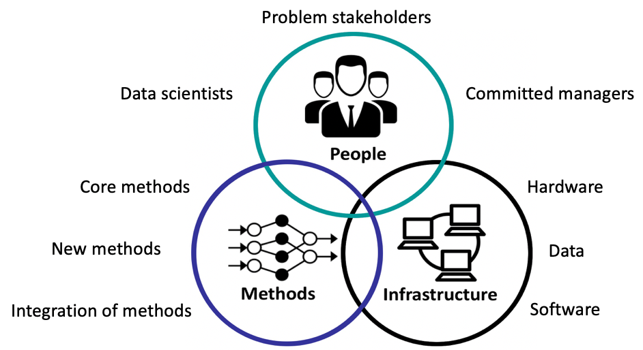
The Troika

Slide 3
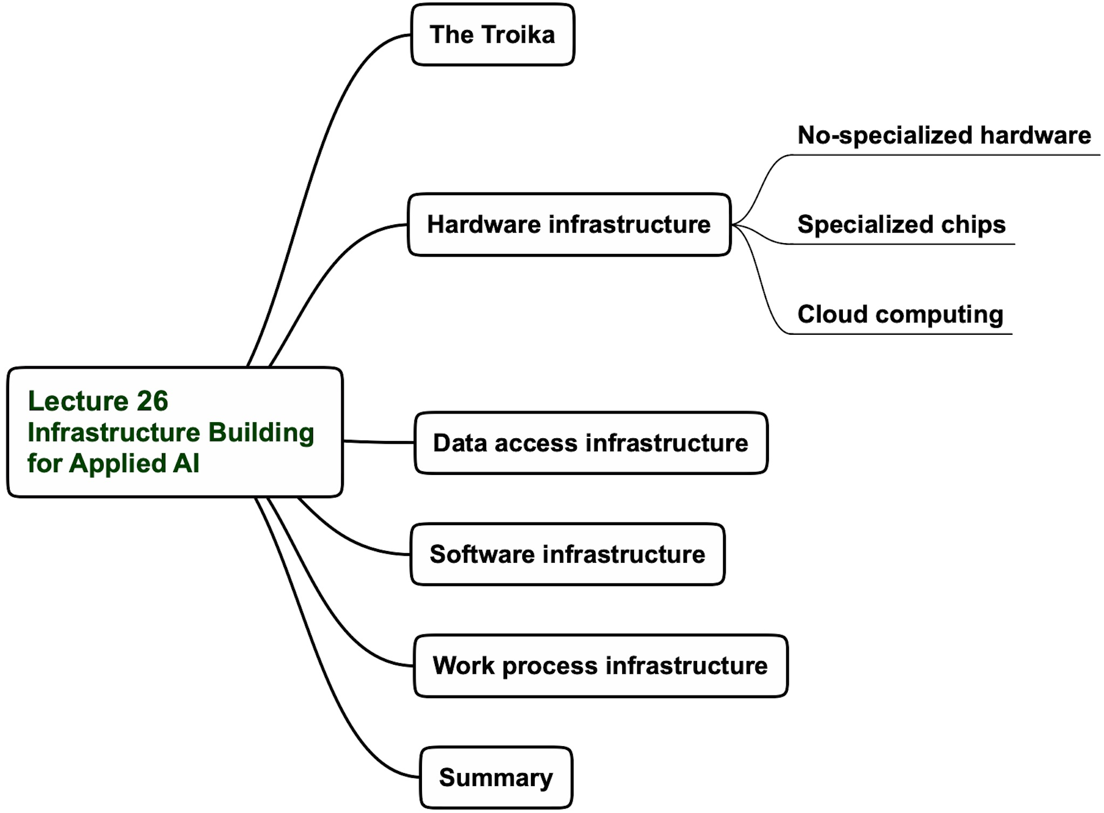
Hardware infrastructure options

Slide 4
Hardware infrastructure hierarchy

Slide 5
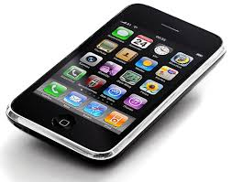
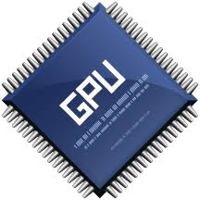
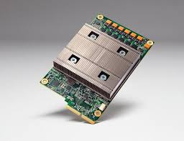
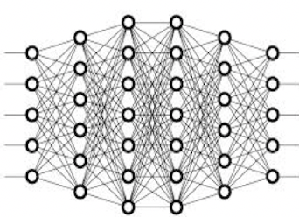
Hardware infrastructure
No-specialized hardware
TPU
Specialized chips
Cloud computing

Slide 6
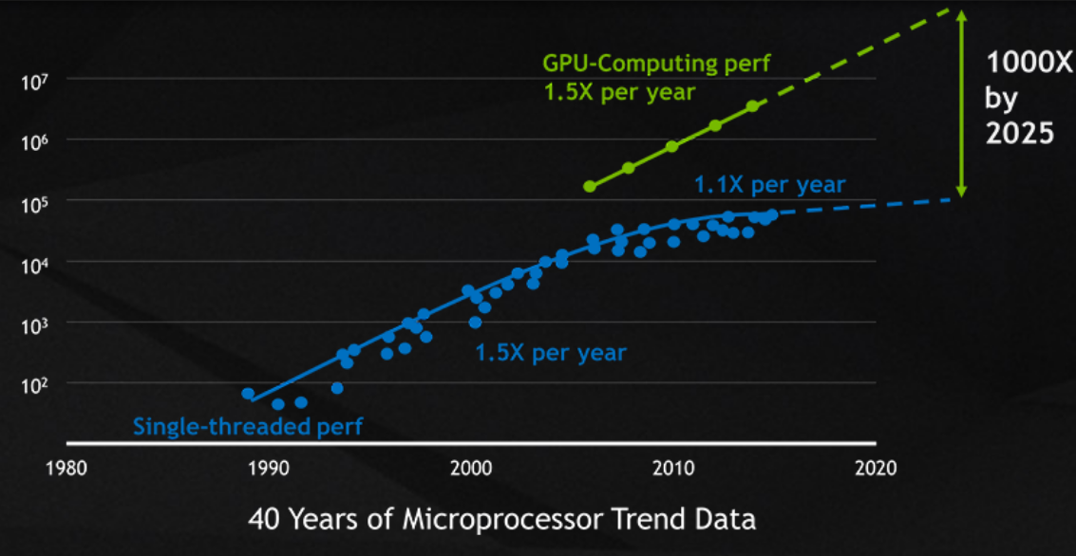
GPU Peak Performance vs. CPU
GPU’s Moore’s Law
S. Yun, GPU introduction

Slide 7
Some tricks in GPU pipeline
Pipeline implemented in hardware
Each stage does fixed task
Tasks are parameterized
Inflexible – fixed, parameterized functions
Vector-matrix operations (some parallelism).
Scene Transformations
GPU
CPU
Frame
buffer
Display
Lighting & Shading
Viewing
Transformations
Rasterization
S. Yun, GPU introduction

Slide 8
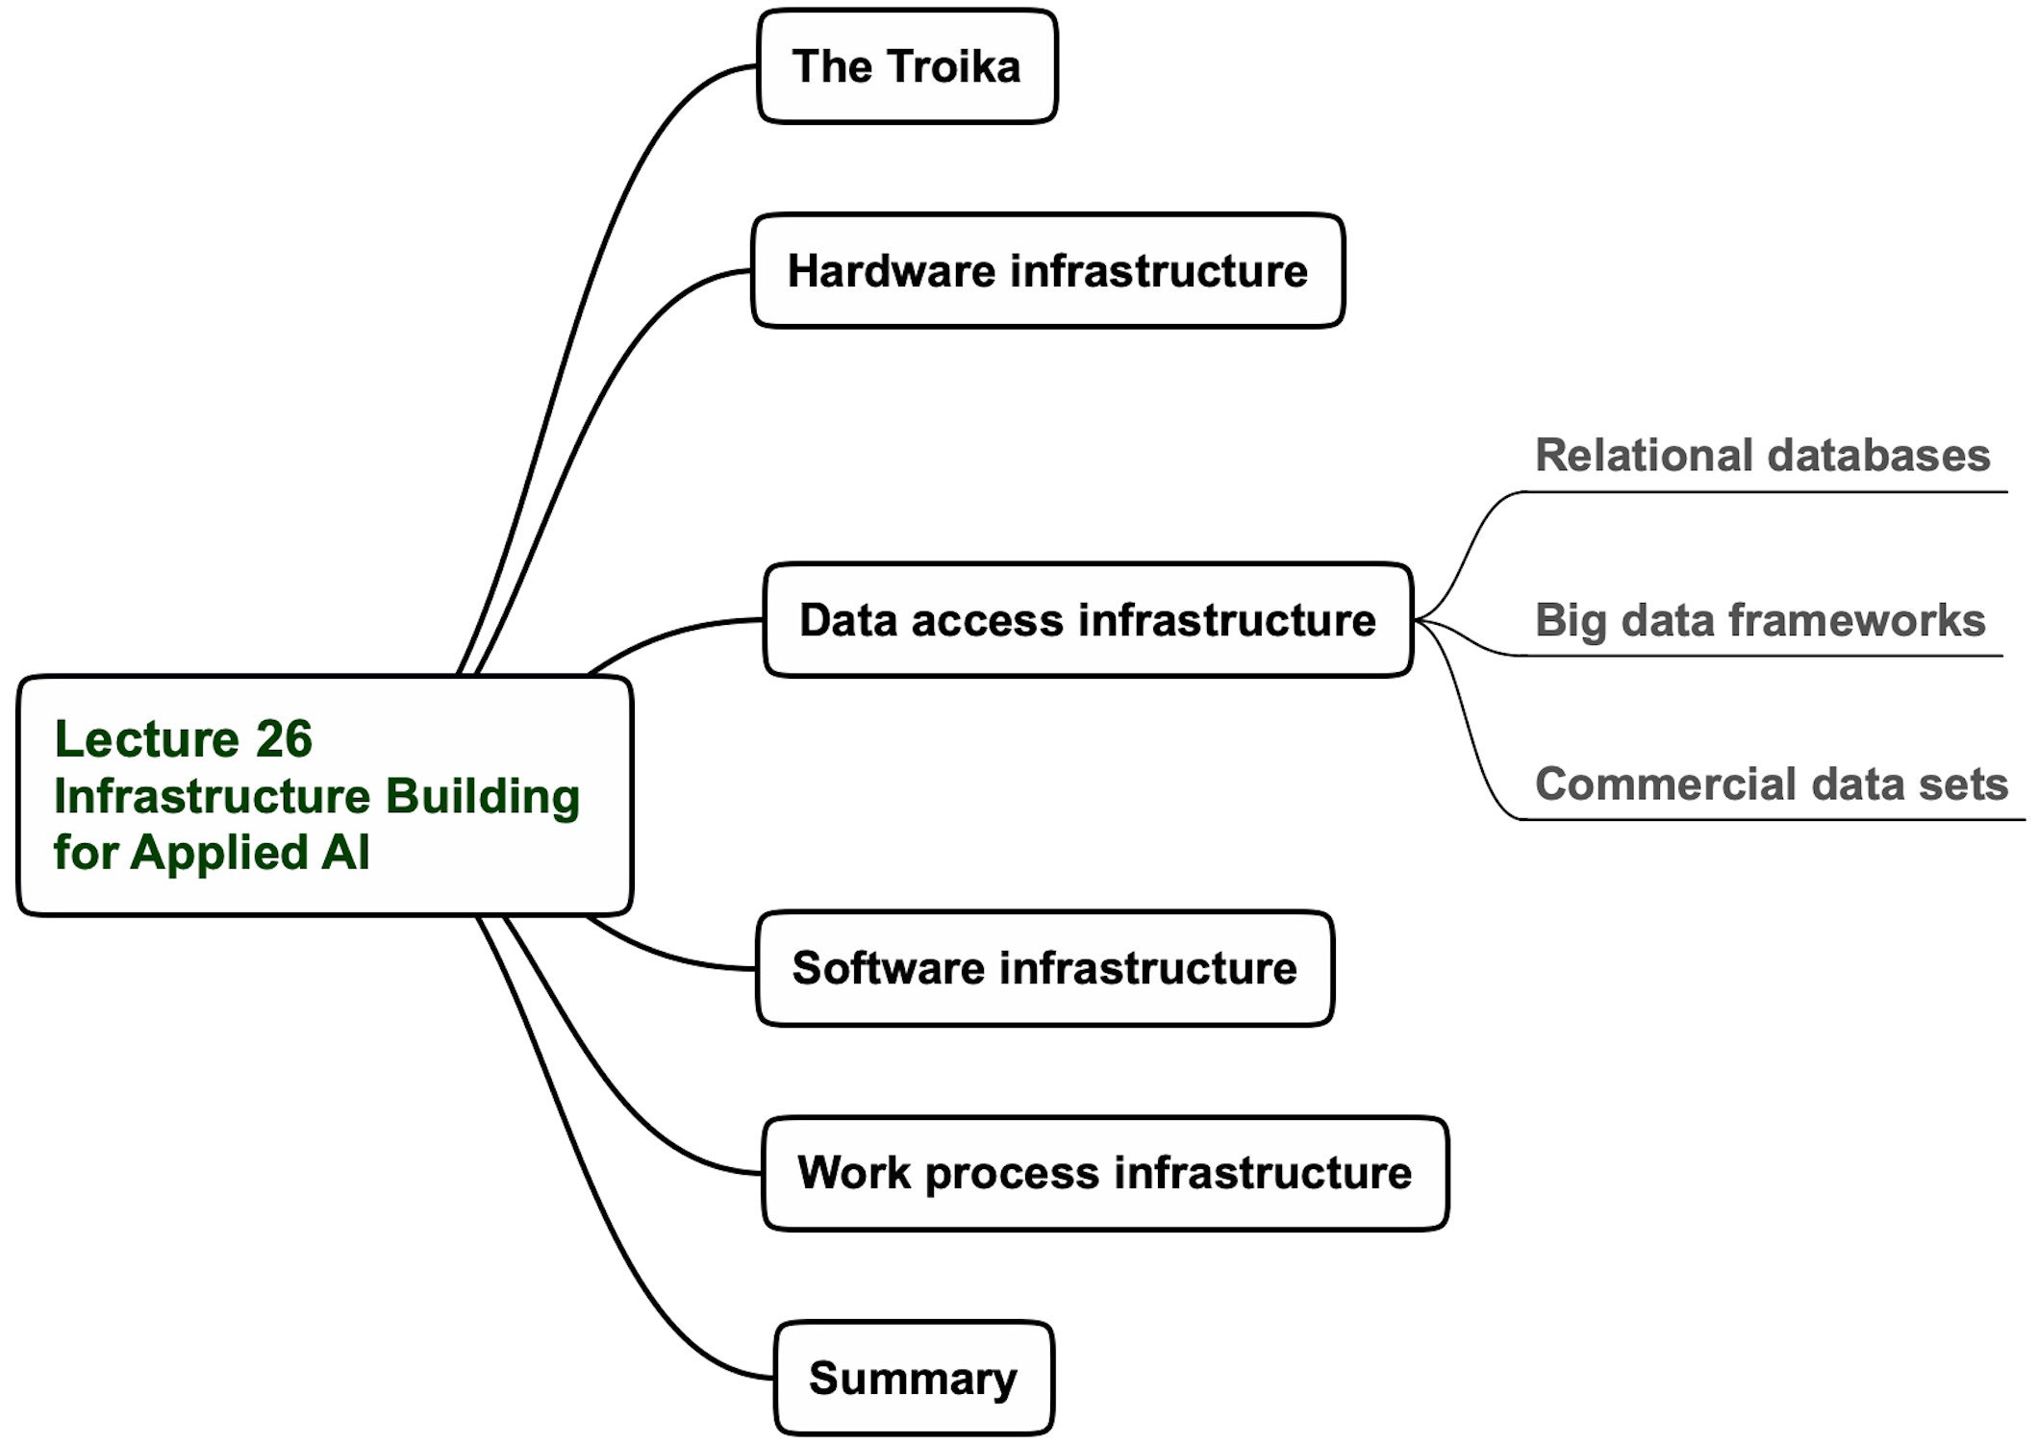
Lecture 26 agenda

Slide 9
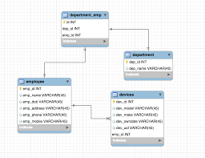
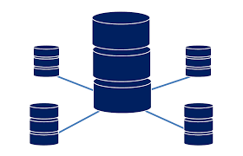
Relational Databases
A relational database is a collection of data items with pre-defined relationships between them. These items are organized as a set of tables with columns and rows. Tables are used to hold information about the objects to be represented in the database.
Relational databases are limited to numerical and categorical data

Slide 10
Big databases platforms

Slide 11
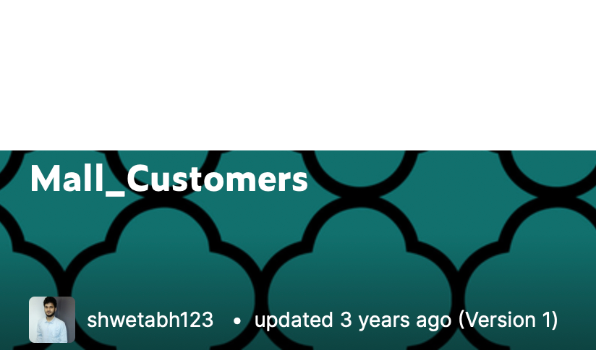
Popular and commercial data sets

Slide 12
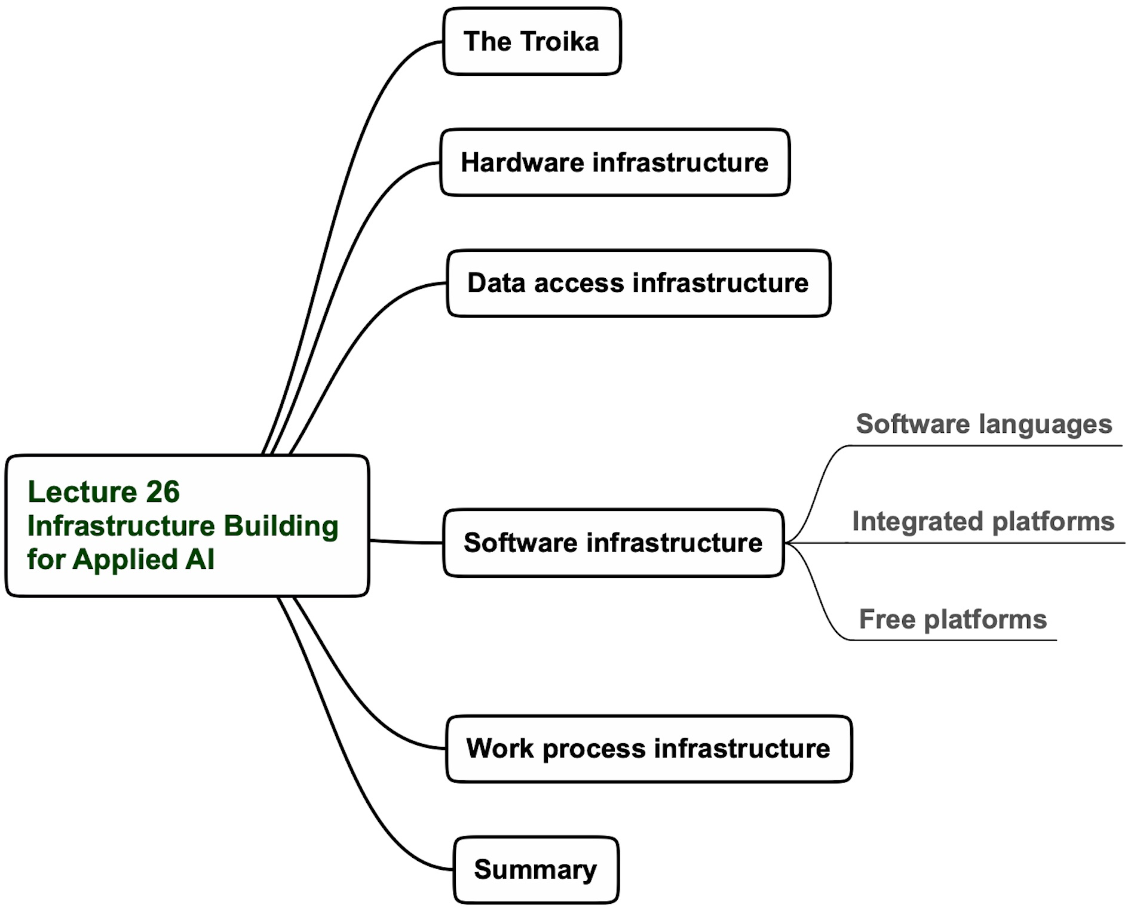
Lecture 26 agenda

Slide 13
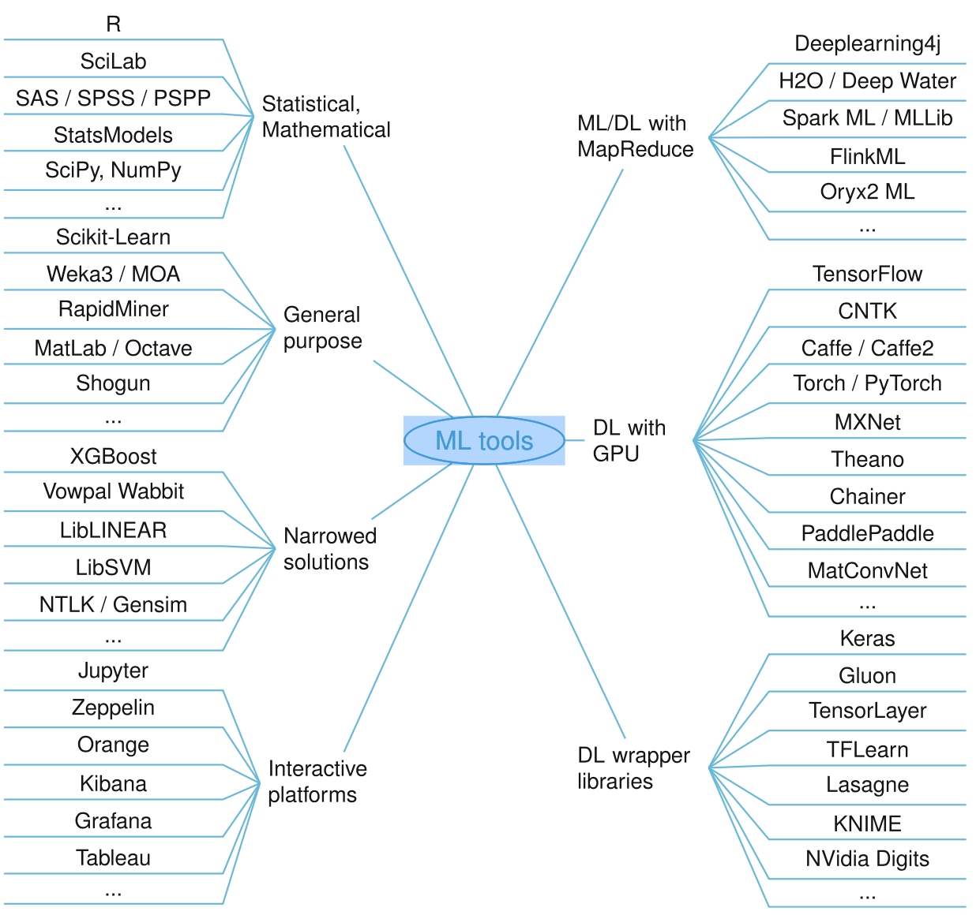
Software frameworks for machine learning
Nguyen2019_Article_MachineLearningAndDeepLearning

Slide 14
Critical software languages related to applied AI

Slide 15
Critical Python libraries related to applied AI

Slide 16
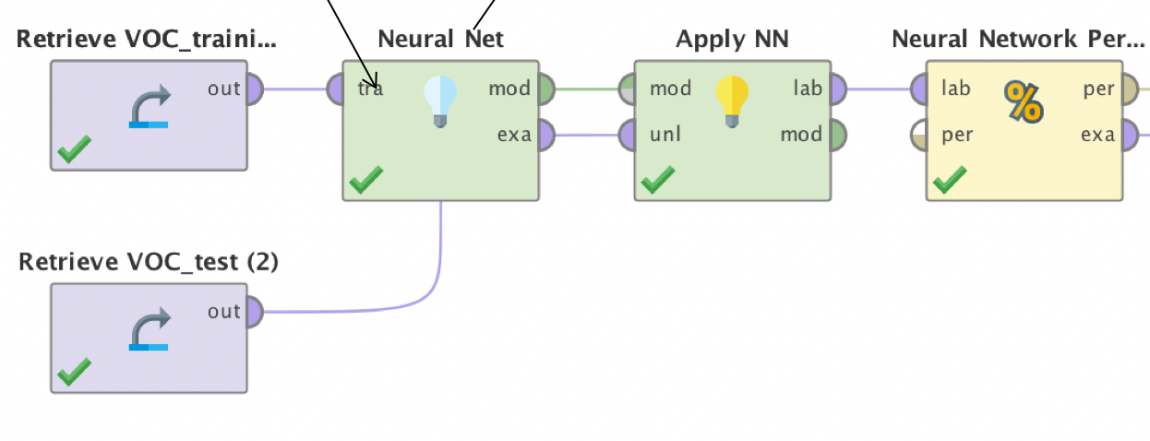
Integrated platforms vs. free packages
Drag-and-drop
Code writing/debugging

Slide 17
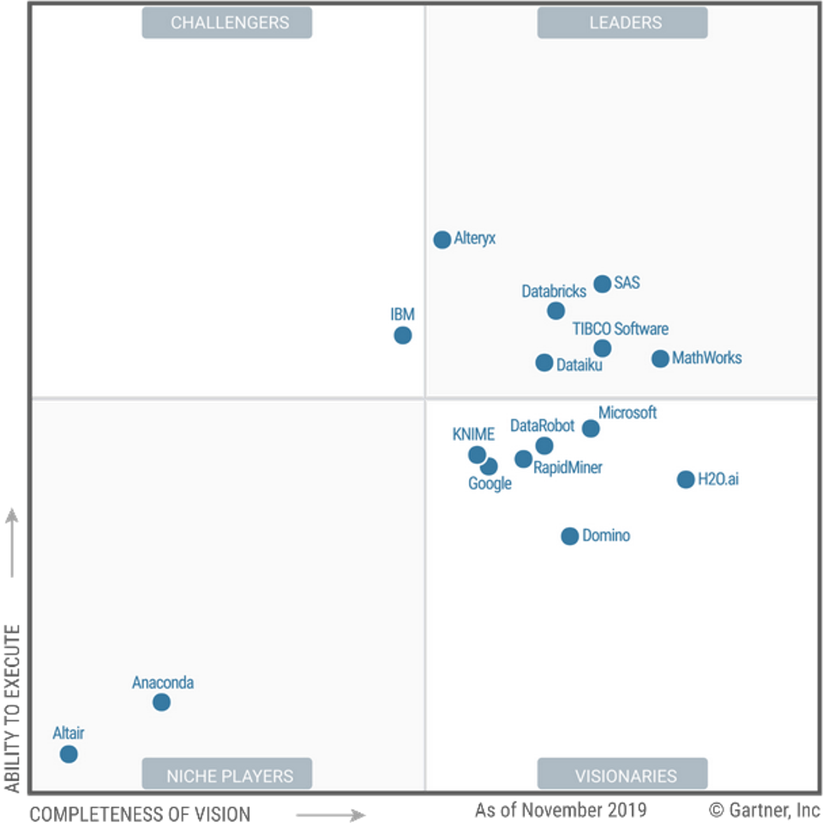
2020 Magic Quadrant For Data Science And Machine Learning Platforms

Slide 18
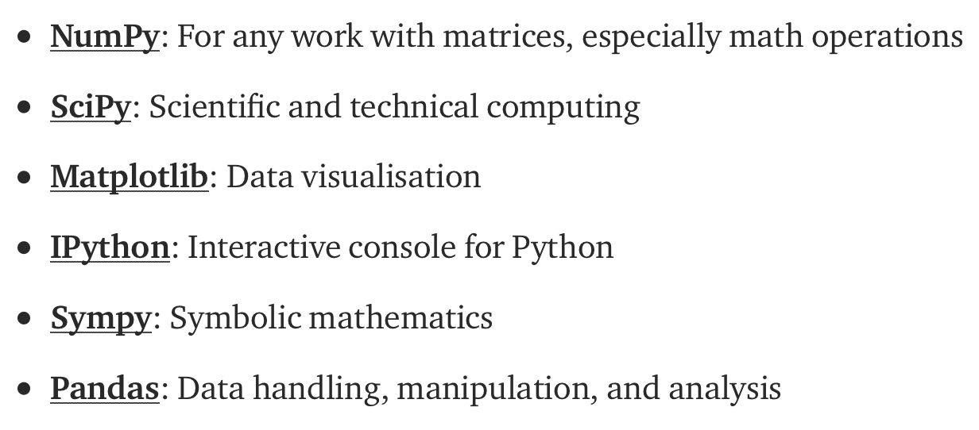
Popular free machine learning platform: Scikit Learn

Slide 19
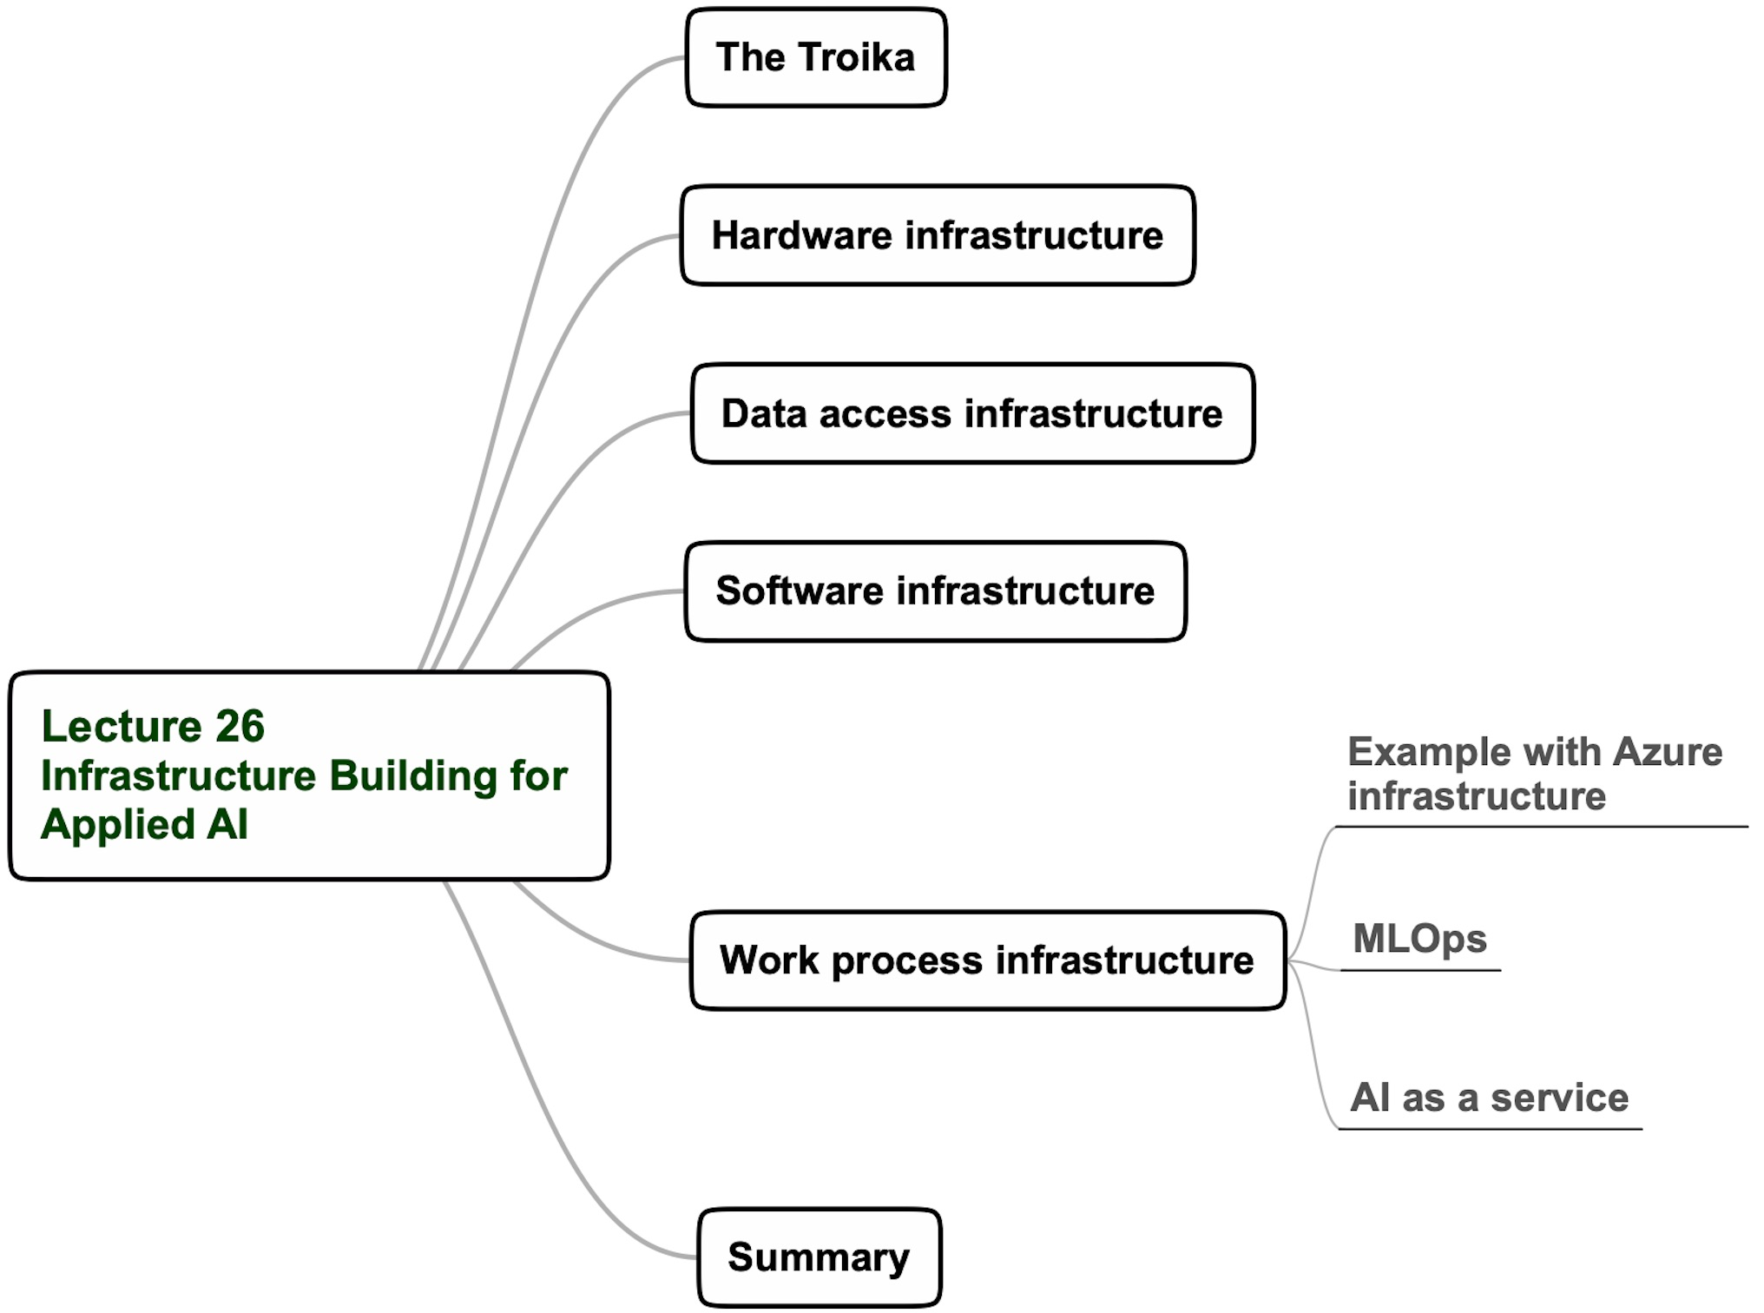
Lecture 26 agenda

Slide 20
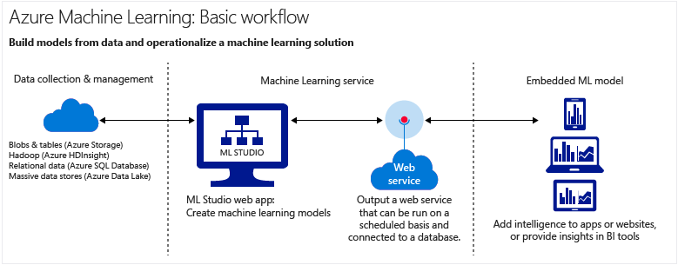
Microsoft Azure Machine Learning Studio
Collaborative, drag-and-drop tool you can use to build, test, and deploy AI-generated solutions on your data.
ML Studio publishes models as web services that can easily be consumed by custom apps or BI tools such as Excel.
A. Njeguš, Introduction to the Microsoft Azure

Slide 21
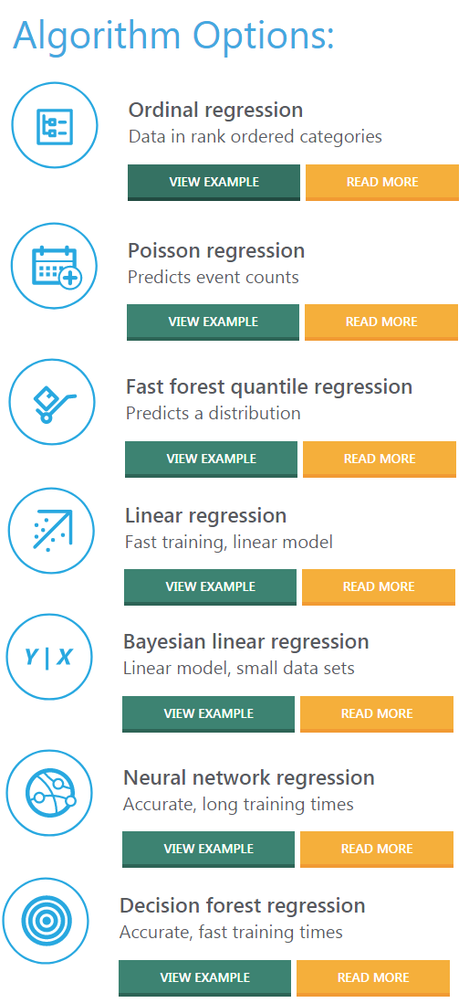
Model development steps are user-friendly in a dialog mode

Slide 22
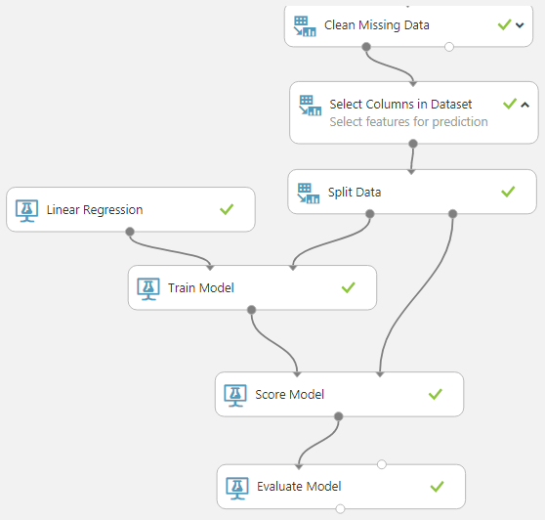
Azure model development flow example
A. Njeguš, Introduction to the Microsoft Azure

Slide 23
Azure model deployment as a web service example
To convert your training experiment to a predictive experiment, click Run at the bottom of the experiment canvas, click Set Up Web Service, then select Predictive Web Service.
To deploy your predictive experiment, click Run at the bottom of the experiment canvas. Once the experiment has finished running, click Deploy Web Service and select Deploy Web Service New.
The deployment page of the Machine Learning Web Service portal opens.

Slide 24
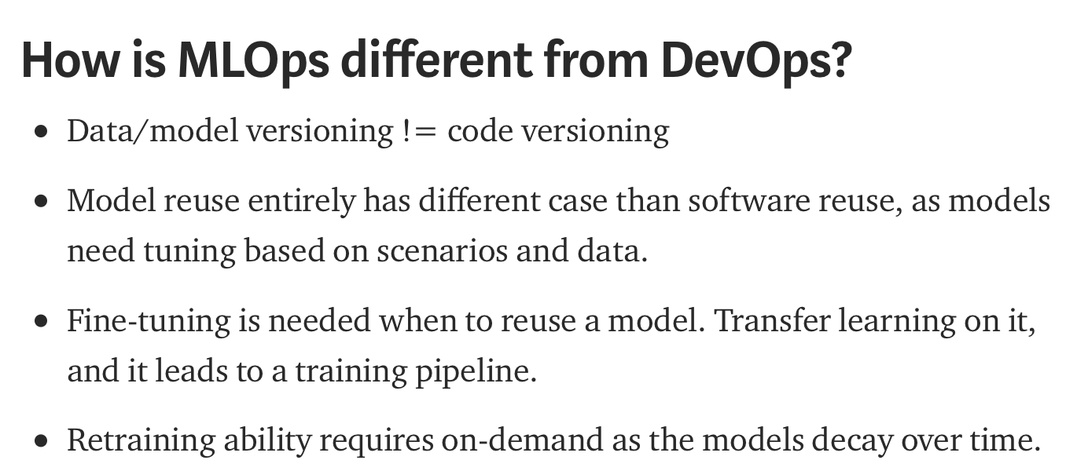
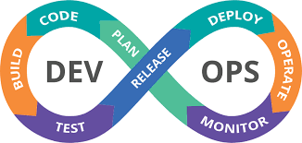
MLOps
MLOps (a compound of “Machine Learning” and “Operations”) is a practice for collaboration and communication between data scientists and operations professionals to help manage production ML (or deep learning) lifecycle.

Slide 25
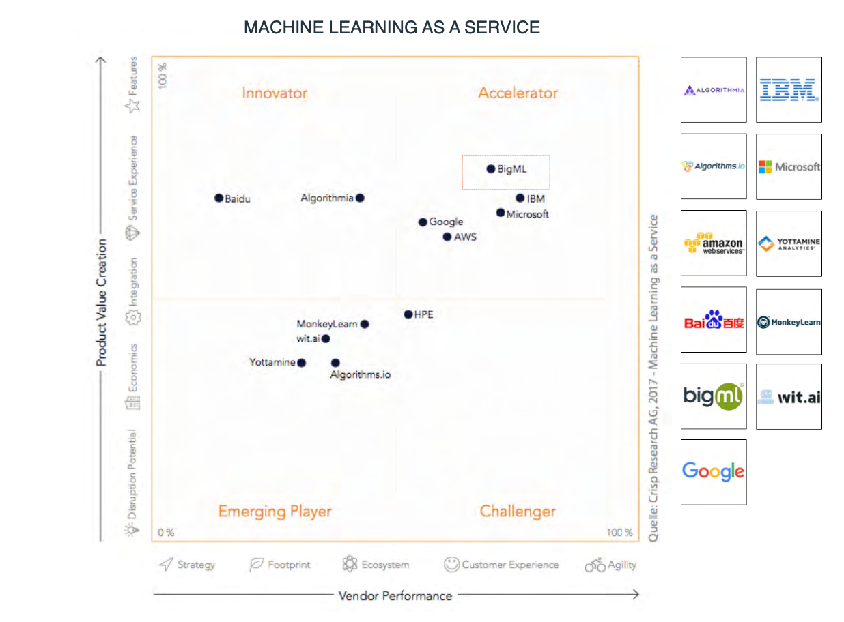
Machine learning as a service vendors map 2020

Slide 26
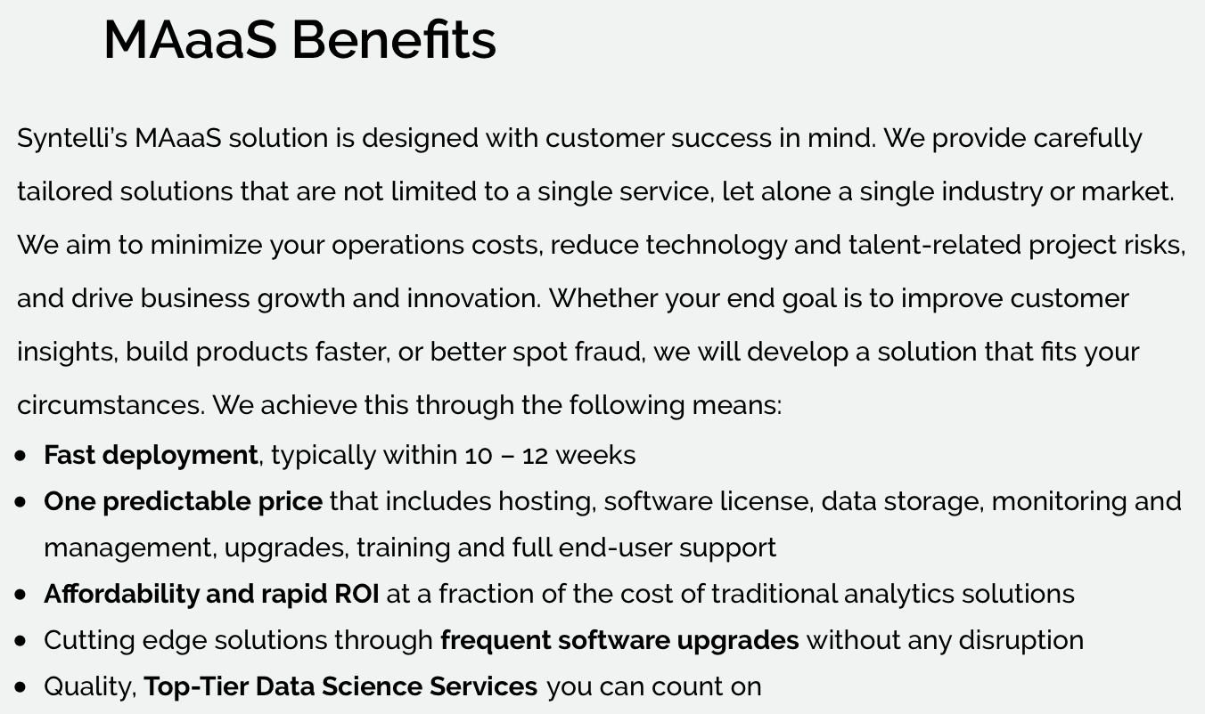
An example of a service similar to machine learning as a service

Slide 27
Lecture 26 “Infrastructure building for applied AI” Summary
Except for deep learning, no specialized hardware for other AI technologies is needed
Recently, several big database tools gradually replace relational databases
Python has become the dominant programming language to apply AI methods
An adequately integrated software platform is recommended for using AI to solve real-world problems and deliver value
A cloud-based work process, such as Azure, is recommended for AI-based systems development and deployment
A recommended alternative of infrastructure development for the small business application of AI is using the growing AI as a service capability
Google with the latest options before making decisions.
The Bottom Line
Many possibilities for developing AI infrastructure are available, including using external resources to solve your real-world problems with this technology.

Slide 28
Details on this topic are given in the following chapters of “Applying Data Science” book: Chapter 12

