Slide 1
Applied Artificial Intelligence Lecture 29 Roadmap to Introducing AI in an Organization
Arthur Kordon
Kordon Consulting LLC

Slide 2
Applied AI landscape
Olympians
AI research and infrastructure
development
Big business
Applied AI enterprise-wide solutions
Small business
Applied AI small-scale solutions
Your strategy: Find known solutions and scale-down

Slide 3
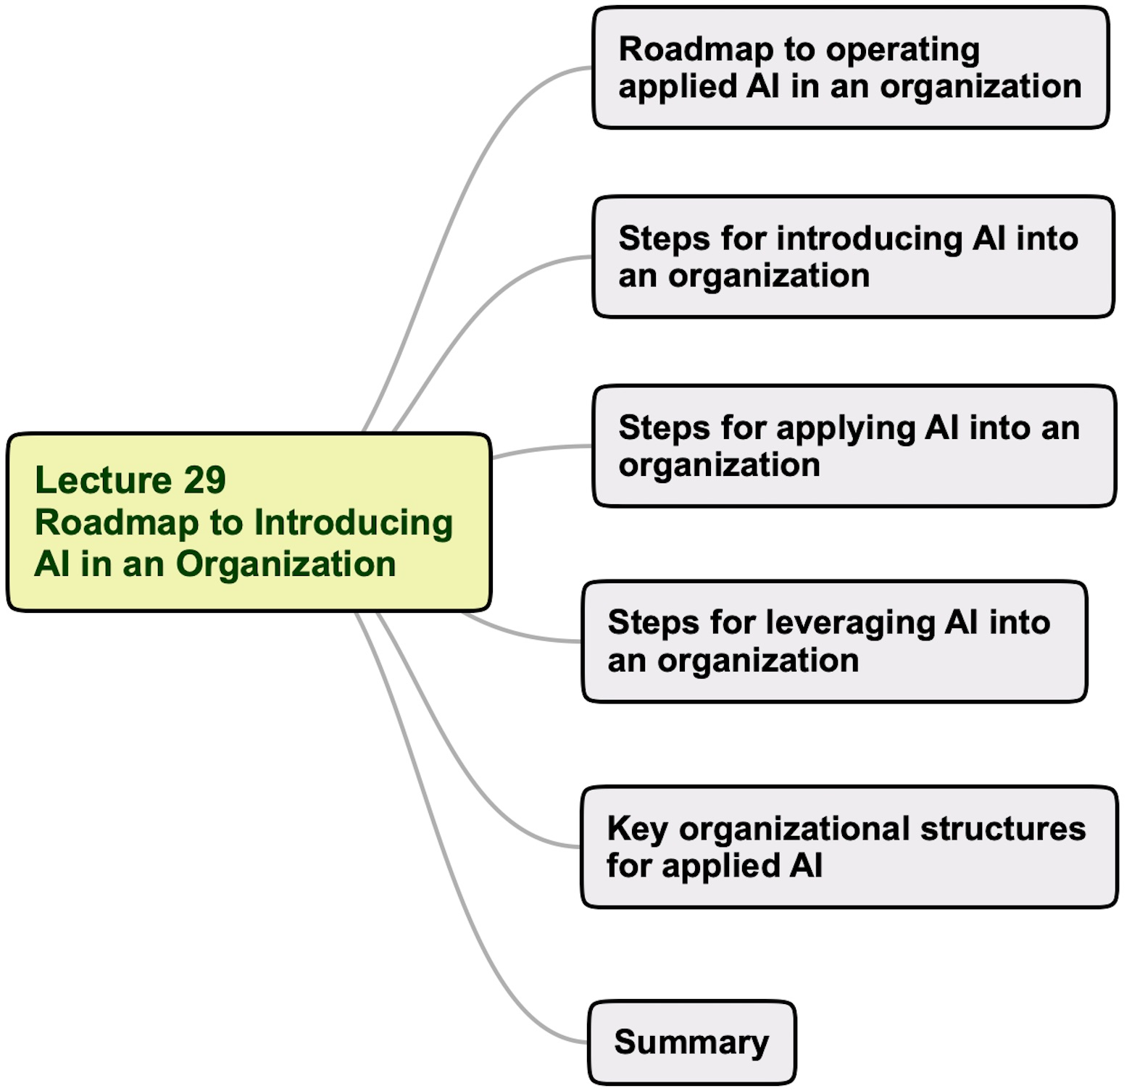
Lecture 29 agenda

Slide 4
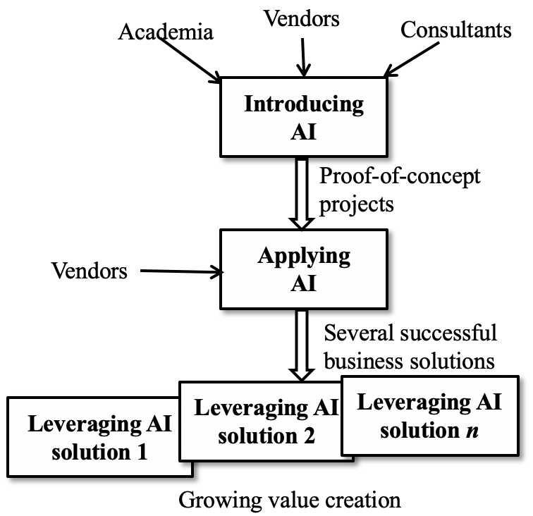
A roadmap of operating applied AI into an enterprise without deep structural changes
1997 - 2014
2012 - 2016
2015 - current
Manufacturing companies

Slide 5
Lessons learned
Technical advantages of AI have been proven in many use cases and delivered significant value but have not translated into a business competitive advantage breakthrough
In most applied use cases, the actionable decisions have been made by humans, not by algorithms
AI has NOT changed existing enterprise work processes and culture
Long-term CONSISTENT leadership support is critical for the success of AI adoption
Documenting value creation from AI-based use cases is one of the key bottlenecks
Operating AI by cost-reduction mentality has reduced the potential impact of the technology
AI has NOT become the engine of the enterprise

Slide 6
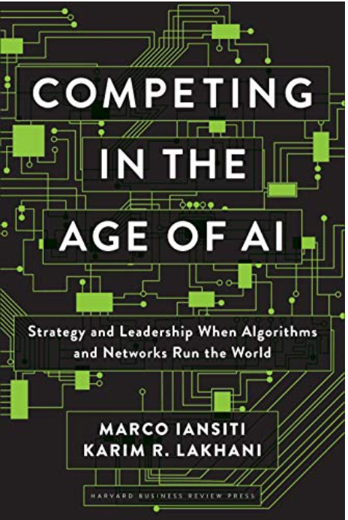
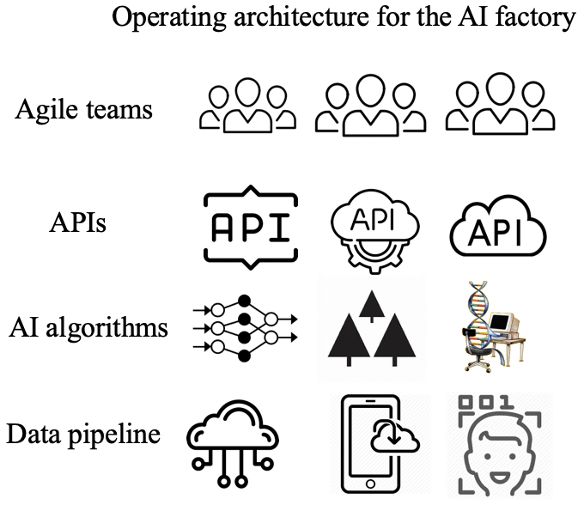
Introducing AI with deep structural changes: The AI factory
In the AI factory managerial decisions are increasingly embedded in software which digitizes many processes that have traditionally
been carried out by employees.
AI-based decisions

Slide 7
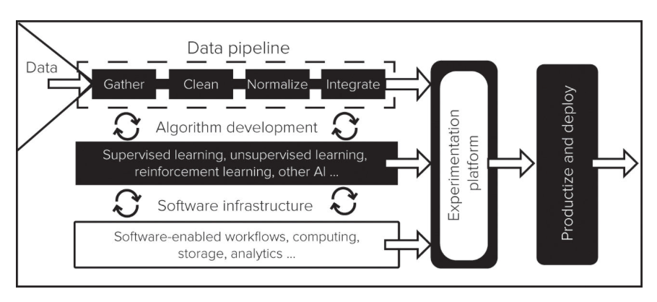
AI factory components

Slide 8
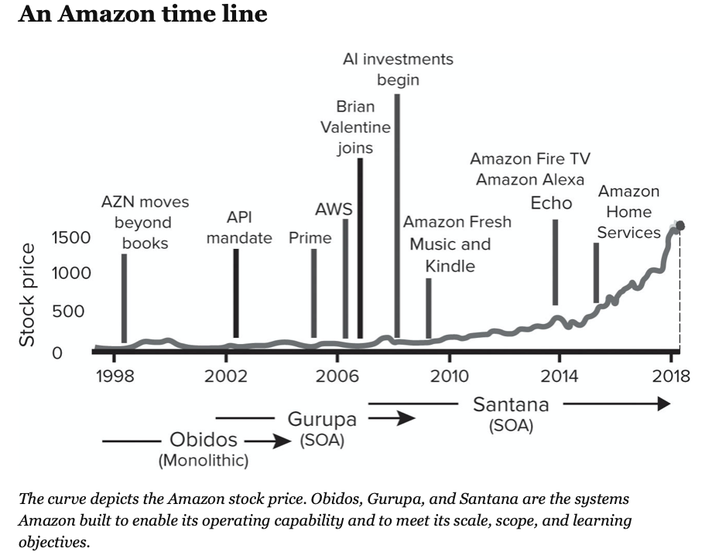
Amazon is the leader of the AI factory
Companies using the AI factory
Microsoft
Fidelity
Uber
Netflix
Vodafone
Airbnb
M. Iansiti and K. Lakhani, Competing in the Age of AI

Slide 9
Lecture 29 agenda

Slide 10
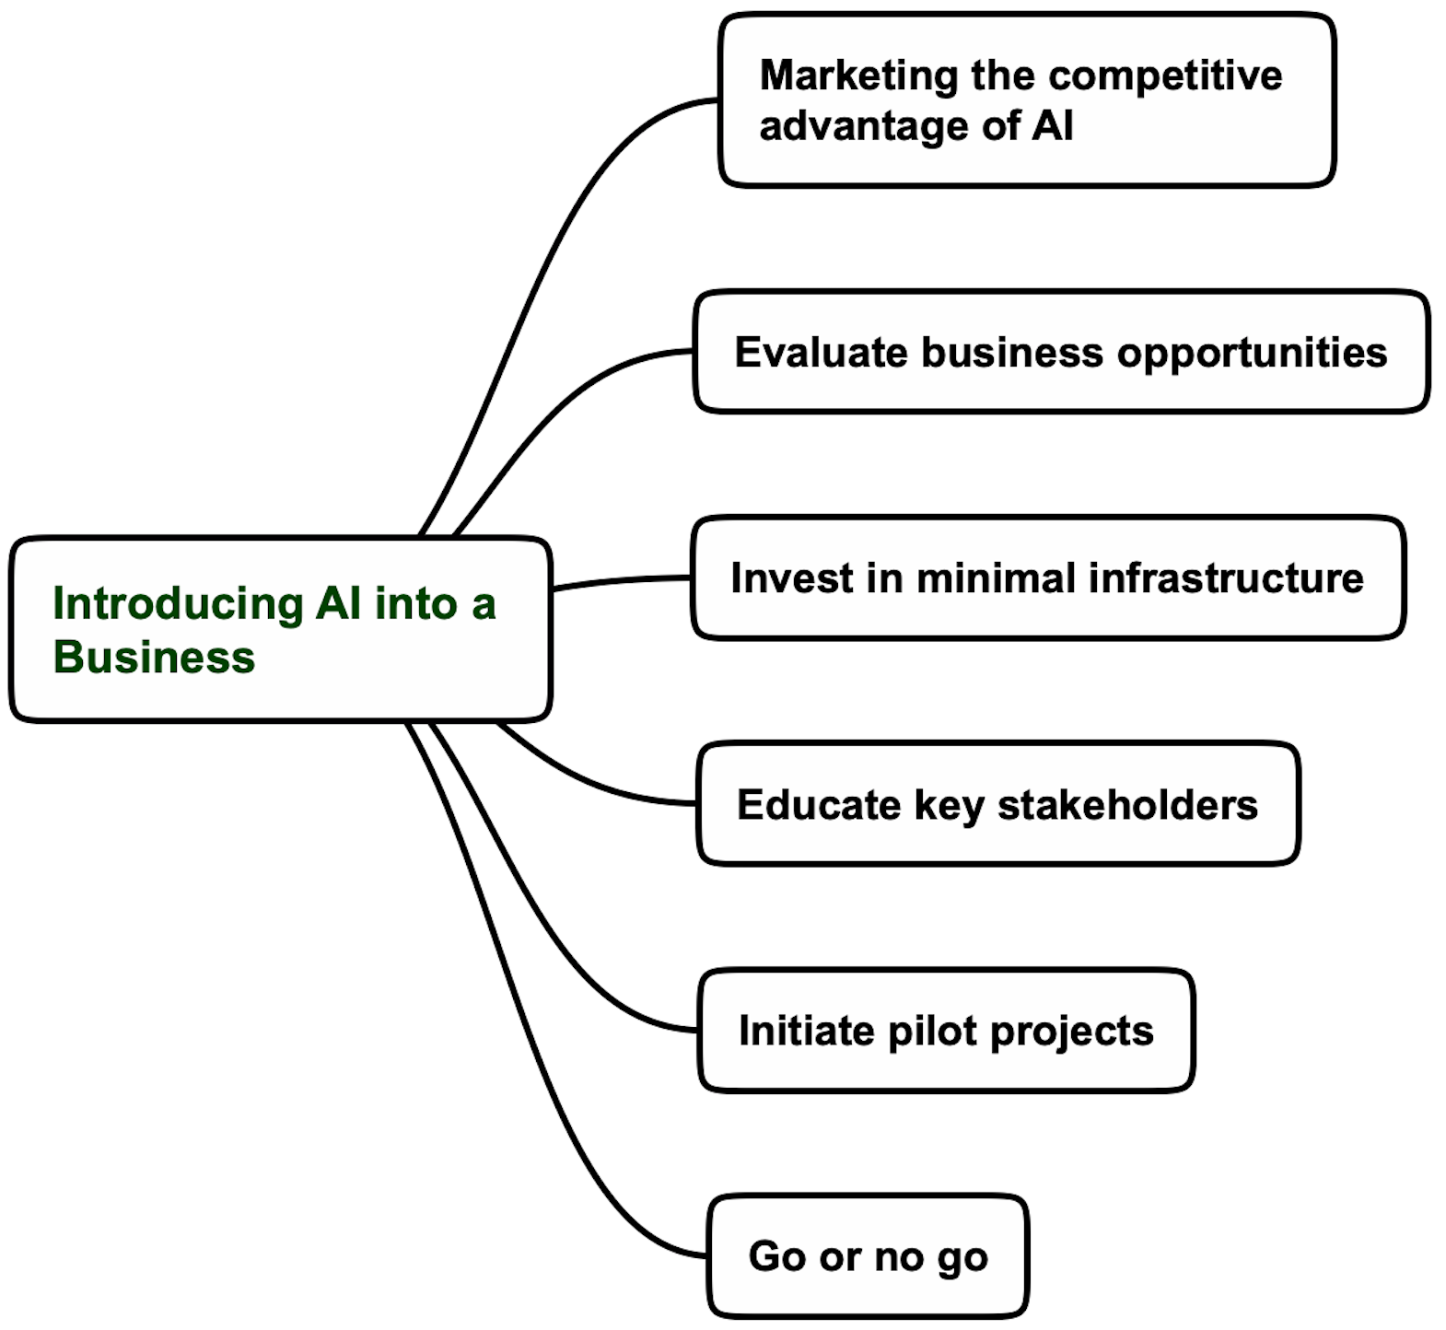
Key steps of introducing AI into a business

Slide 11
Lecture 29 agenda

Slide 12
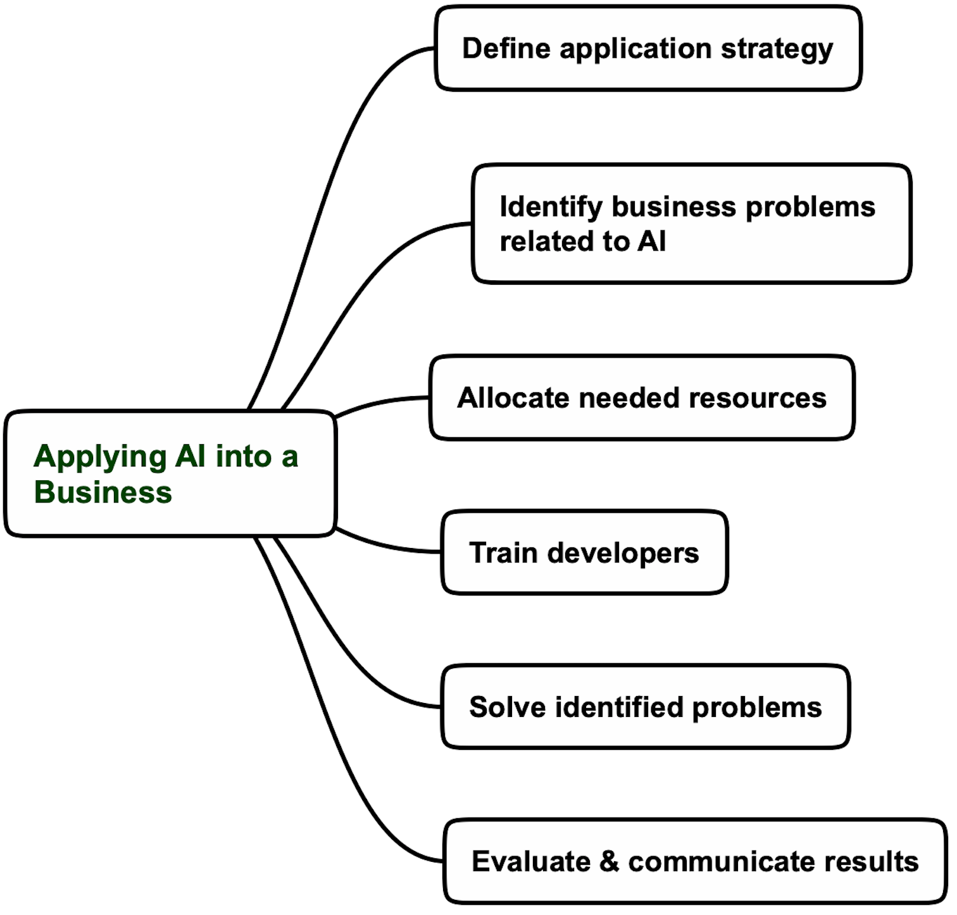
Key steps of applying AI into a business

Slide 13
Lecture 29 agenda

Slide 14
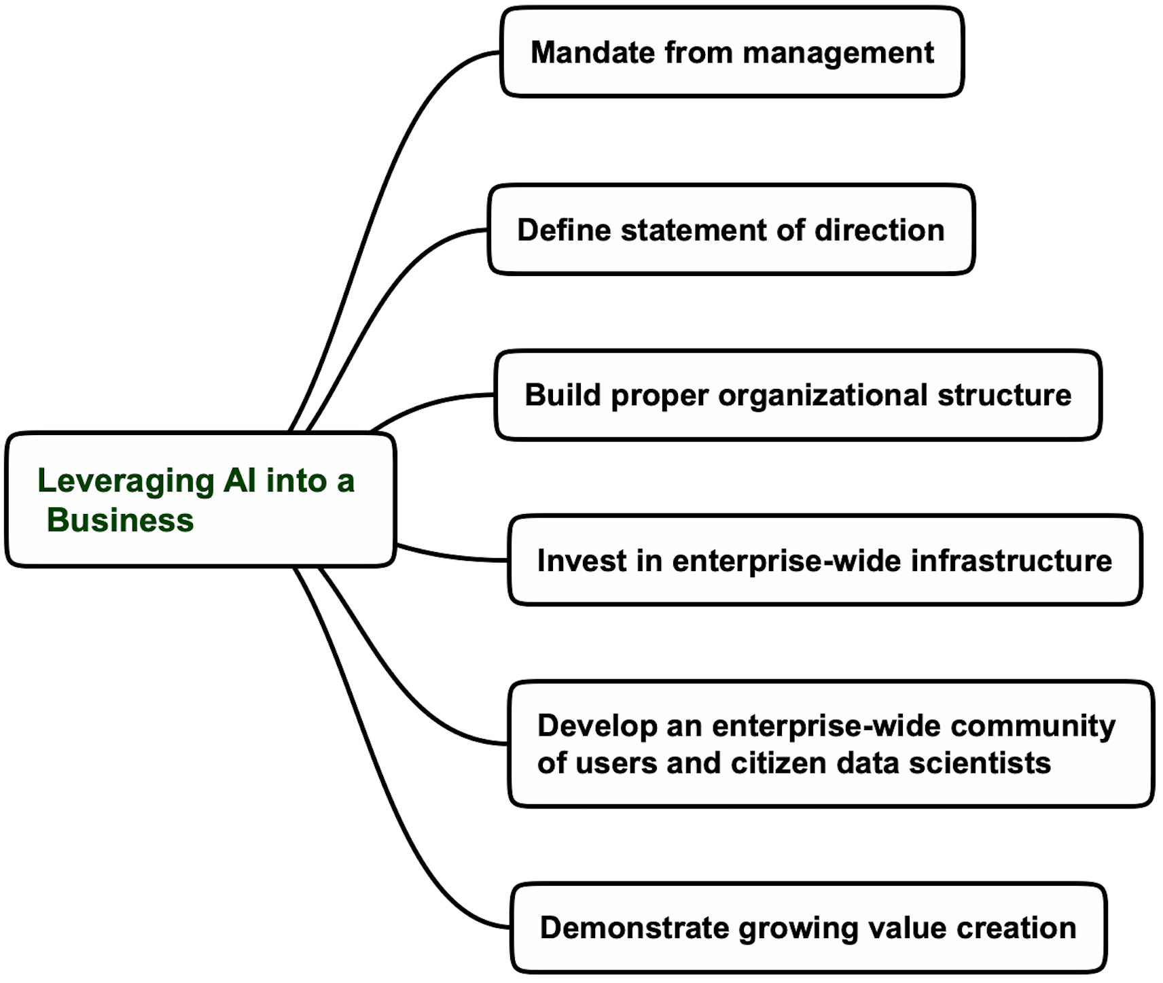
Key steps of leveraging AI into a business

Slide 15
Lecture 29 agenda

Slide 16
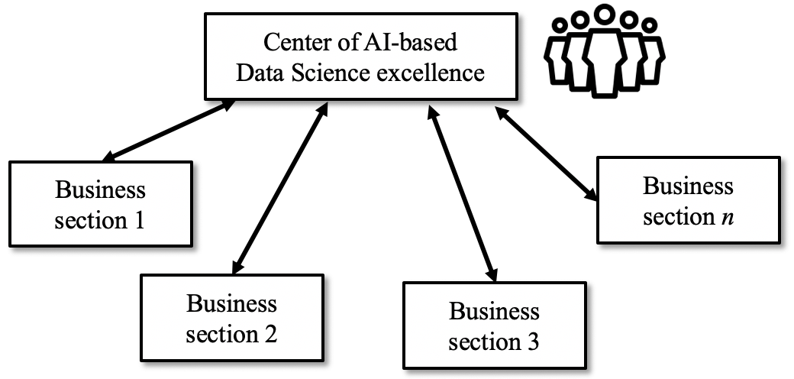
Centralized applied AI group
High efficiency
High cost

Slide 17
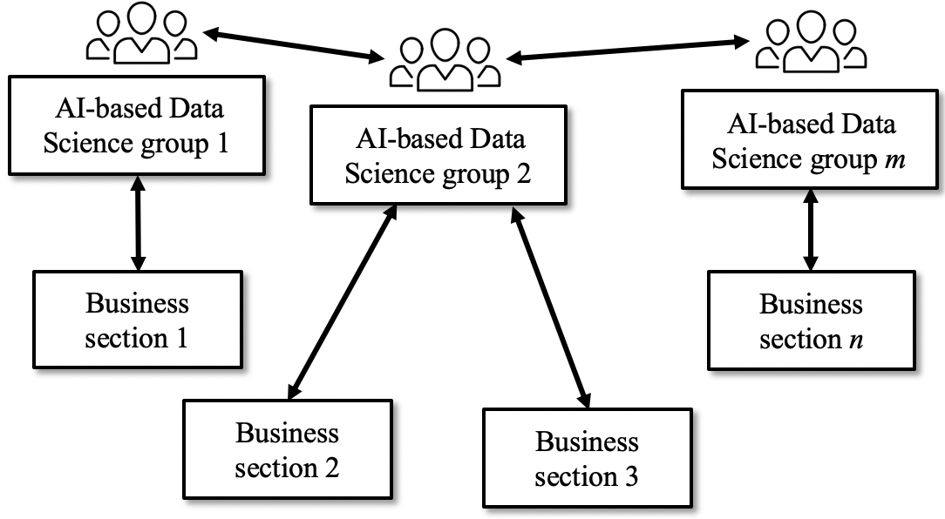
Decentralized applied AI groups
Cost effective
Reduced capacity

Slide 18
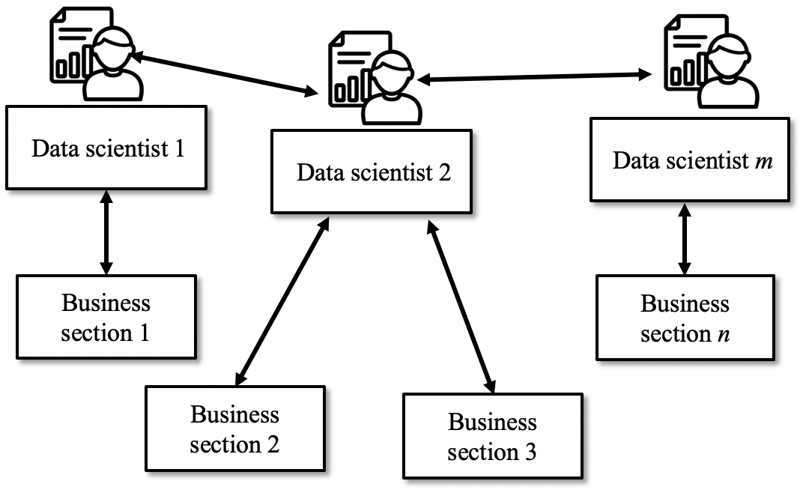
A network of individual data scientists
Affordable solution for small organizations
Low efficiency

Slide 19
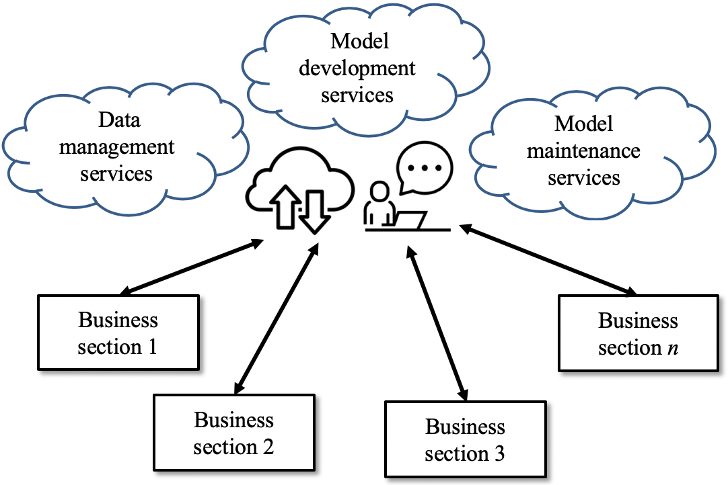
Using AI as a service (AIAAS)
Recommended solution for small organizations
High communication risk

Slide 20
Lecture 29 “Roadmap to introducing AI in an organization” Summary
The recommended strategy for introducing applied AI in an organization is to
find a similar, publicly available approach from the big businesses and scale it down appropriately
The roadmap of introducing applied AI in an organization includes three fundamental steps: introducing, applying, and leveraging AI
Introducing AI requires evaluating business opportunities, investing in minimal infrastructure, and initiating pilot projects
Applying AI step includes defining an application strategy, demonstrating value creation opportunities, and training developers.
Leveraging AI into an organization requires building a proper organizational structure, investing in enterprise-wide infrastructure, and showing growing value creation.
The Bottom Line
Introducing applied AI in an organization is a long process of well-planned and executed steps

Slide 21
Details on this topic are given in the following chapters of “Applying Data Science” book: Chapter 16, Section 16.2 – 16.3

