Slide 1
Applied Artificial Intelligence Lecture 22 Data Preparation
Arthur Kordon
Kordon Consulting LLC

Slide 2
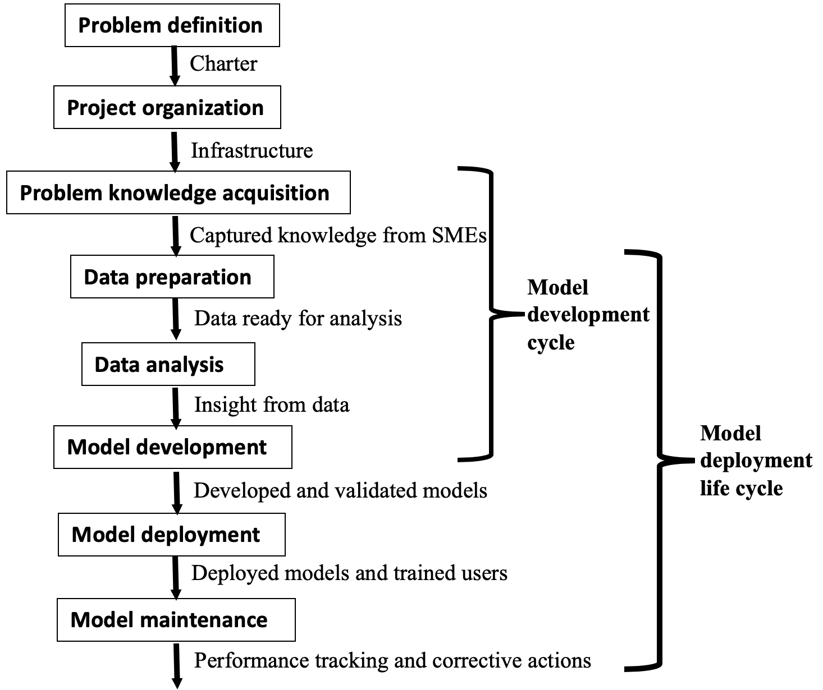
Methodology workflow

Slide 3
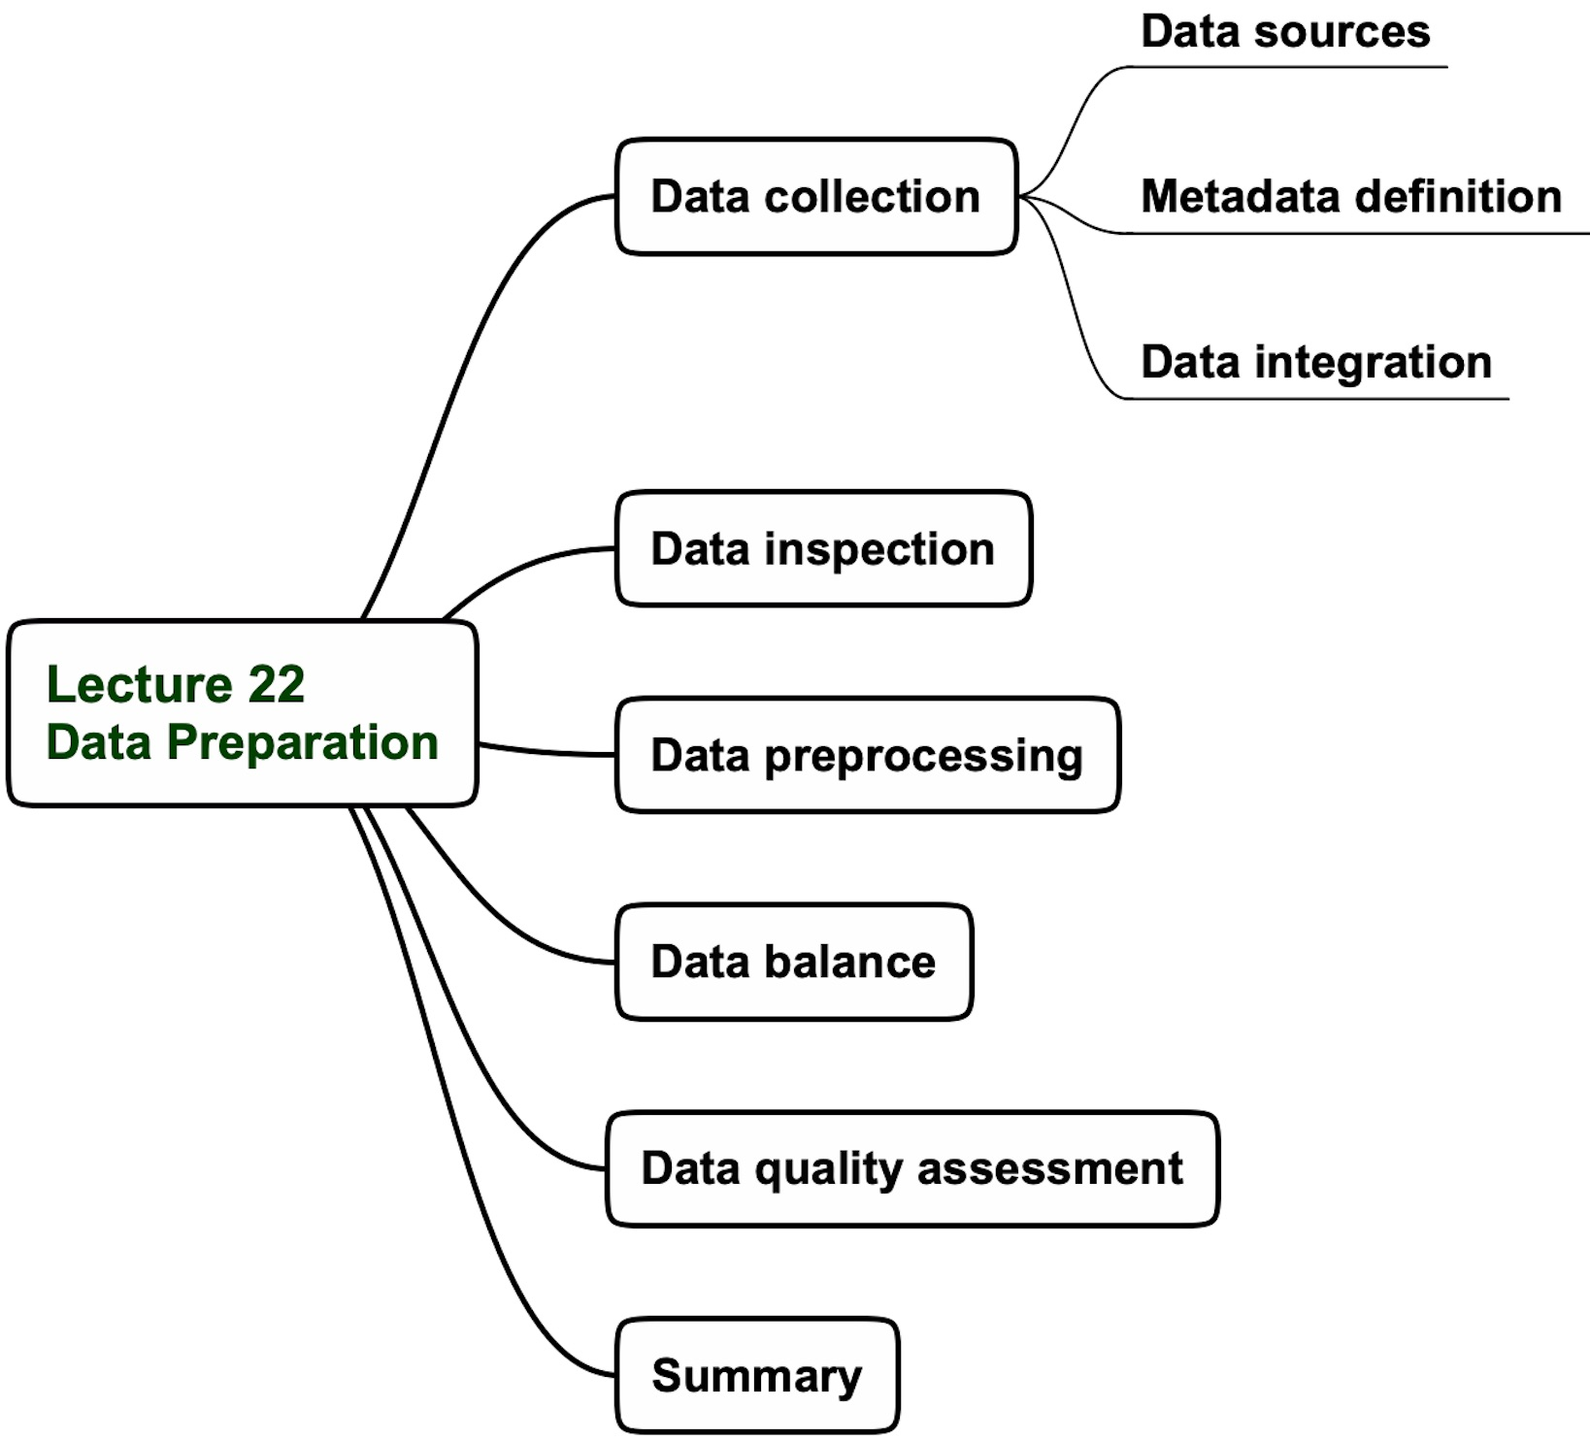
Lecture 22 agenda

Slide 4
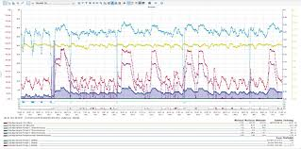
Importance of Data Preparation
Solves the dilemma: Models OR GIGO
GIGO 1.0 – Garbage-In-Garbage-Out
GIGO 2.0 – Garbage-In-Gold-Out
Key productivity factor
If inappropriate – can significantly reduce modeling efficiency
May take 70-80% of project time/cost
Murphy’s Laws Kingdom
Murphy’s law effects on data
If you need it, it’s not recommended
If it’s recommended, it’s not collected
If it’s collected, it’s missing
If it’s available, it’s junk
Notes:
FACILITATOR NOTES
PARTICIPANT NOTES
In this phase you will:
Develop a validated, refined problem statement capturing stakeholders strategy
Identify sources of data
Build context for data
Develop systems process flow and structure
At the end of this phase you will:
Understand and document the customer requirements
Know where to find the raw dataset or data requirements
Establish the data context
Document the system process flow
Develop and validate a specific problem statement of why you are mining the data

Slide 5
Data preparation key questions
Do we have the data to solve the problem?
Number of variables
Number of data points
Can we accept the available data?
Are the data visually acceptable?
Are the data statistically acceptable?
How can we improve the information content in the data?
Handle missing data
Remove outliers
Reduce dimensionality
Are we ready for modeling?
Are the data prepared according to the specific modeling technique requirements?

Slide 6
Popular data sources

Slide 7
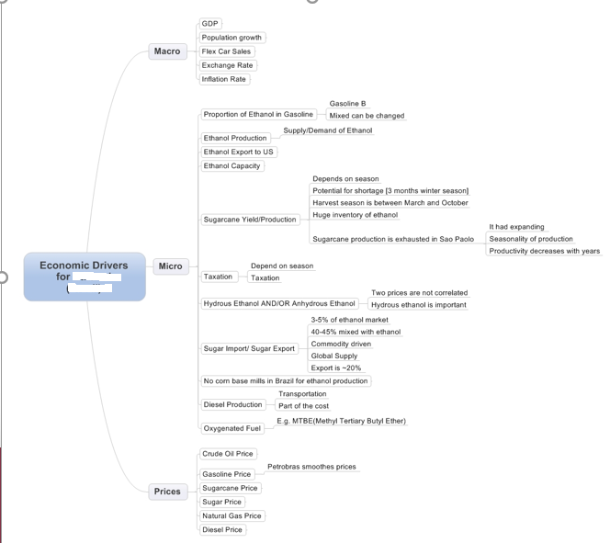
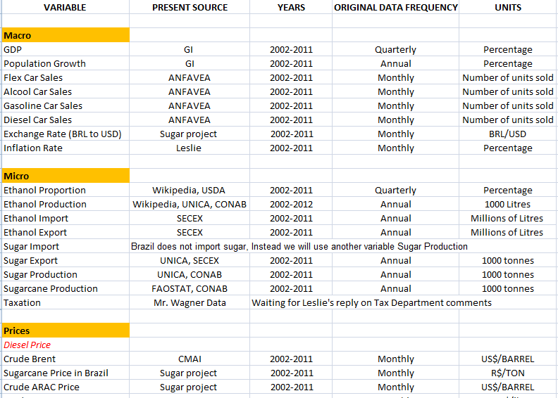
Data collection: find data sources after knowledge acquisition
Reality correction
Match mind-map with real data sources

Slide 8
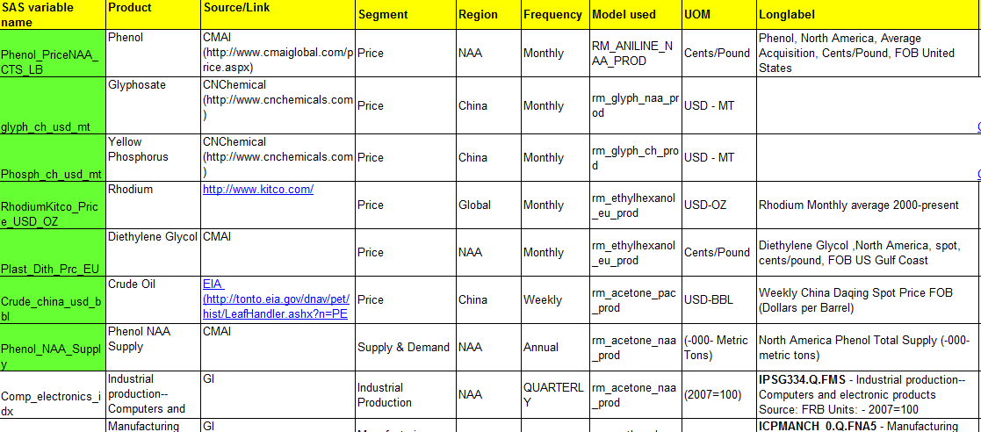
Data collection: define Meta Data
A Meta Data definition example

Slide 9
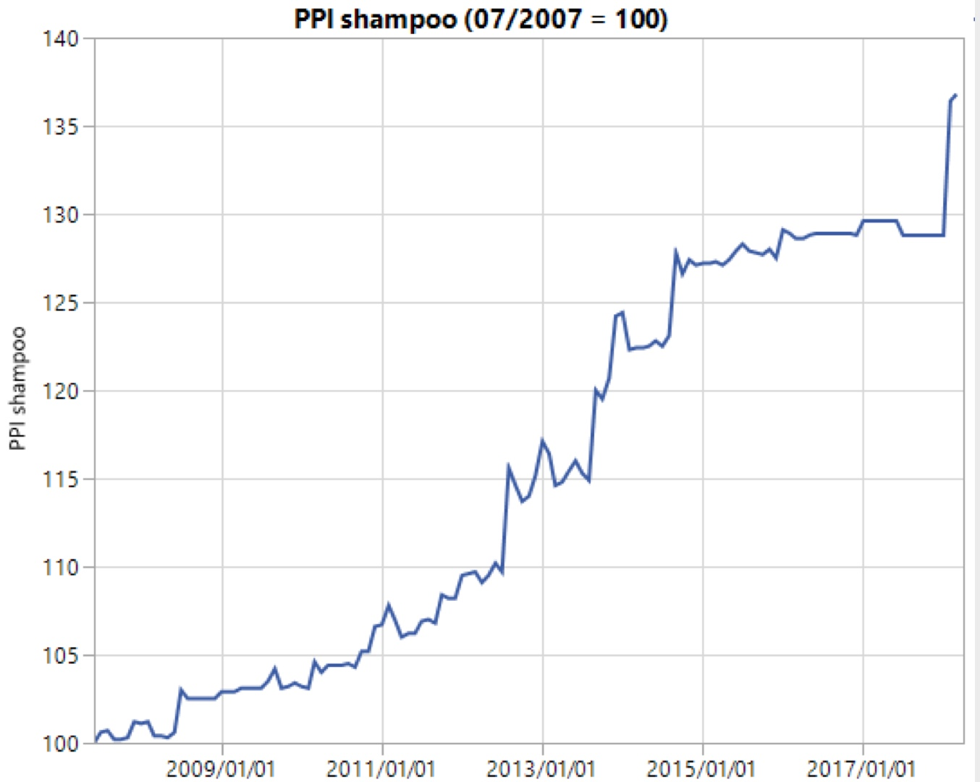
Integrating economic data with a business structure
North American Industry Classification System (NAICS)
Example with shampoo production index
It helps to use the corresponding index as a
proxy to real production data

Slide 10
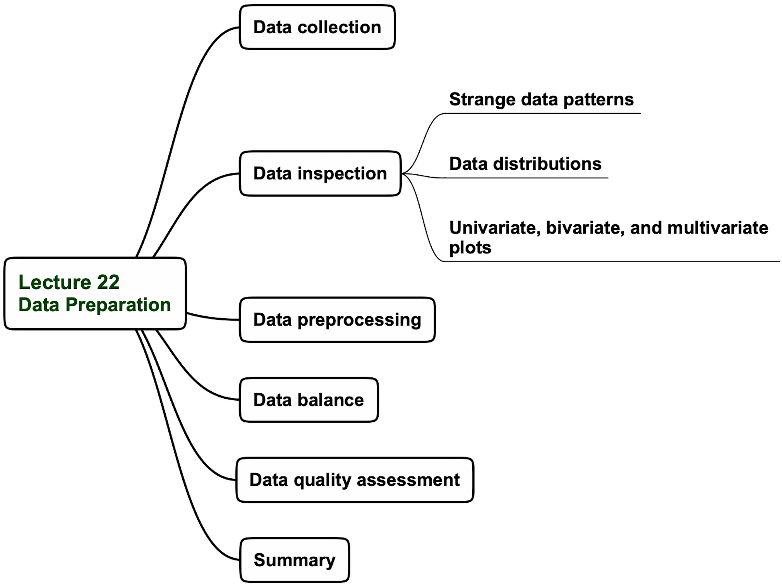
Lecture 22 agenda

Slide 11
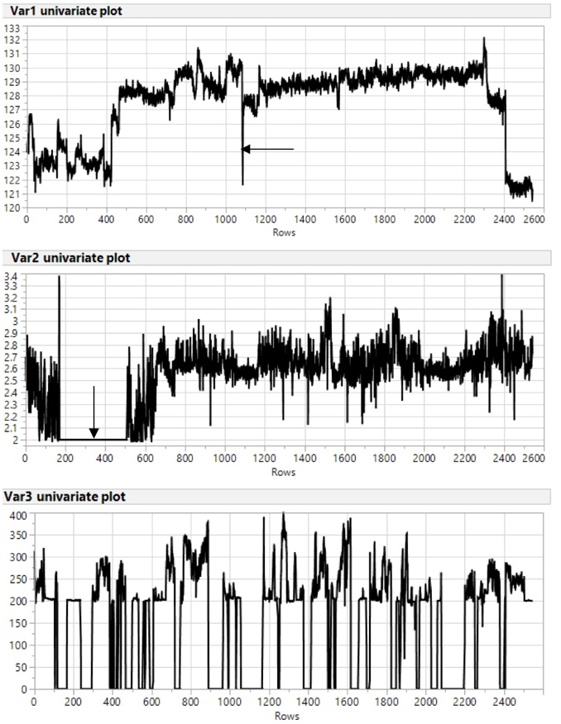
Strange data patterns
Significant deviation from the current trend
Long periods of constant values
Frequently changing periods with zero values

Slide 12
Statistical distributions and histograms
Statistical distributions is an arrangement of values of a variable showing their observed or theoretical frequency of occurrence.
Histogram is a graph showing frequency distribution
in which rectangles based on the horizontal axis are assigned widths that correspond
to class intervals and heights that
correspond to frequency.
Normal distribution, also known as the Gaussian distribution, is a probability distribution that is symmetric about the mean, showing that data near the mean are more frequent in occurrence than data far from the mean. In graph form, normal distribution will appear as a bell curve.

Slide 13
Some Common Probability Distributions
The Weibull distribution is widely used in reliability and life data analysis.
The F distribution is typically used to develop hypothesis tests and confidence intervals.
The Poisson distribution is used to model the number of events occurring within a given time interval.
The Beta distribution can be used to represent proportion or probability outcomes. For example, to find how likely it is that your preferred candidate for mayor will receive 70% of the vote.
Statistical distributions are an essential feature of data

Slide 14
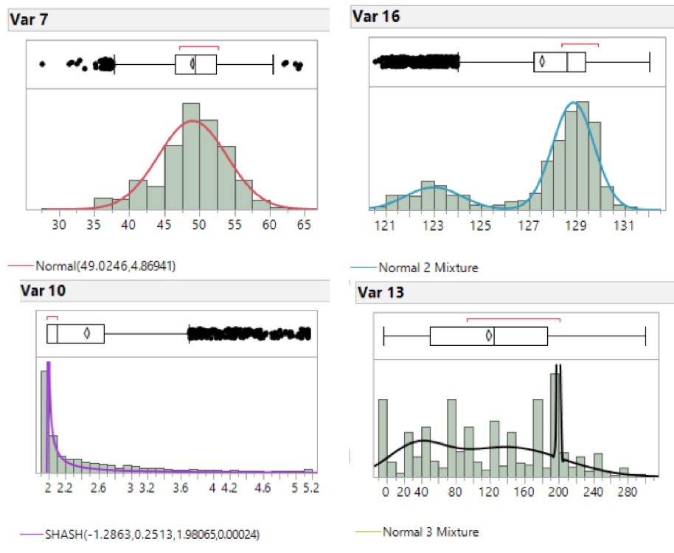
Inspecting data by fitting histograms to distributions

Slide 15
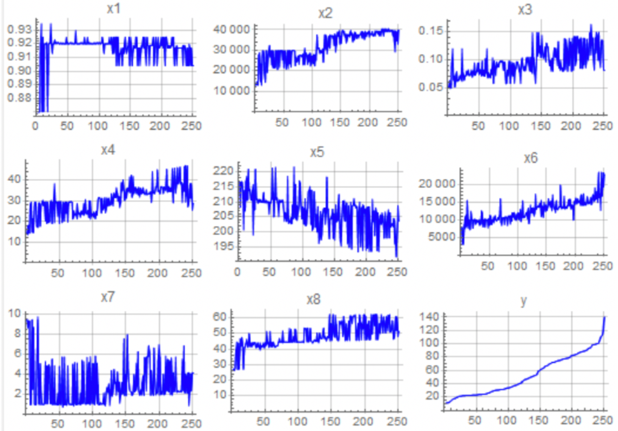
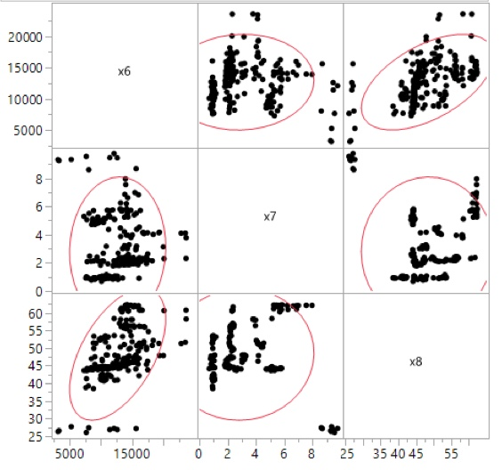
Inspecting data with univariate and bivariate plots
Univariate plots
Bivariate plots

Slide 16
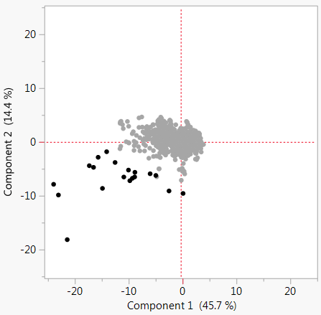
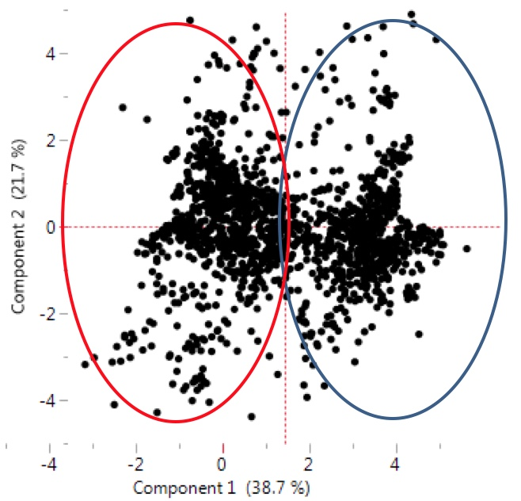
Inspecting data with multivariate plots
Multivariate plot of a process with one operating regime
Multivariate plot of a process with two operating regimes

Slide 17
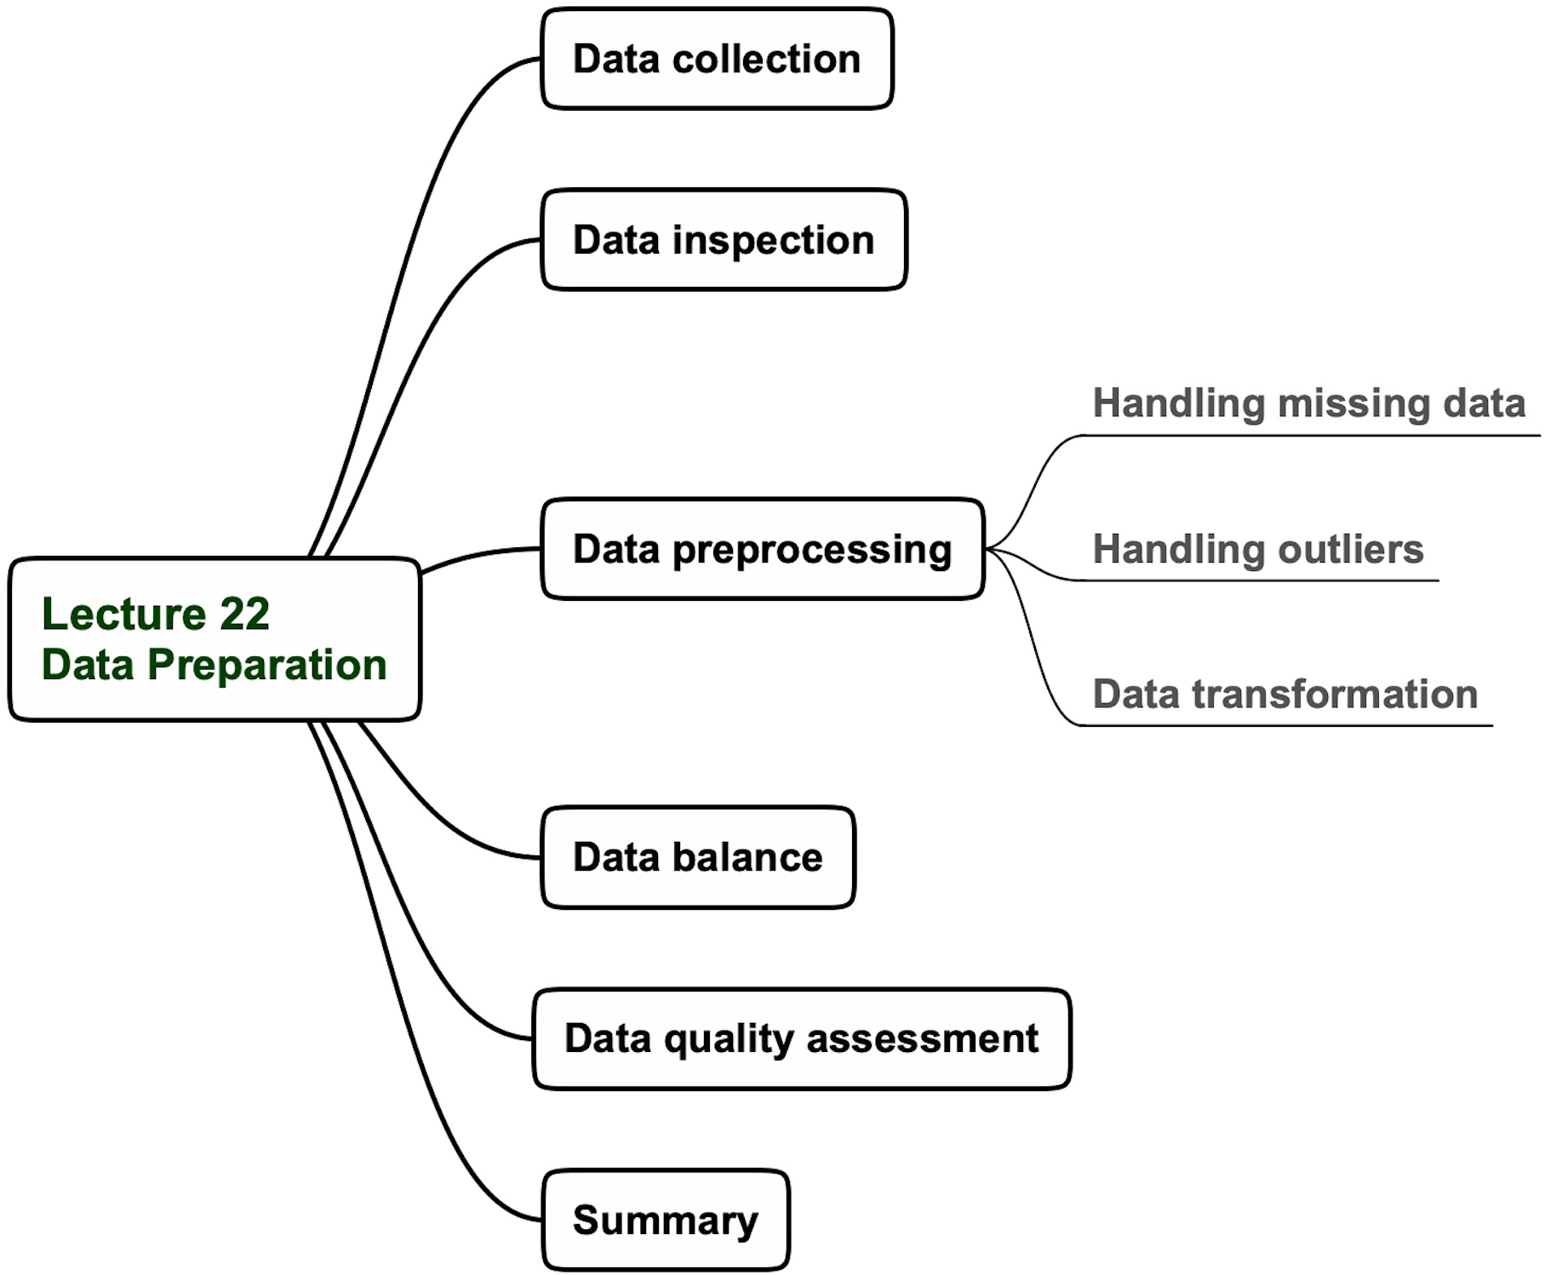
Lecture 22 agenda

Slide 18
Handling missing data
Simple data imputation
Model-based data imputation
Avoid imputation if missing data is > 30%

Slide 19
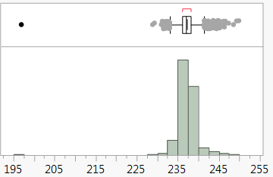
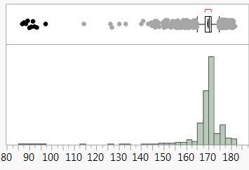
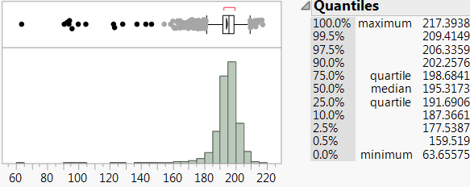
Handling univariate outliers
Obvious outlier
Obvious outlier cluster
Statistically defined outliers: data
<160 is <0.5%

Slide 20
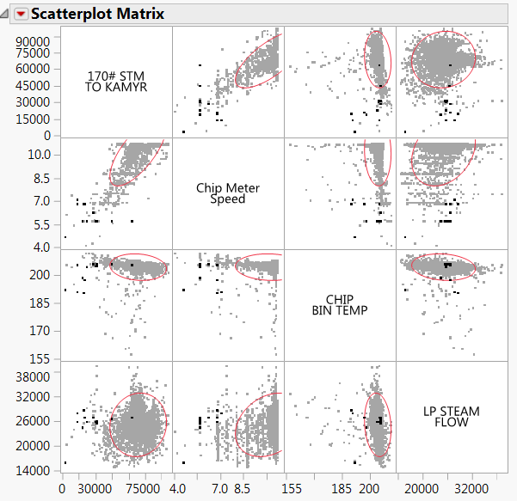
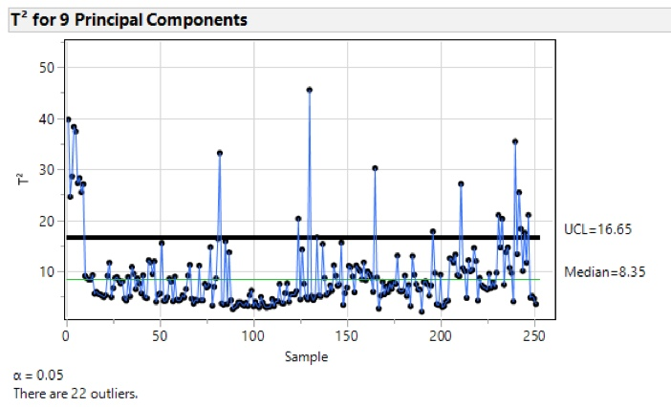
Handling multivariate outliers
Key Objective: remove multivariate outliers based on Scatterplot Matrix and Multivariate statistics (T²)

Slide 21
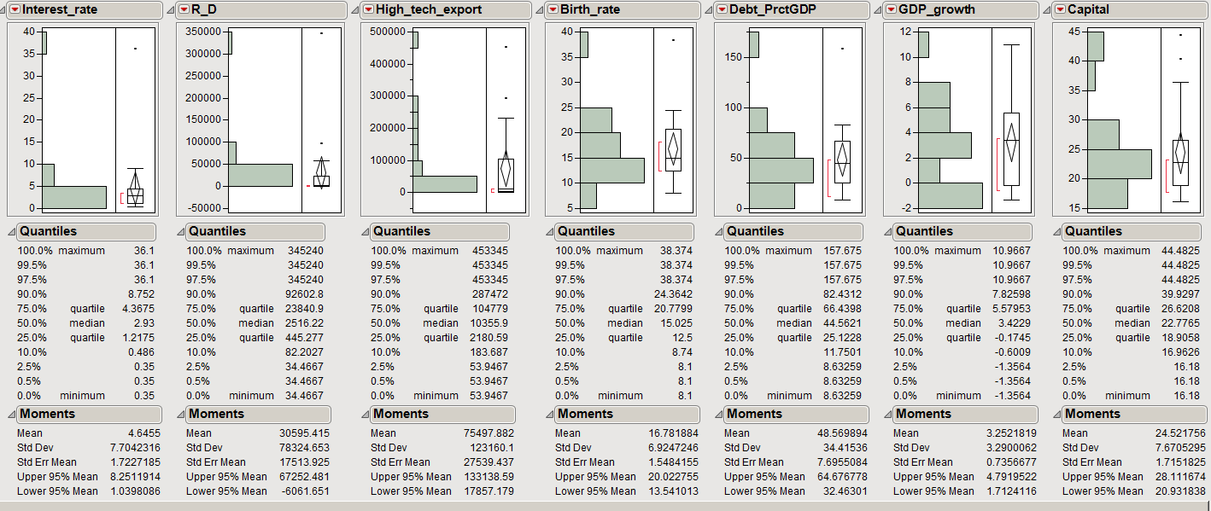
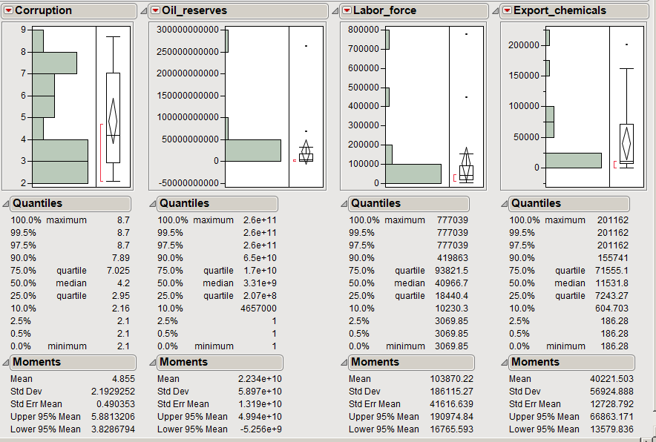
Data transformation – original data
Key Objective: Transform data towards a normal distribution
Some data have non-normal distribution Log transform is suggested for improvement
Some original data are replaced by standardized version, for example R_D/person

Slide 22
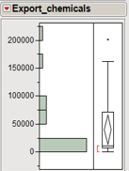
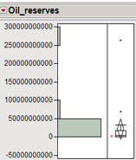
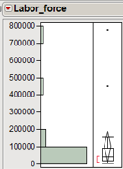
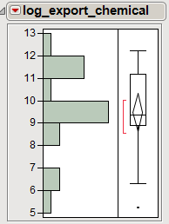
Data transformation – transformed data
Key Objective: Transform data towards a normal distribution
Log transform distribution and standardized factors are closer to normal distribution
!!! Models are more difficult for interpretation

Slide 23
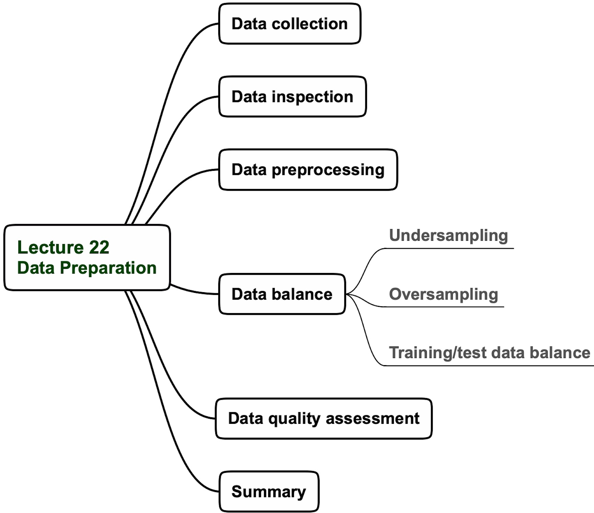
Lecture 22 agenda

Slide 24
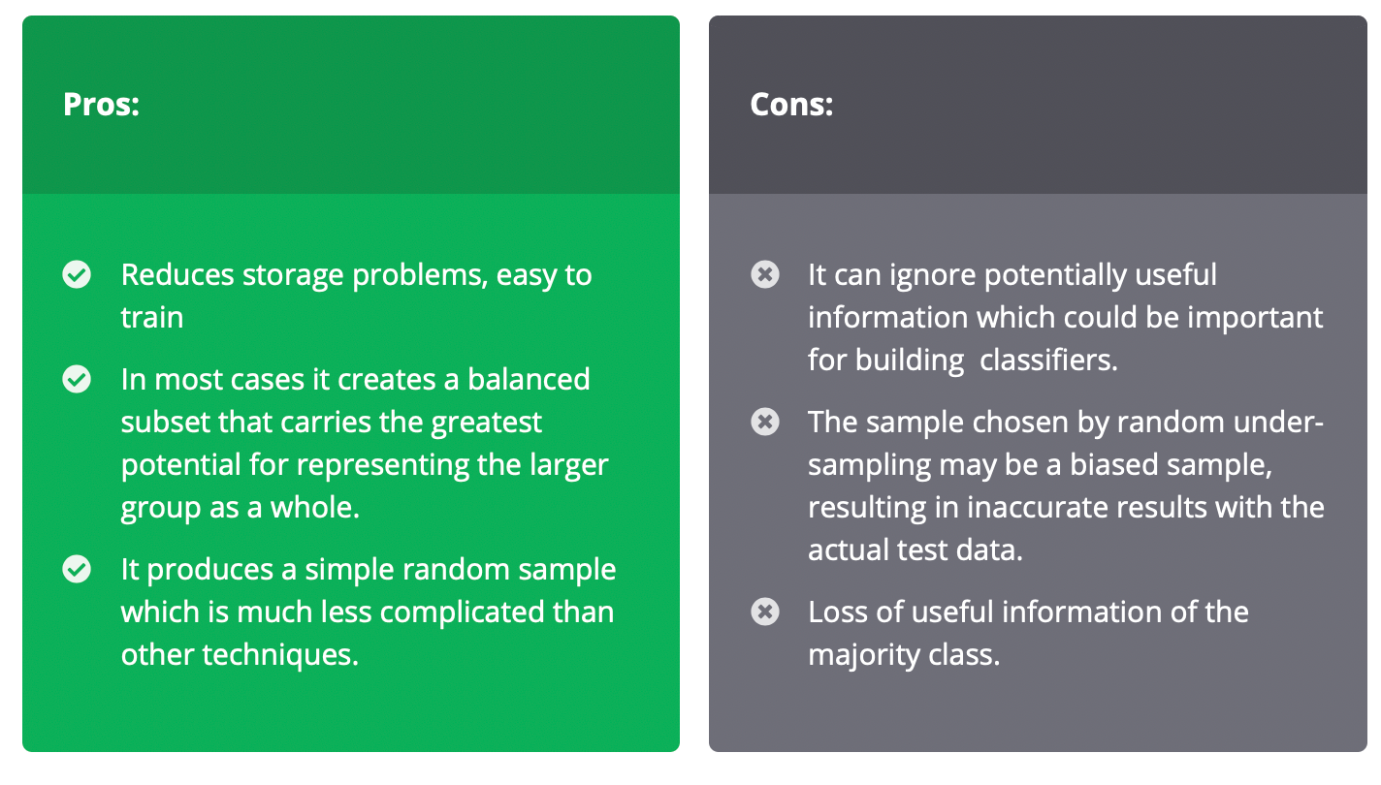
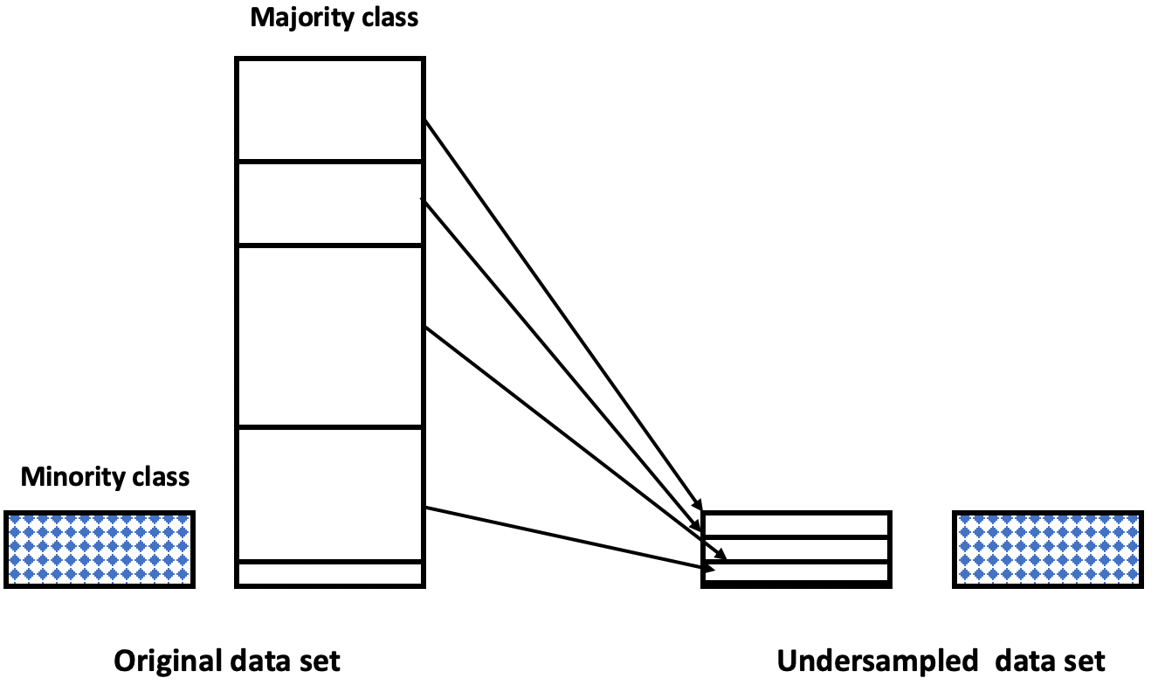
Undersampling the data
Data balance by undersampling

Slide 25
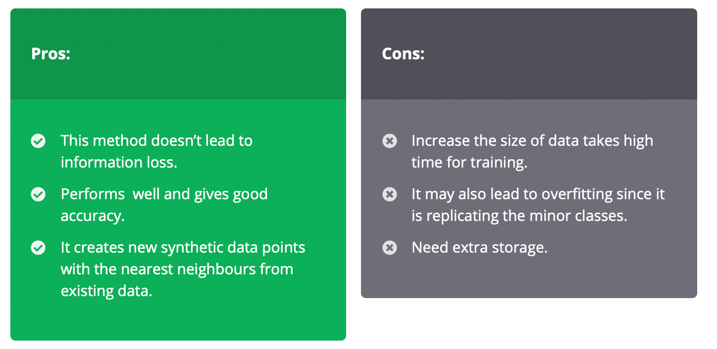
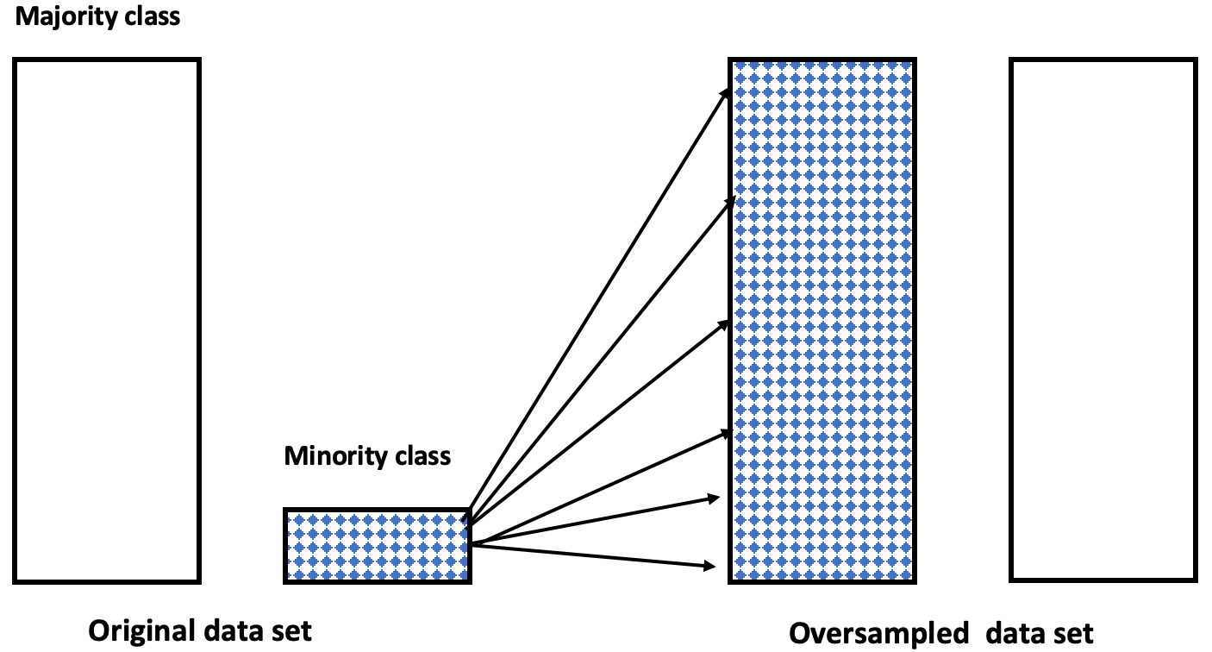
Oversampling the data
Data balance by oversampling
A combination of both undersampling and oversampling is recommended

Slide 26
Balancing training and test data avoiding covariate shift
Covariate shift refers to a situation where predictor variables have different distribution in training and test data.

Slide 27
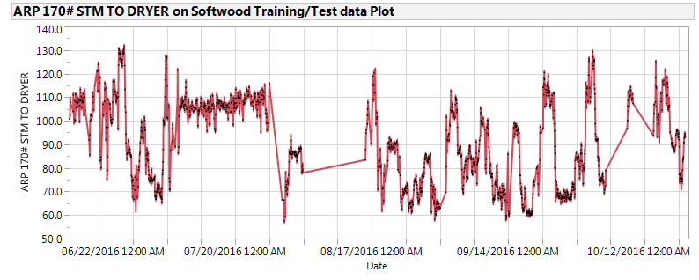
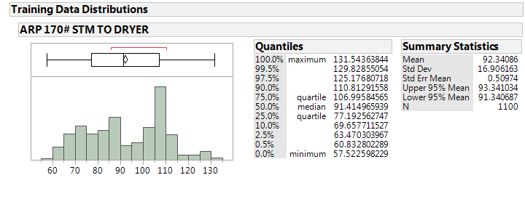
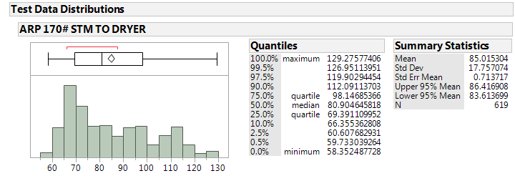
Balancing training and test data for model building
Training data (06/16/16 – 09/07/16)
Test data (09/07/16 – 10/20/16)
training
test
Test data are the most recent data
Data distributions should be well balanced
Training and test data are well balanced
27

Slide 28
Balancing training and test data for model building – time-series arrangement
A case with data pieces transfer for data balance
Add to
test
training
Add to
training
test

Slide 29
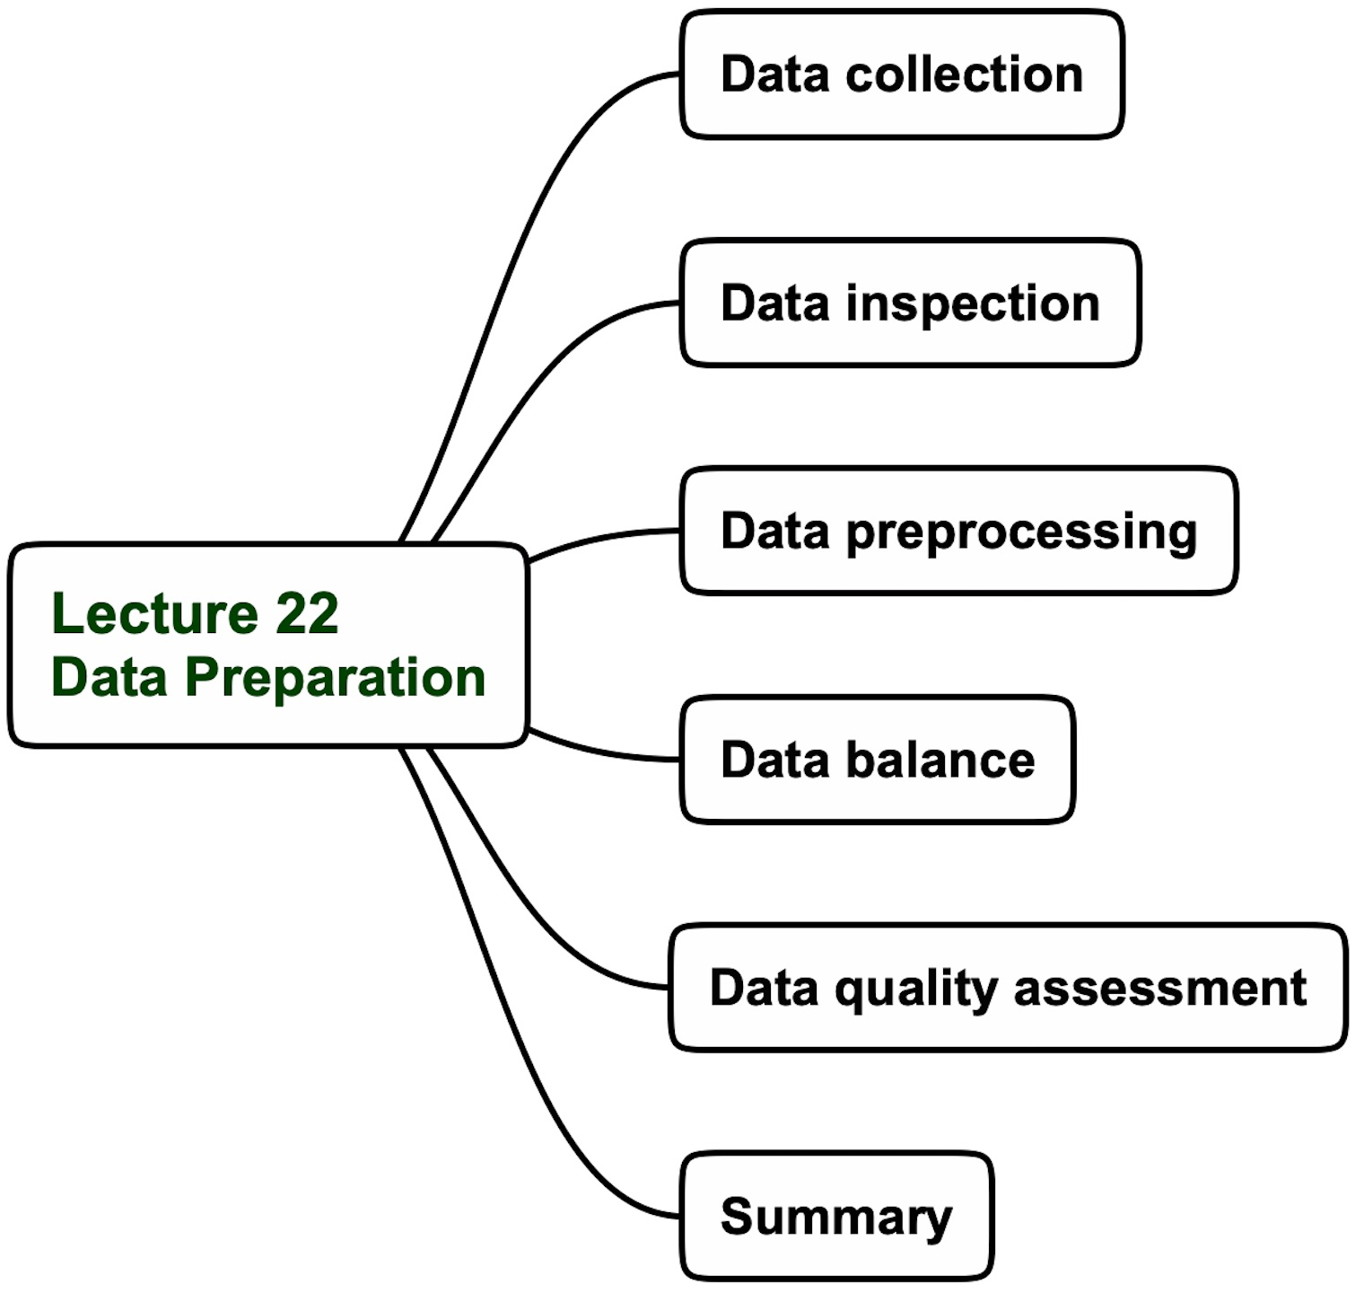
Lecture 22 agenda

Slide 30
Data quality categories
Good Quality
Acceptable Quality
Low Quality
Imputed data < 10%
No missing data
No “bad” variables
No multicollinearity
Handled outliers
Sufficient data size
Correlation with target > 0.3
Well-defined operating regimes
Well-balanced training/test data sets
Imputed data < 30%
Missing data < 20%
Some “bad” variables
No multicollinearity
Handled outliers
Insufficient data size
Correlation with target > 0.3
Undefined operating regimes
Imbalanced training/test data sets
Imputed data > 30%
Missing data > 20%
Many “bad” variables
Multicollinearity
Too many outliers
Insufficient data size
Correlation with target < 0.3
Undefined operating regimes
Imbalanced training/test data sets
Ready for modeling
Iterative modeling
Suggest data collection
changes

Slide 31
Lecture 22 “Data preparation” Summary
Data preparation is the most time-consuming step in developing AI-systems for
real-word problems
Data preparation includes data collection, inspection, preprocessing, and balancing
Data collection covers data extraction, metadata definition, and data integration
Data inspection is focused on strange data patterns, data distributions, and analyzing different plots
Data preprocessing includes handling missing data and outliers, and data transformation
Data balance involves undersampling and oversampling imbalanced data and balancing training and test data
Data quality is categorized as good, acceptable, and low.
The Bottom Line
After data preparation, the quality of the data is a decisive factor for developing a real-world AI system

