Slide 1
Applied Artificial Intelligence Lecture 14 Applied AI in Image Analysis
Arthur Kordon
Kordon Consulting LLC

Slide 2
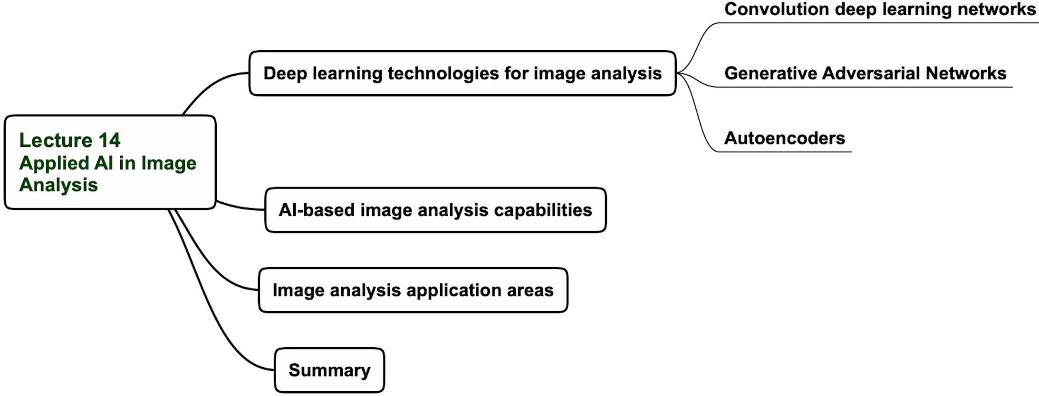
Lecture 14 agenda

Slide 3
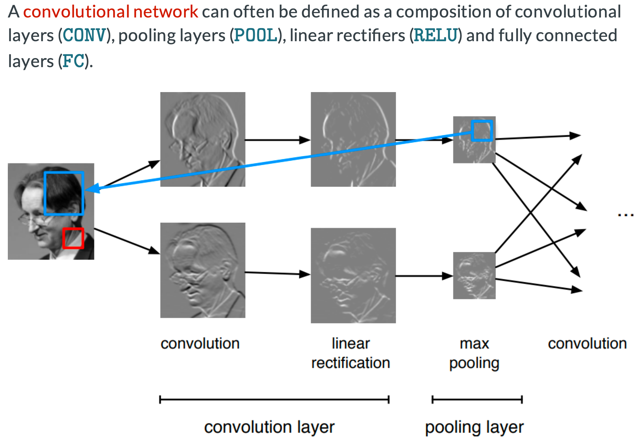
Convolution network principle (loop)

Slide 4
Convolution network principle (loop)

Slide 5
Deep learning networks technologies for image analysis
Deep convolution neural networks
Generative Adversarial Networks
Autoencoders

Slide 6
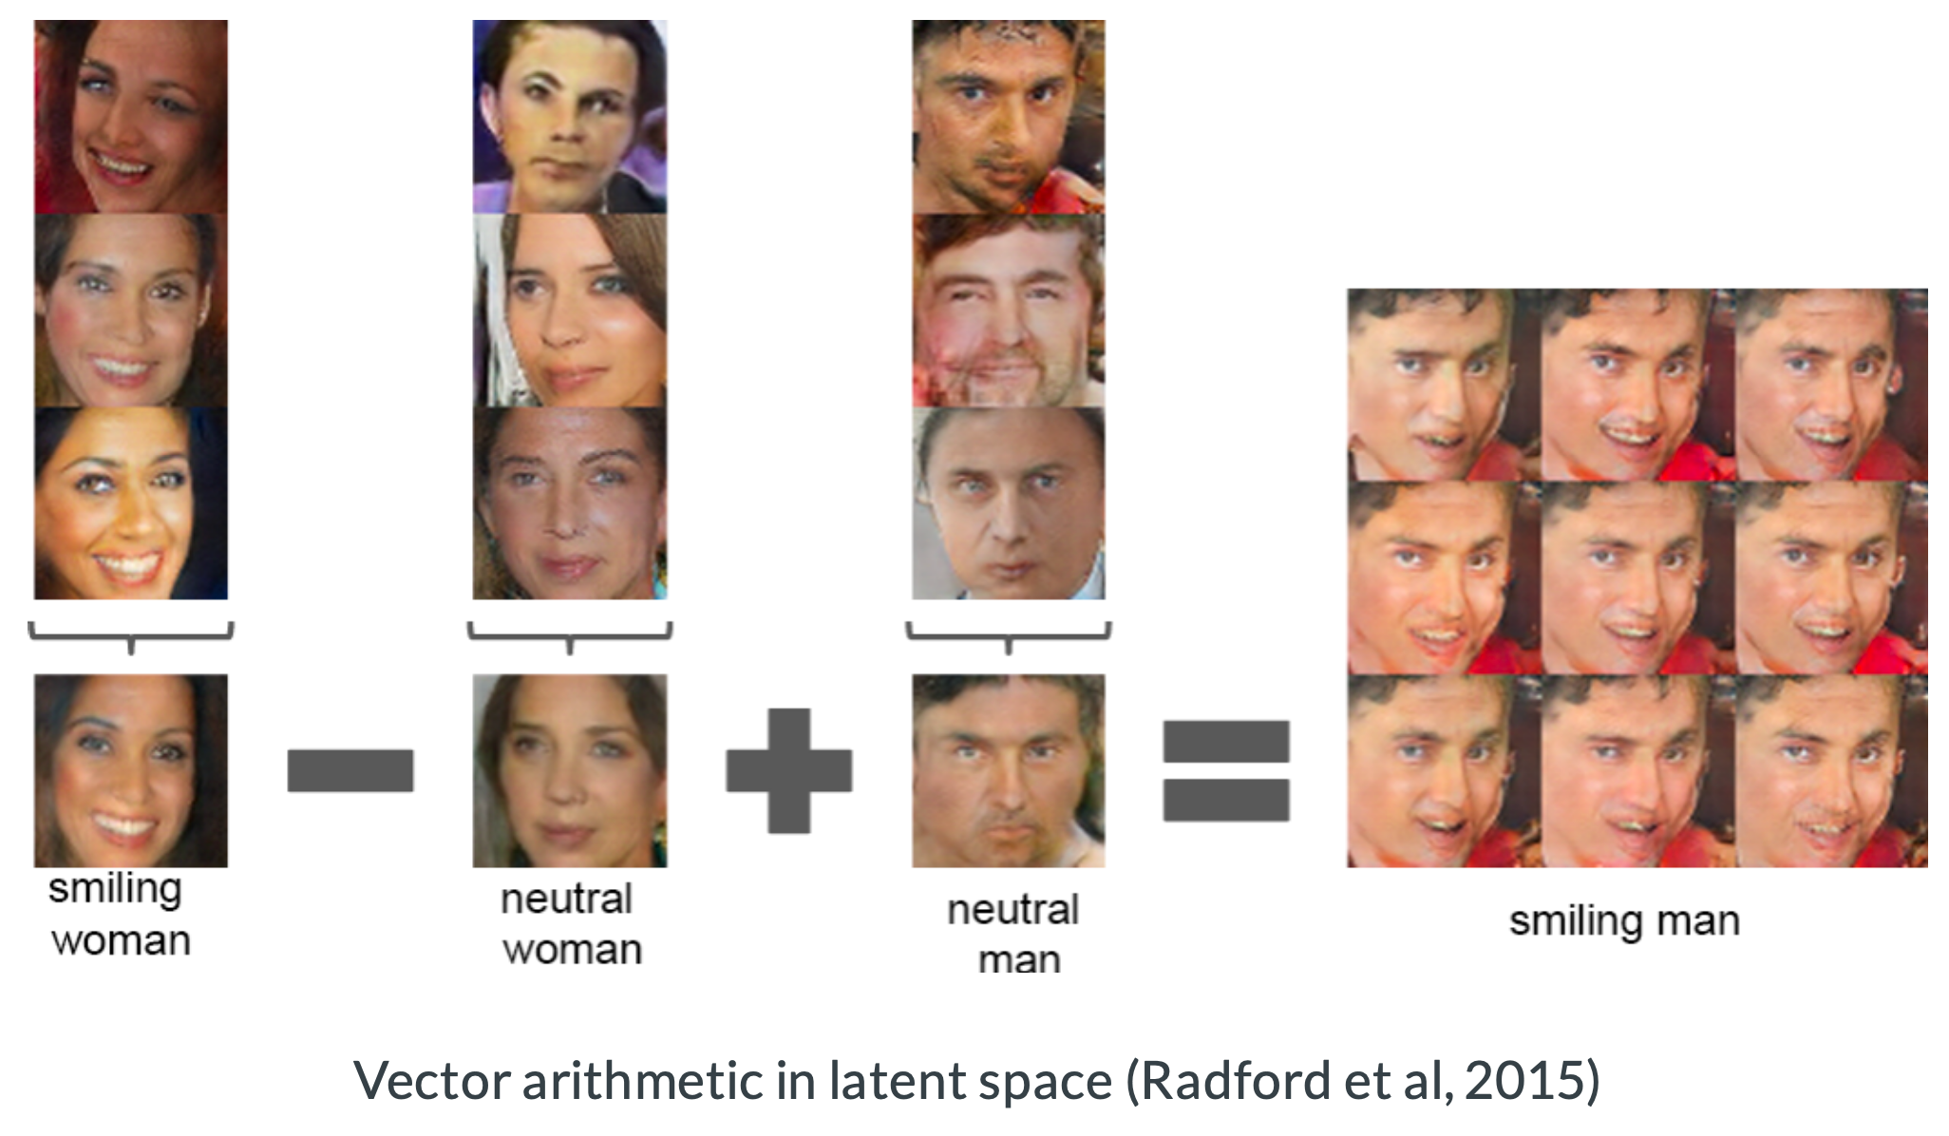
GANs algebra

Slide 7
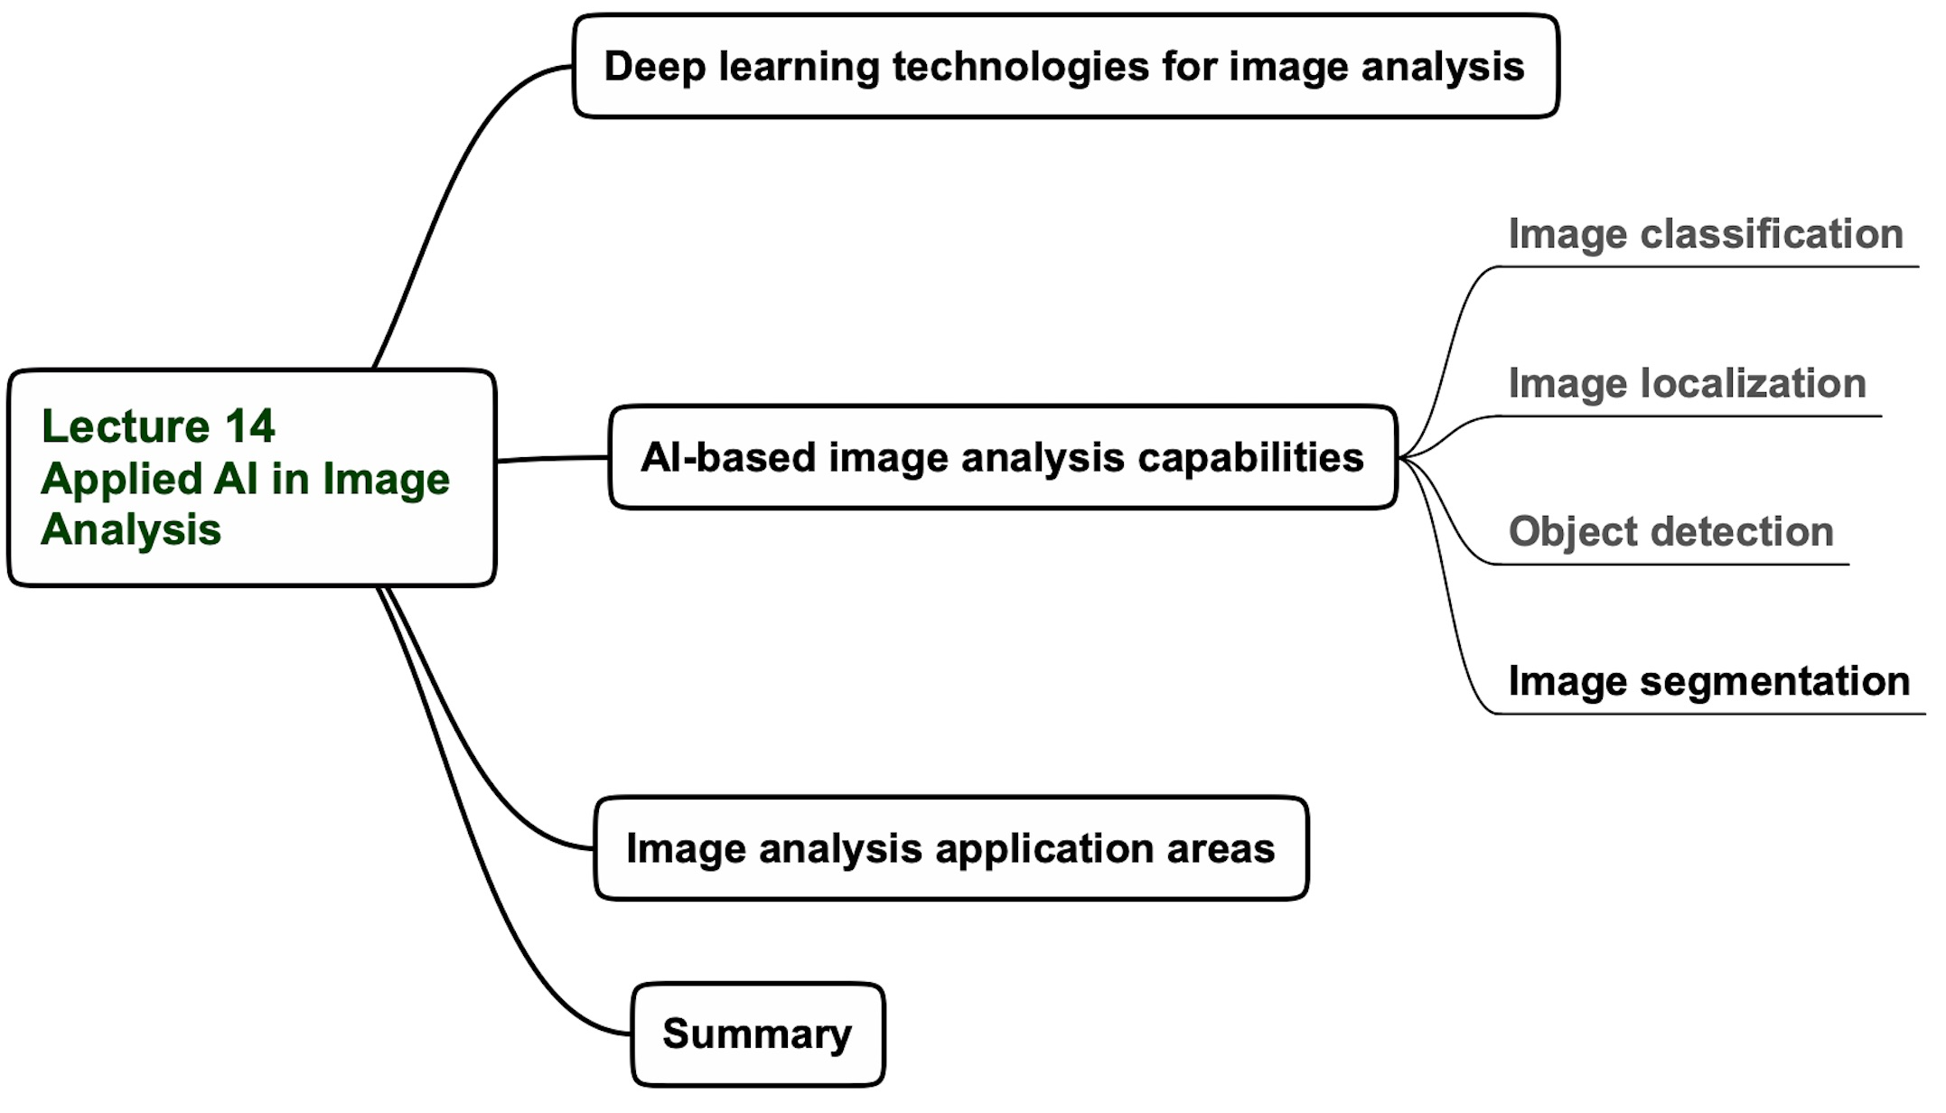
Lecture 14 agenda

Slide 8
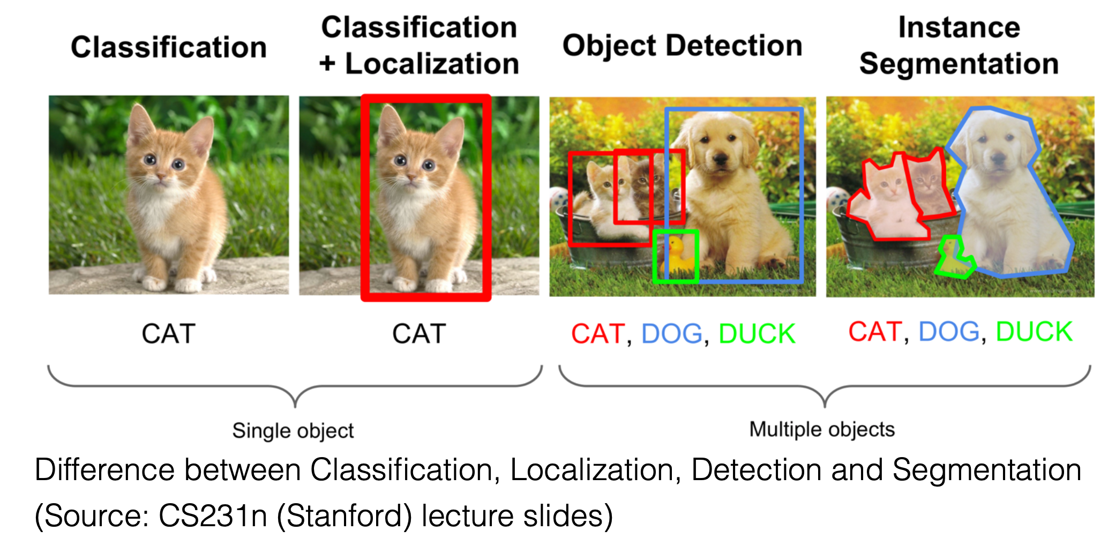
Key tasks of image analysis
https://data--flair-training.cdn.ampproject.org/c/s/data-flair.training/blogs/machine-learning-tutorial/amp

Slide 9
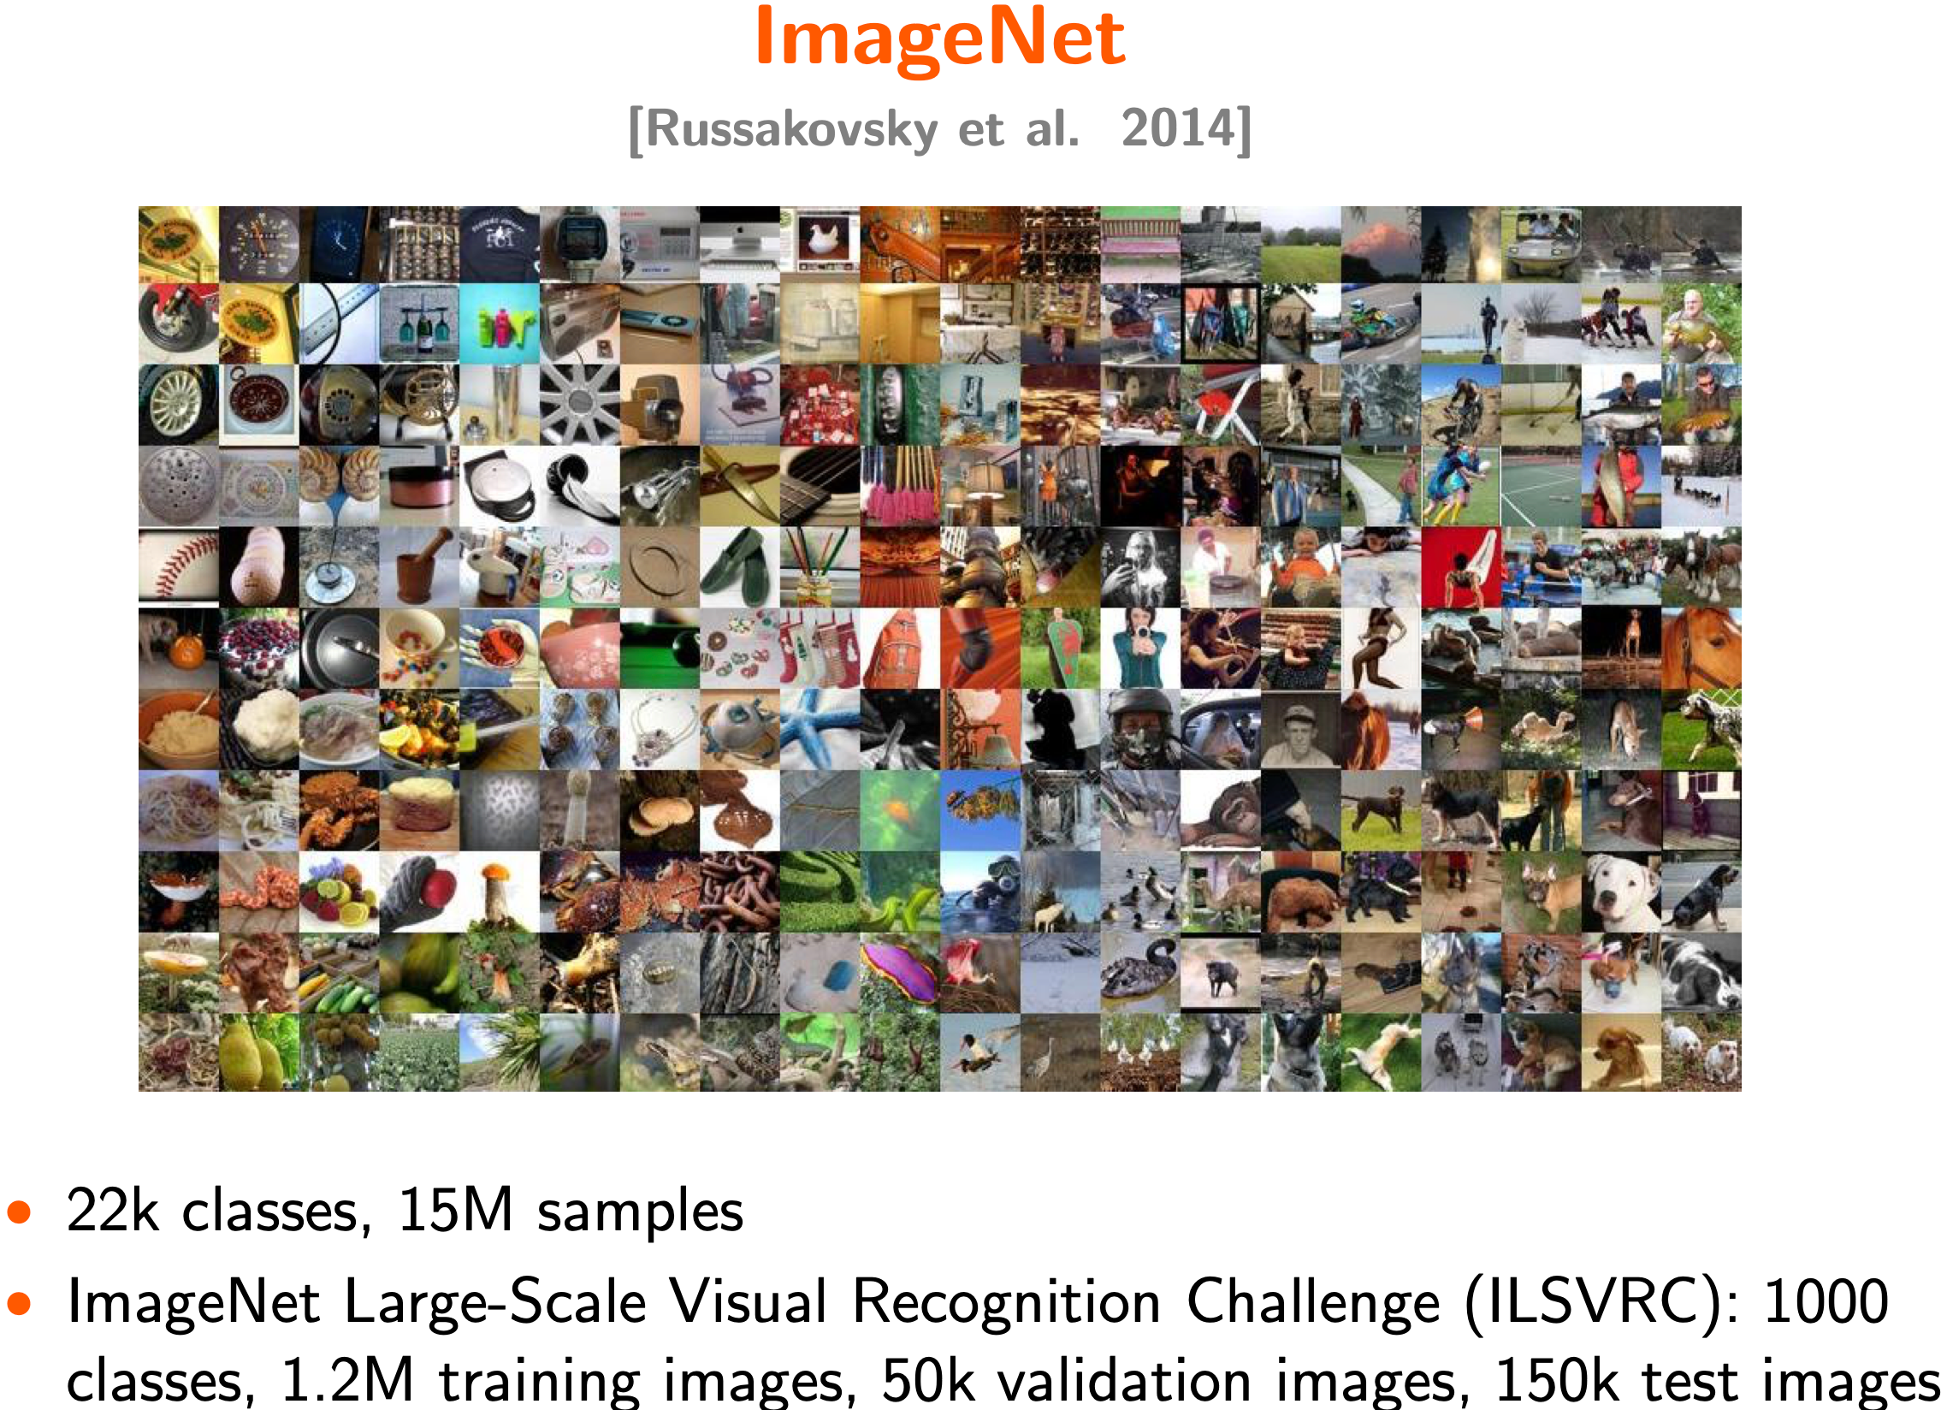
Image libraries (data sets)
https://data--flair-training.cdn.ampproject.org/c/s/data-flair.training/blogs/machine-learning-tutorial/amp

Slide 10
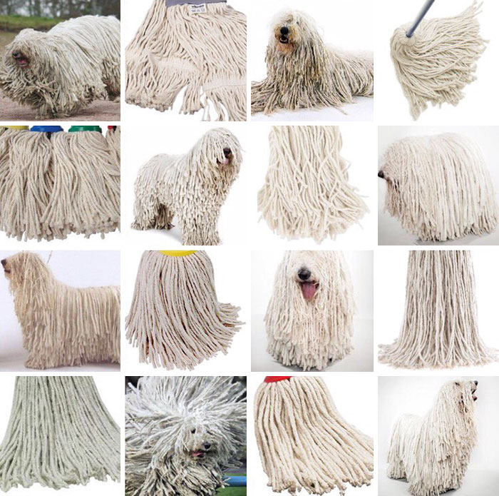
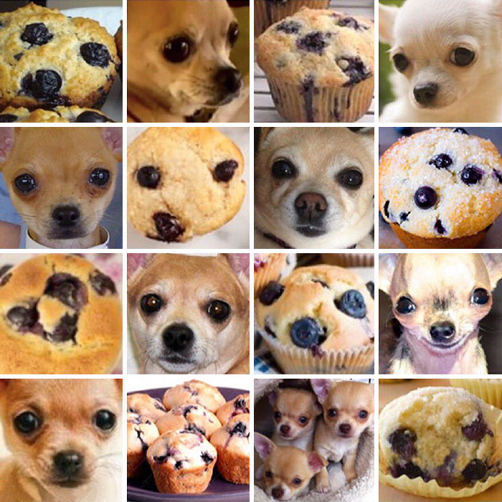
Image classification - issues
Sheepdog or mop?
Chihuahua or muffin?
Deep_Learning_course

Slide 11
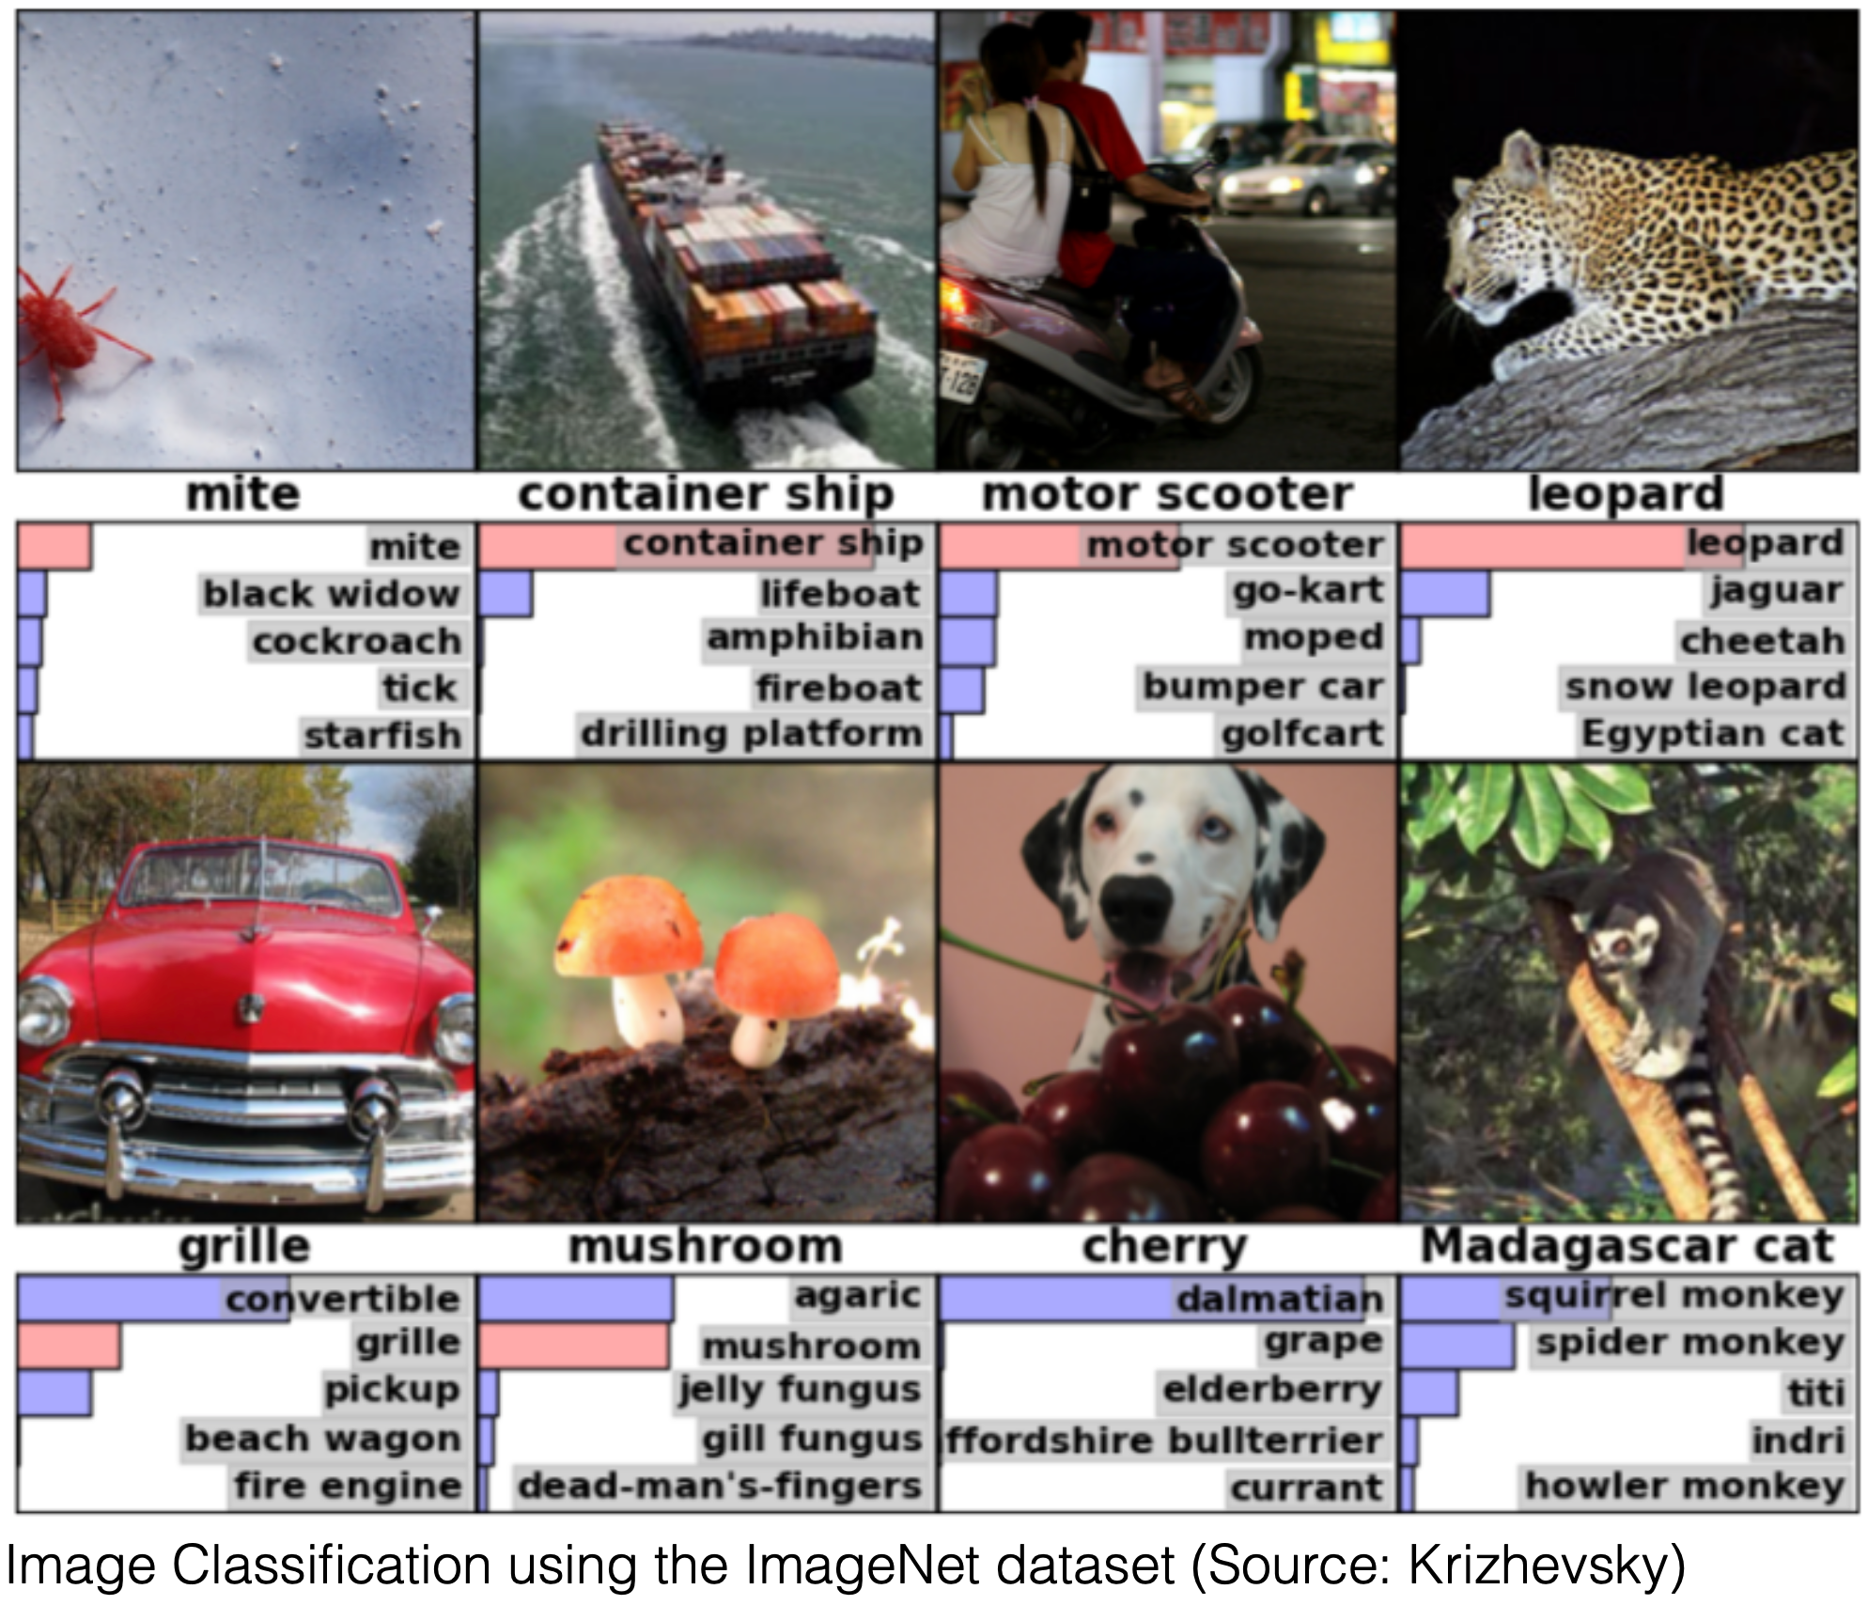
Image classification
Intro to Deep Learning for Computer Vision

Slide 12
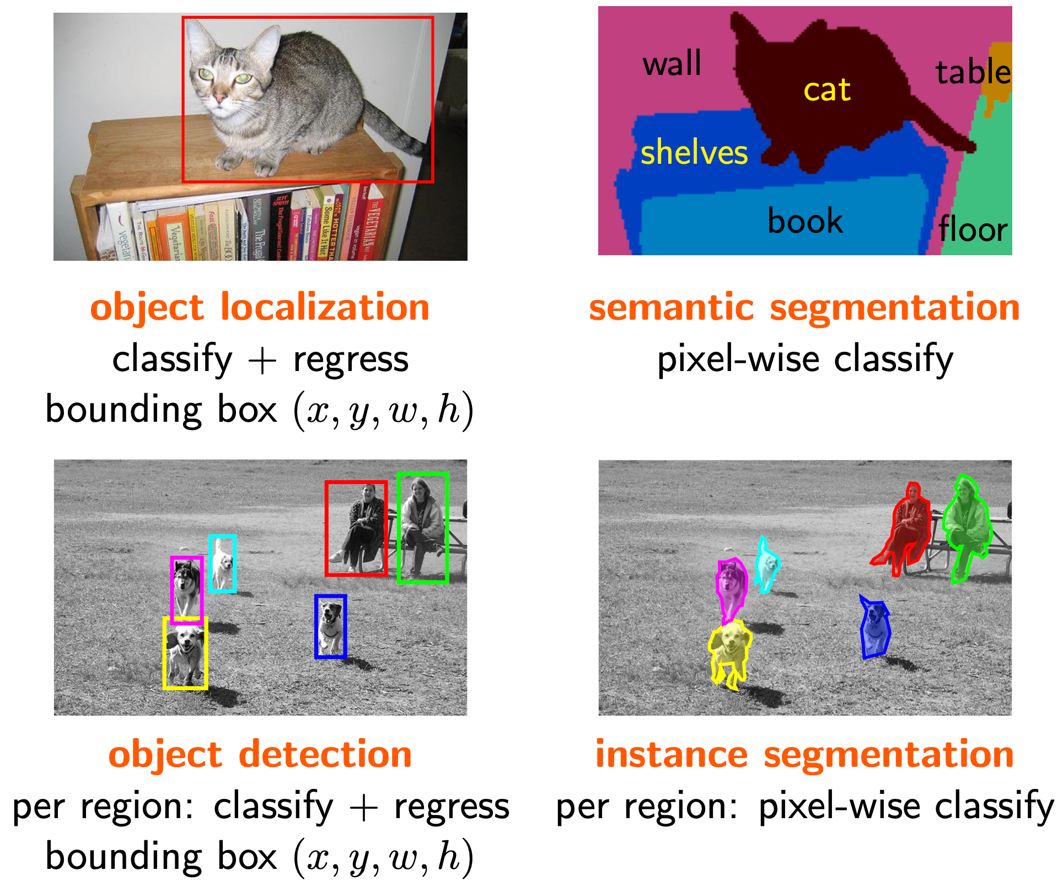
Image localization
https://data--flair-training.cdn.ampproject.org/c/s/data-flair.training/blogs/machine-learning-tutorial/amp

Slide 13
Object detection
f
Intro to Deep Learning for Computer Vision

Slide 14
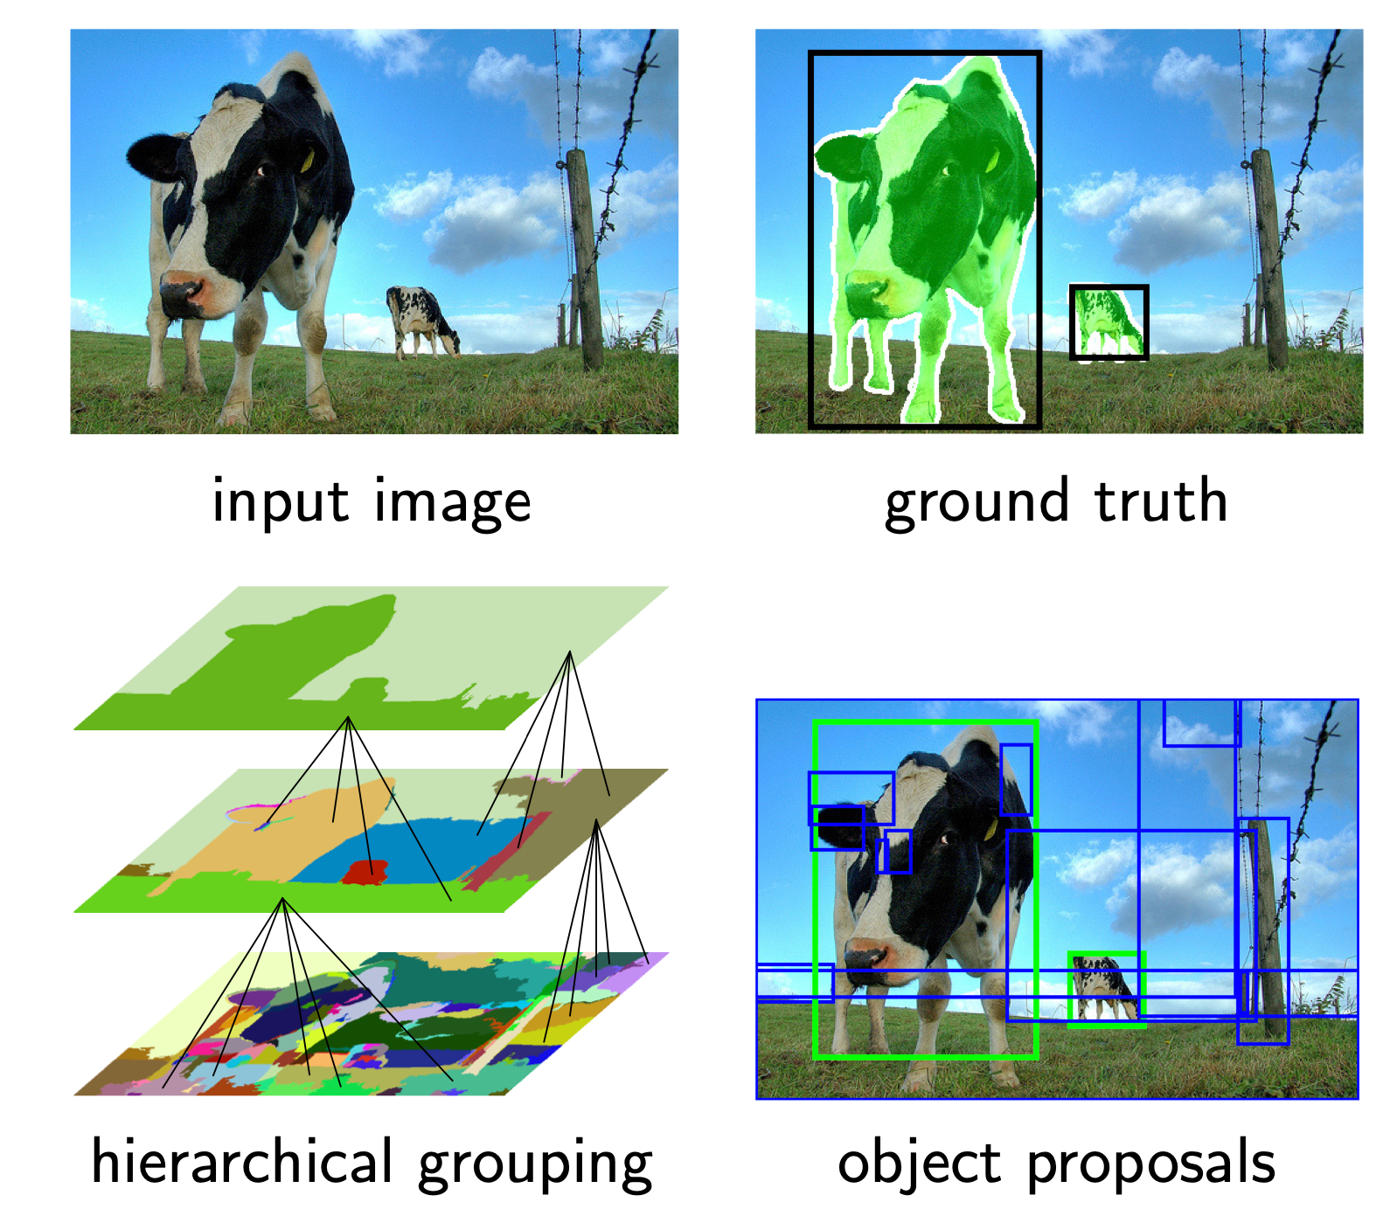
Object detection: from input image to object proposal
Intro to Deep Learning for Computer Vision

Slide 15
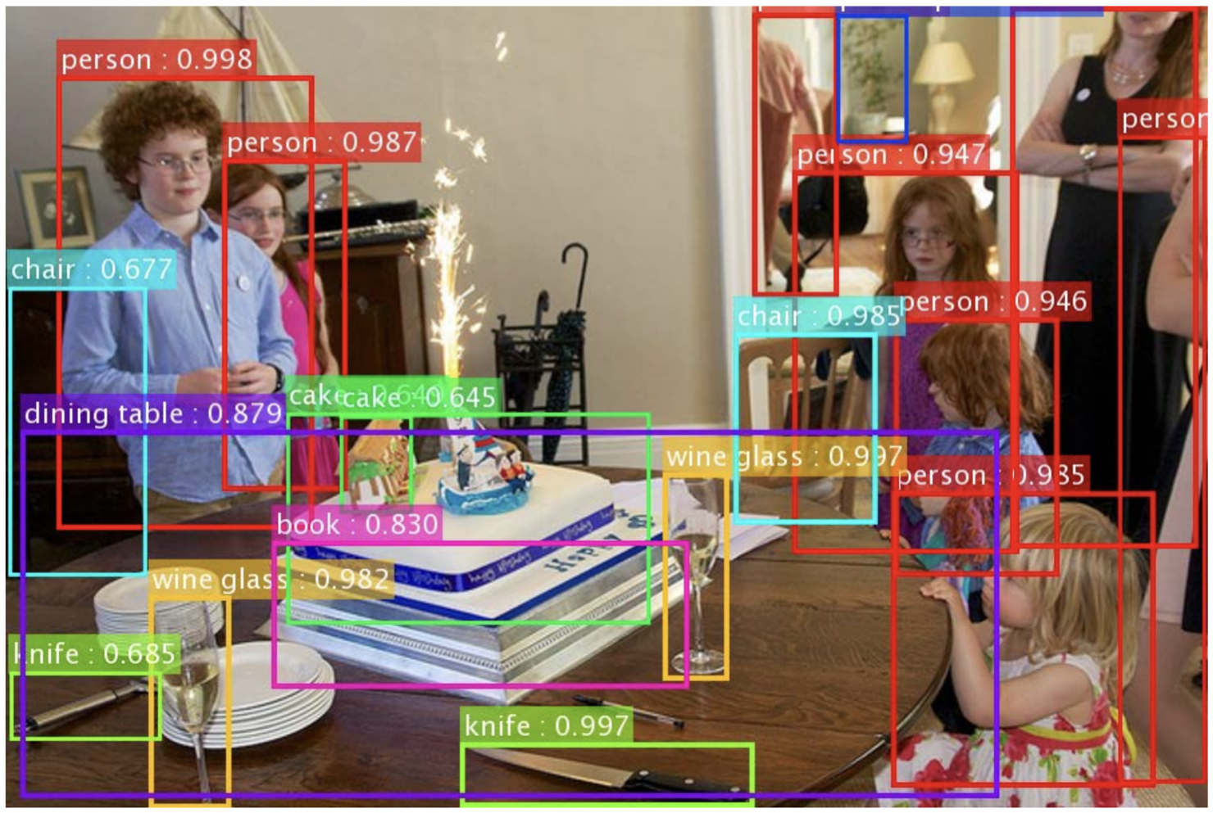
Object detection
Intro to Deep Learning for Computer Vision

Slide 16
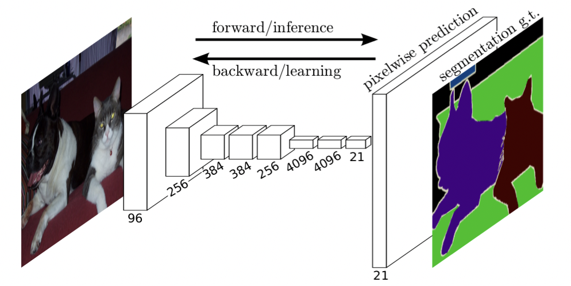
Image segmentation
Image Segmentation using a Pixel Mask
Intro to Deep Learning for Computer Vision

Slide 17
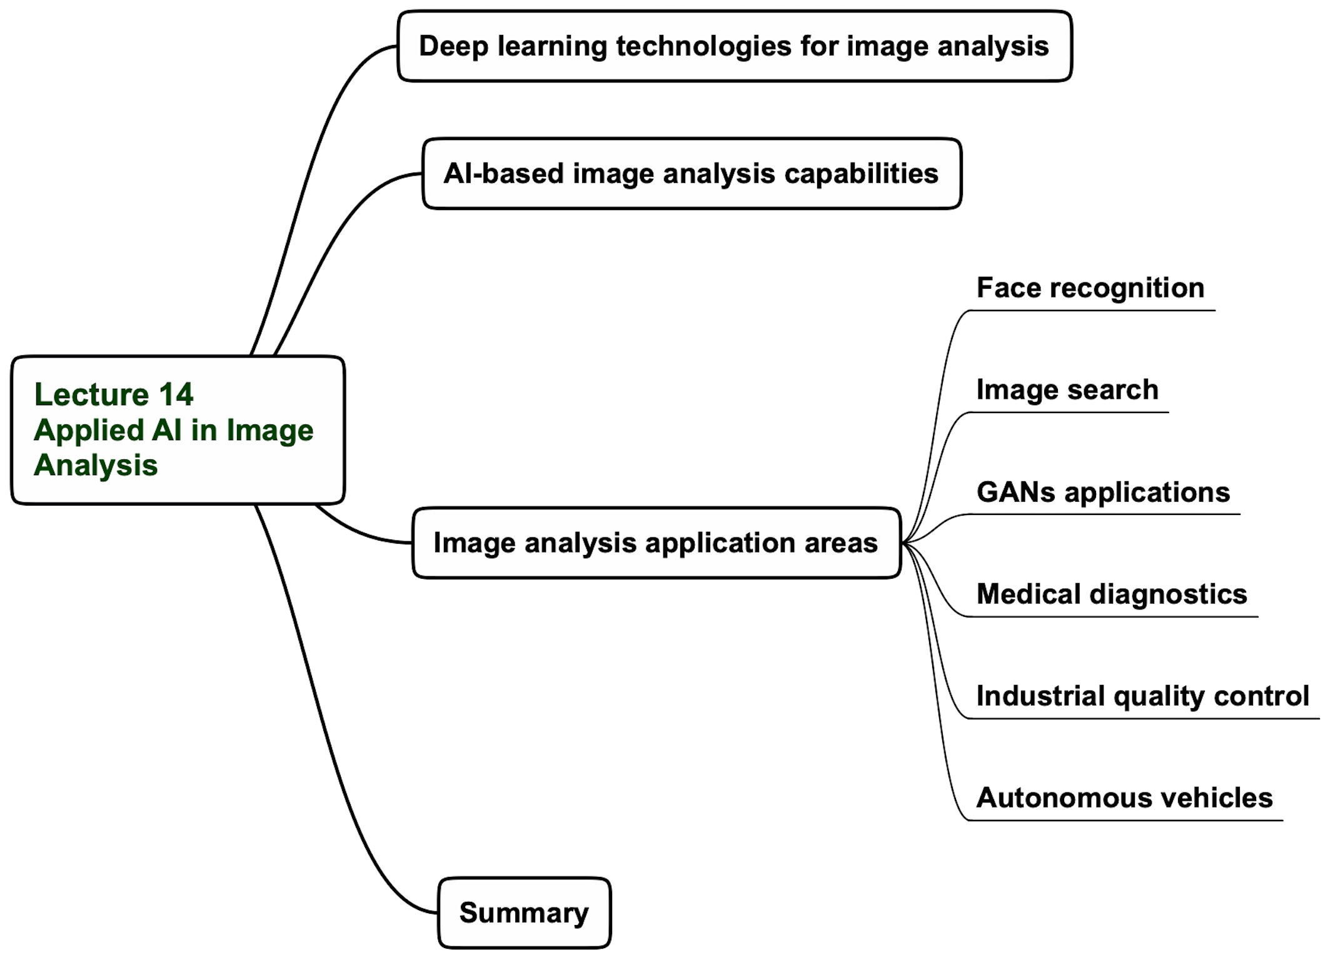
Lecture 14 agenda

Slide 18
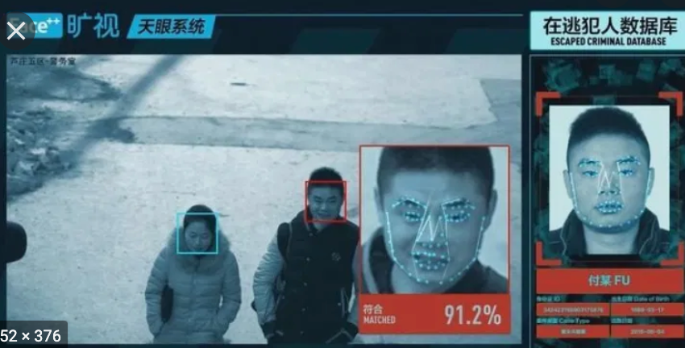
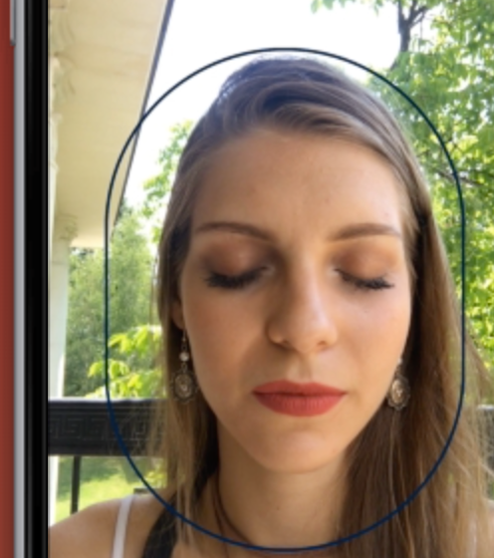
Face recognition
Distant identification
(Evrotrust)
Access control
Finding lost people
Tracking down criminals
Finding your soulmate
Recognizing regular customers
Organizing photos

Slide 19
Image search

Slide 20
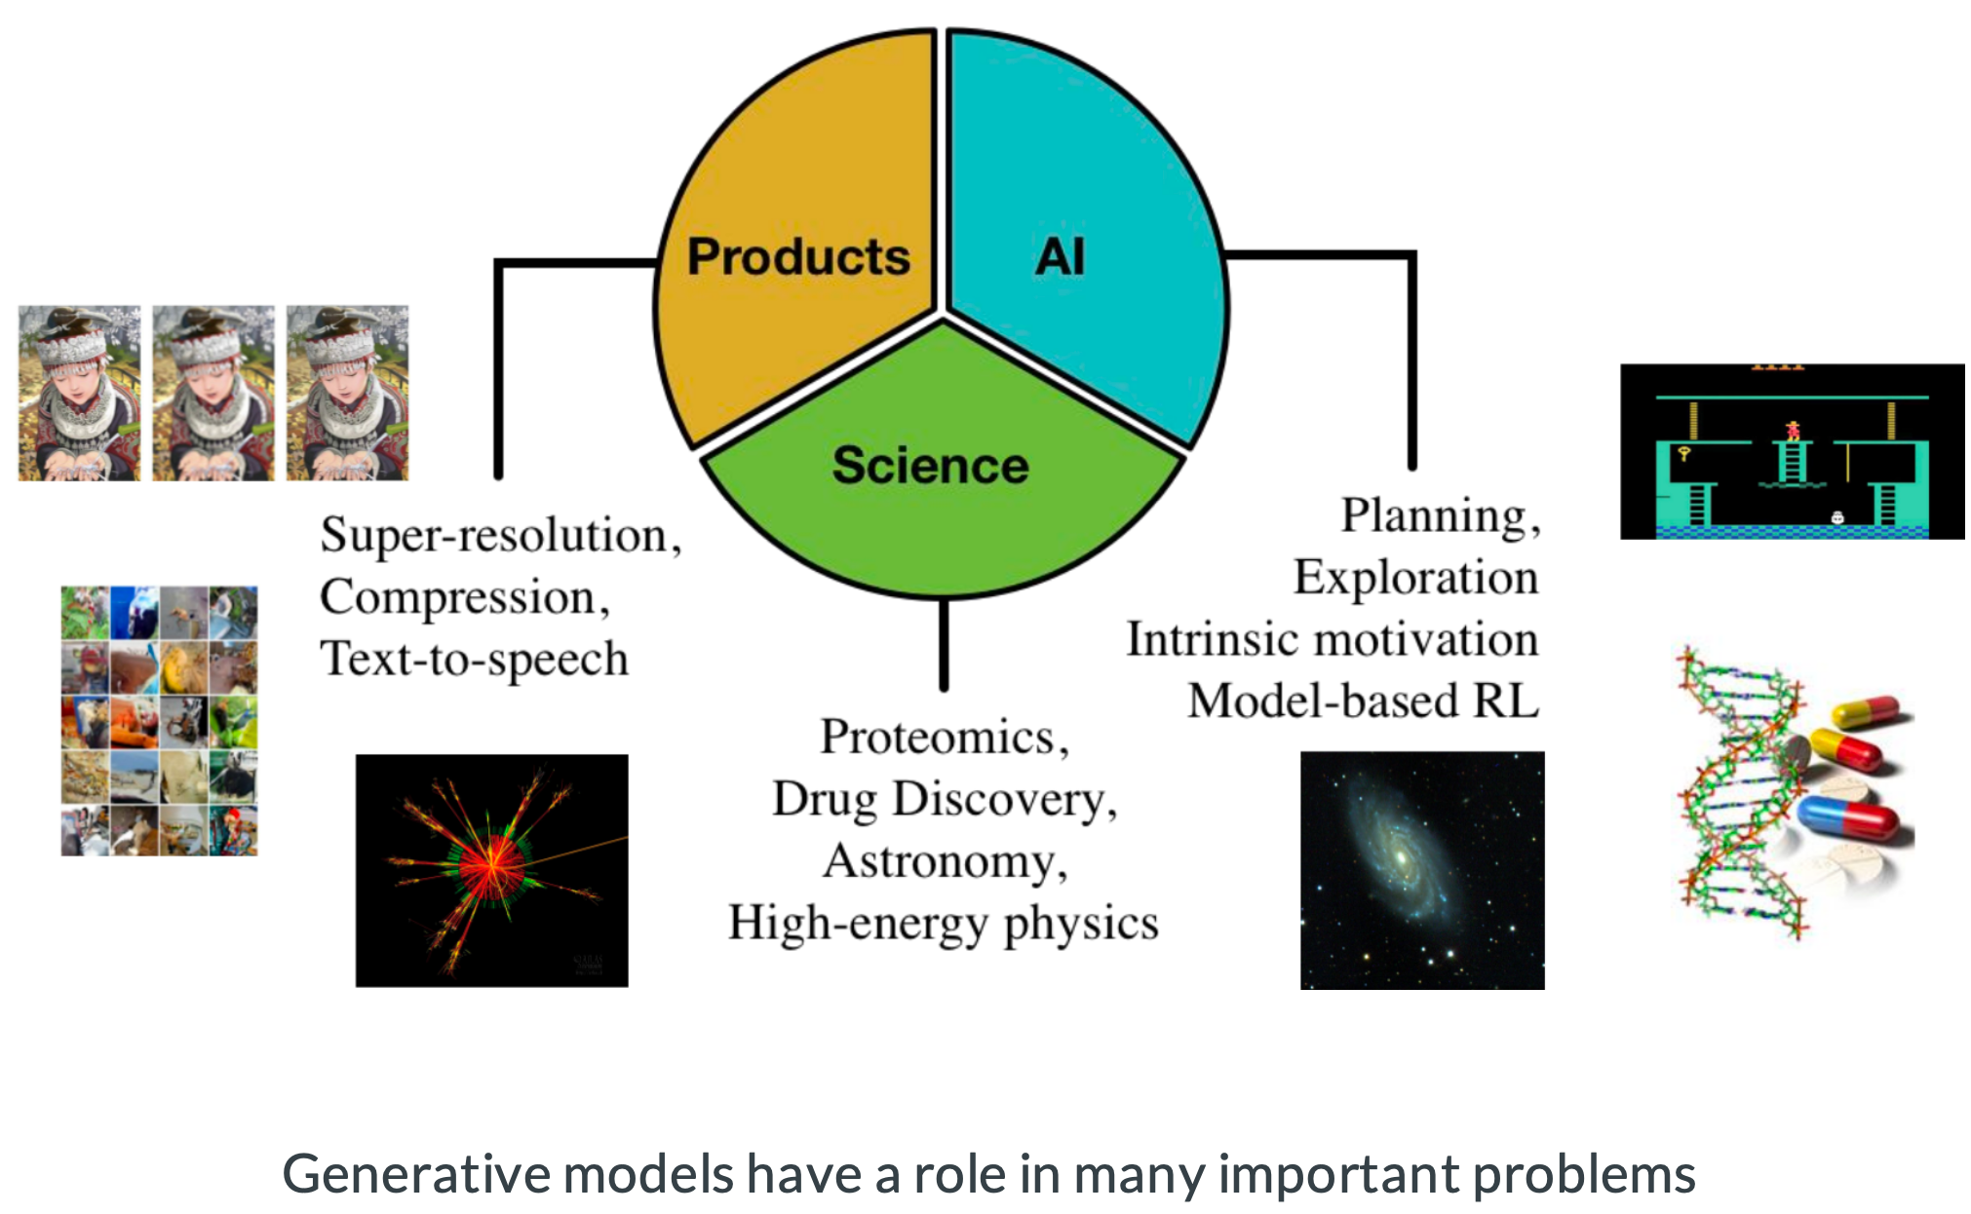
GANs application areas

Slide 21
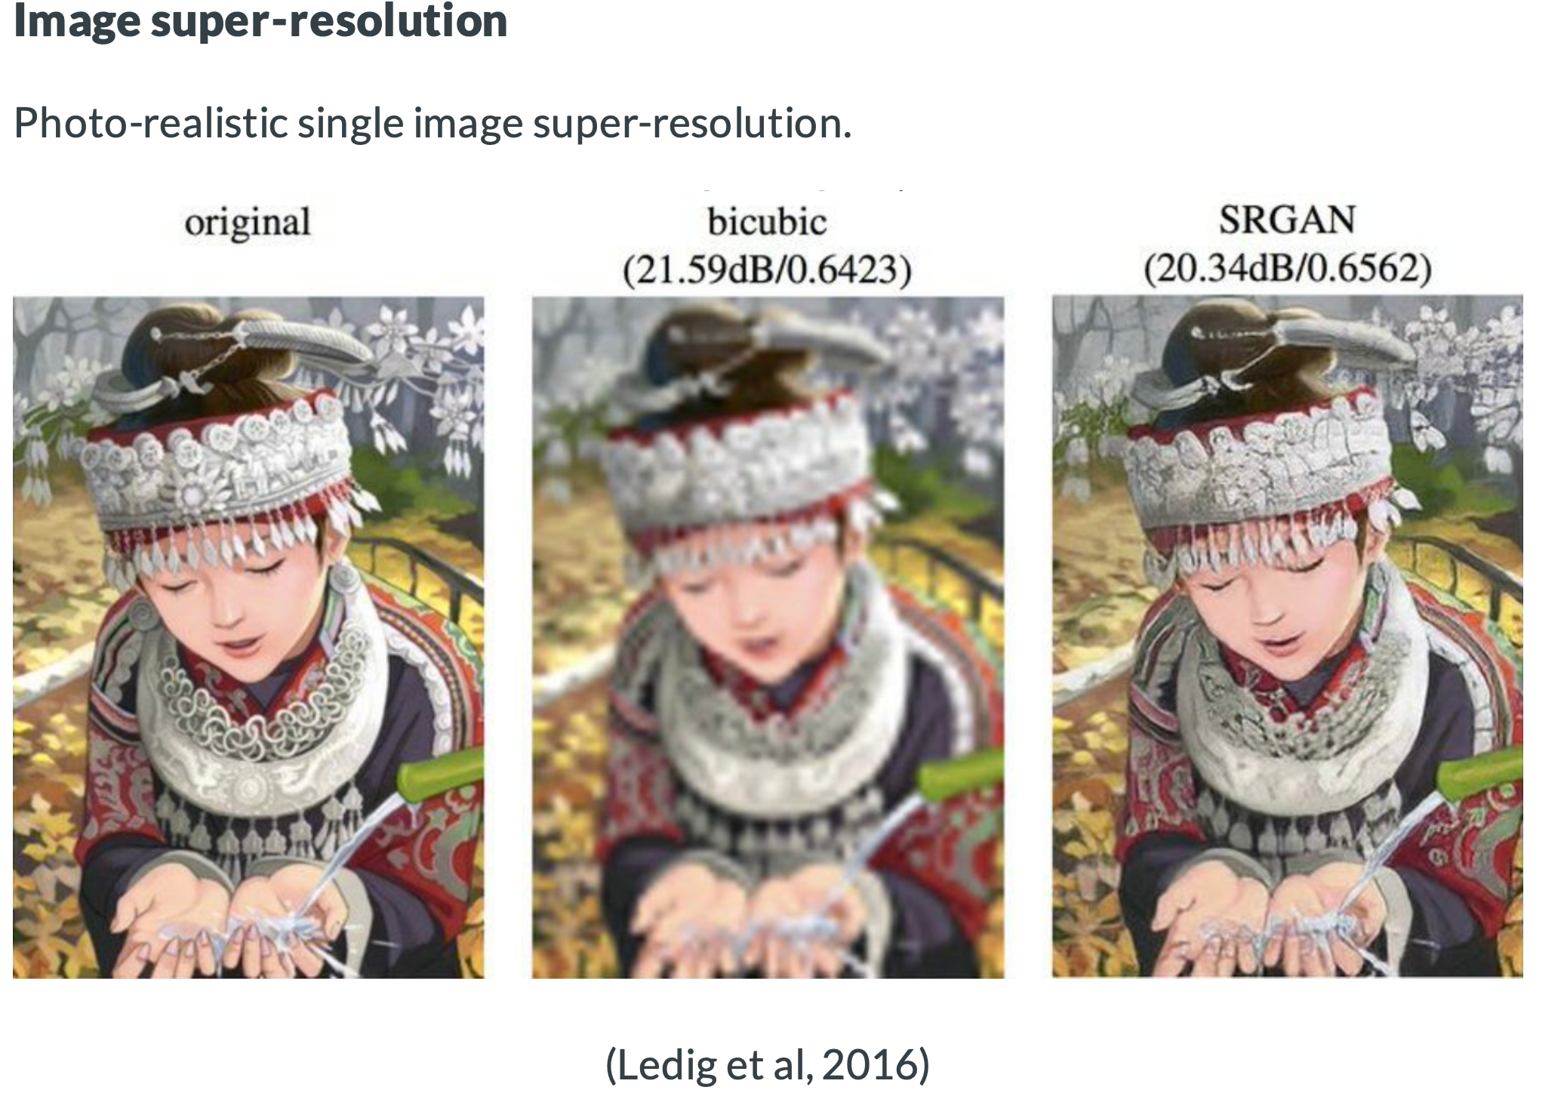
GANs application areas

Slide 22
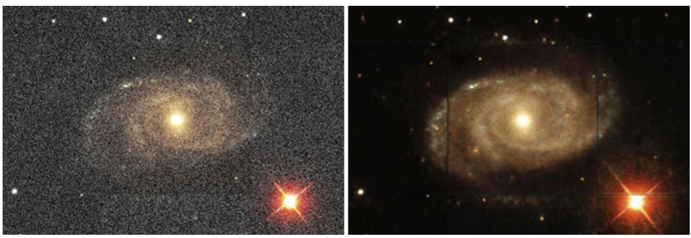
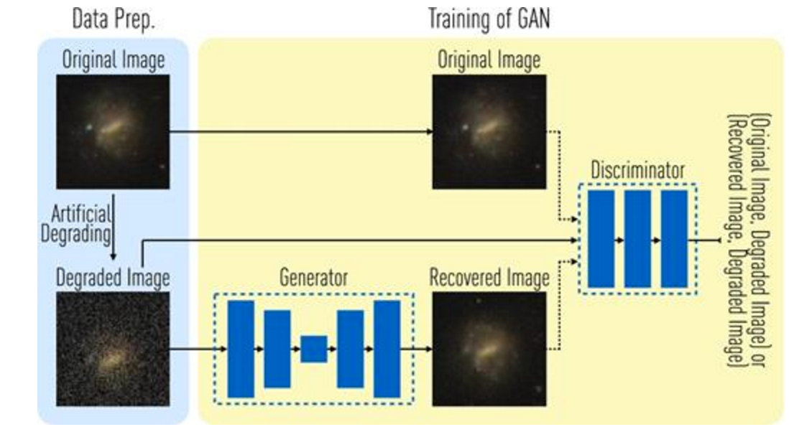
GANs delivers sharper images of galaxies
Trained with 4550 galaxies from the Sloan Digital Sky Survey Data Release 12
Generative Adversarial Network (GAN)
Royal Astronomical Society. "Neural networks promise sharpest ever images." ScienceDaily. ScienceDaily, 23 February 2017.

Slide 23
GANs applications

Slide 24
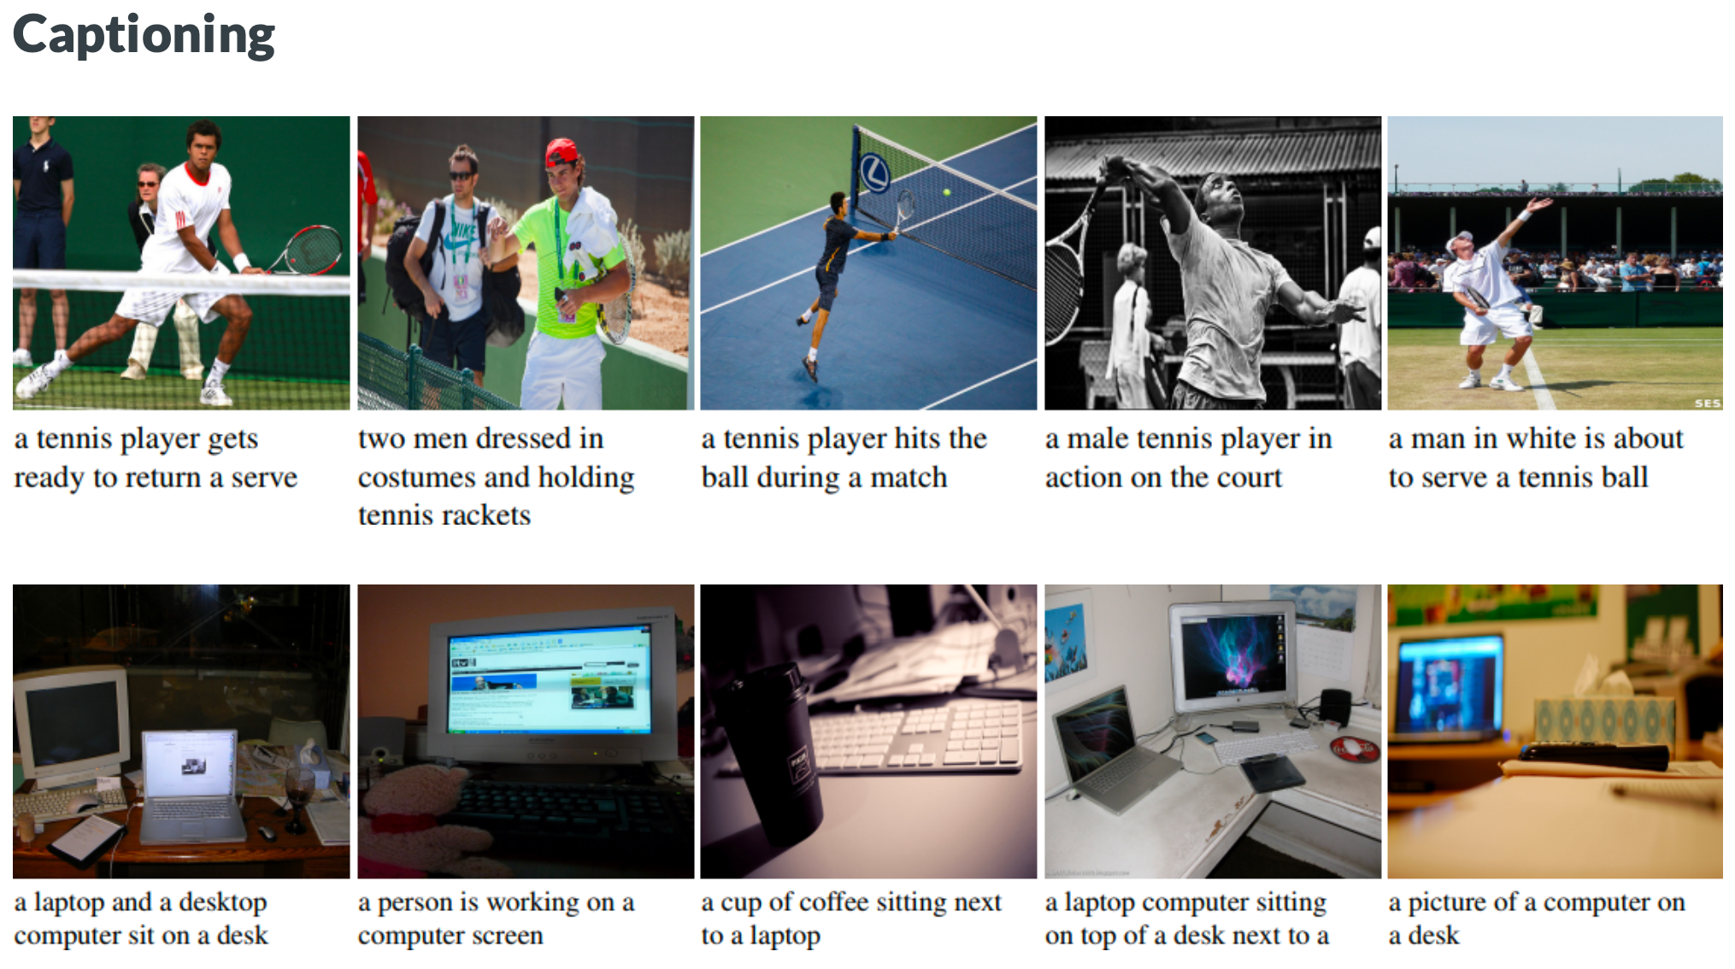
GANs applications

Slide 25
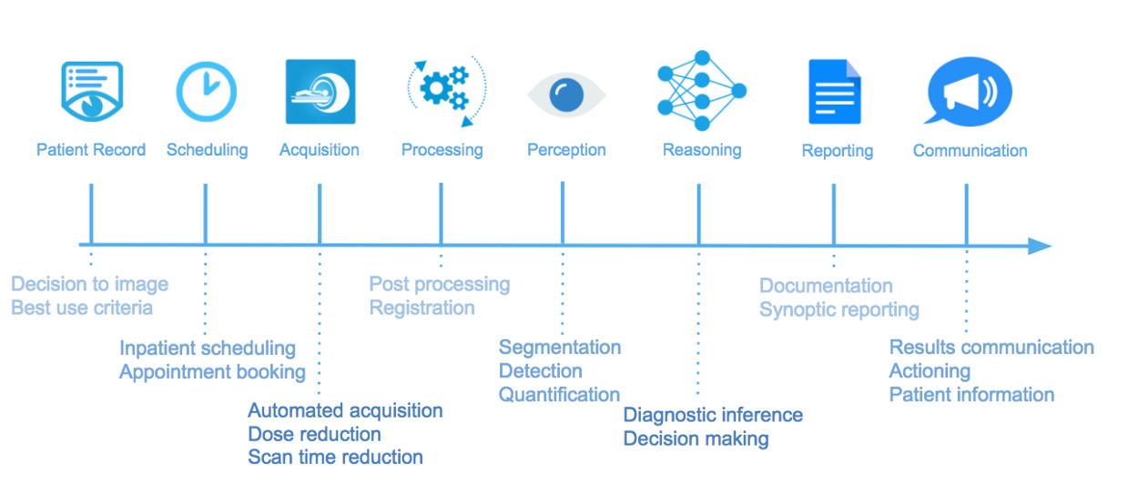
What is a medical diagnostics process

Slide 26
Example: early diagnostic system for lung cancer
AI system has identified the lung cancer with 94% accuracy
for 6716 cases
Model outperformed all six radiologists in the study with absolute reductions of 11% in false positives and 5% in false negatives.
Lung cancer caused 160,000 deaths in the United States
Diagnostic system is based on deep learning neural networks
https://www.nytimes.com/2019/05/20/health/cancer-artificial-intelligence-ct-scans.html

Slide 27
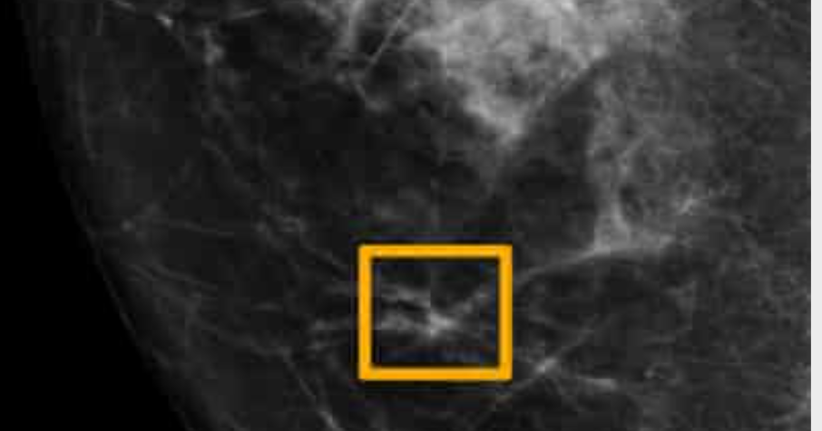
Example: early diagnostic system for breast cancer
Reliable automatically early diagnostic system of breast cancer can save lives
When compared with the US system, the AI produced 5.7% fewer false positives and 9.4% fewer false negatives.
Diagnostic system is based on deep learning neural networks
AI system outperforms experts in spotting breast cancer | Society | The Guardian.

Slide 28
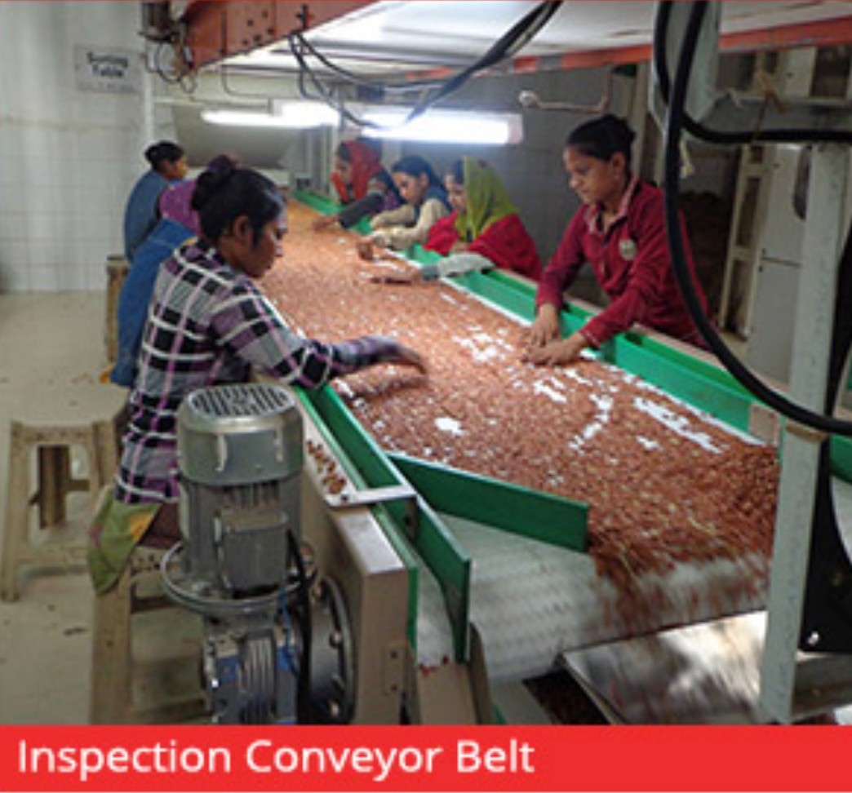
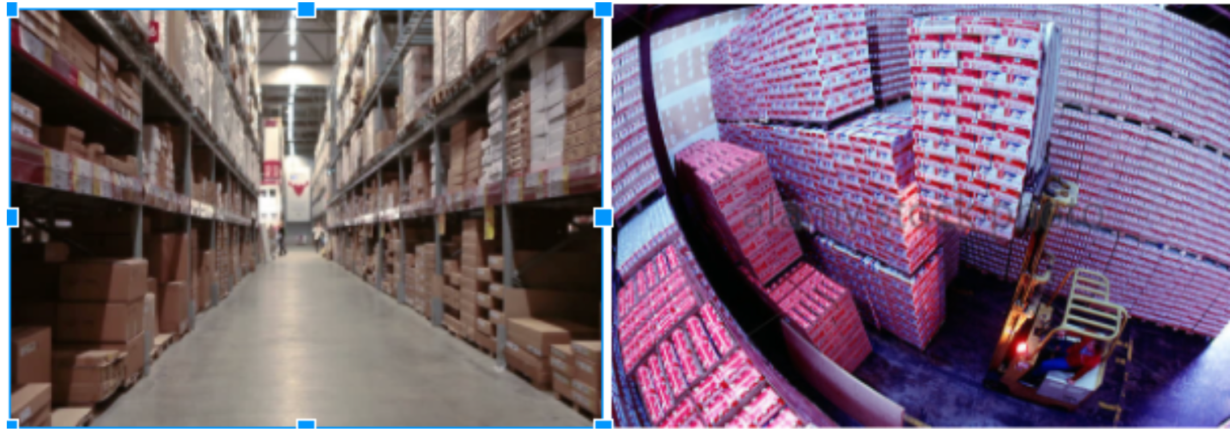
Image-based industrial quality control
Inventory management

Slide 29
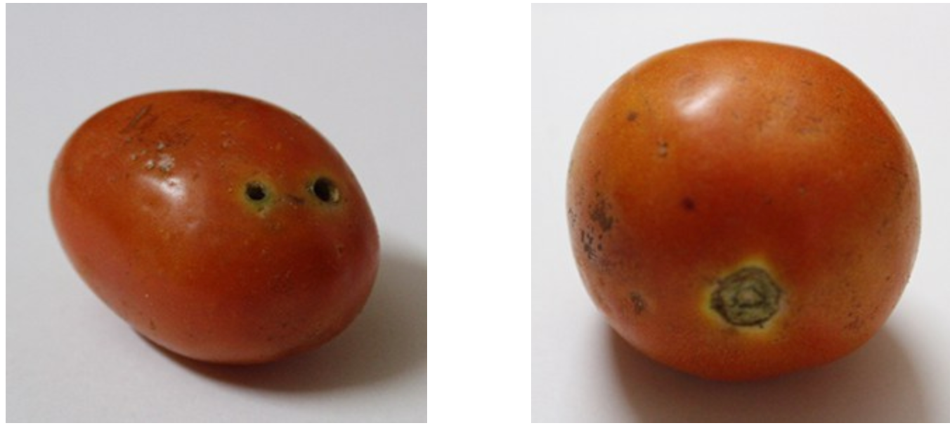
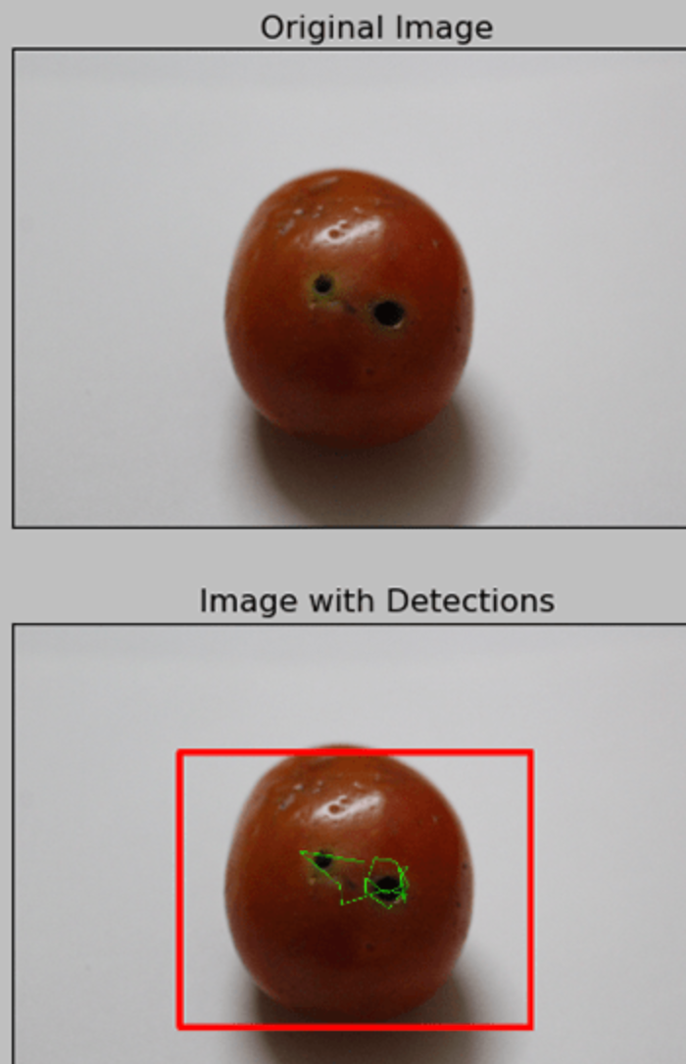
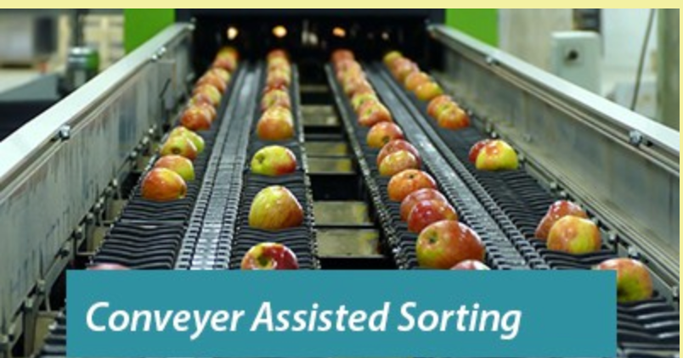
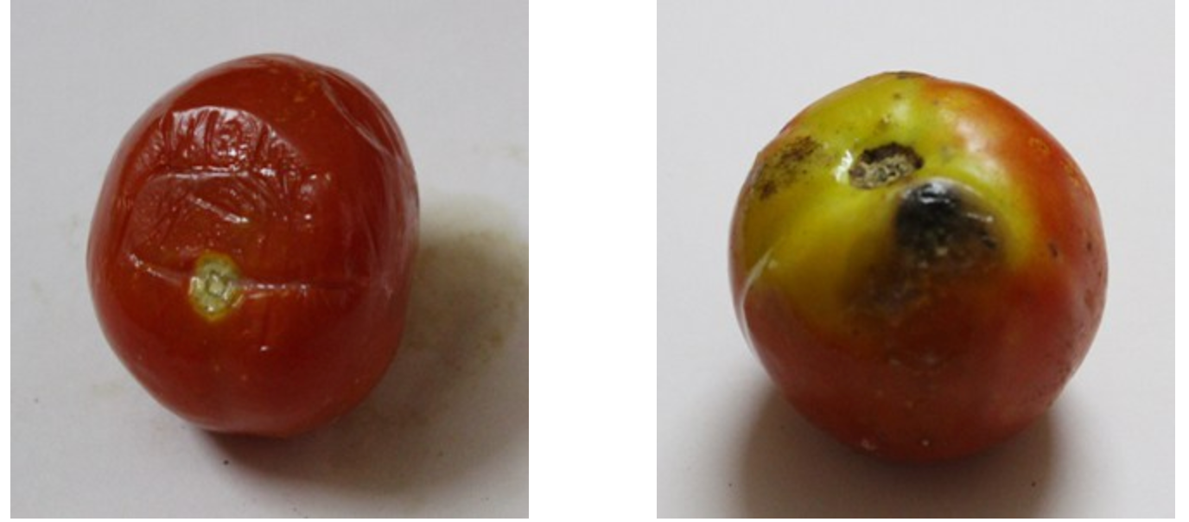
Image-based automated food quality inspection
https://radiostud.io/machine-learning-automated-food-quality-inspection/

Slide 30
Image-based industrial quality control: Wind Turbine Surface Damage Detection
Wind Turbine Surface Damage Detection using Deep Learning Algorithm

Slide 31
Some potential applications from images generated by autonomous vehicles
New opportunities to monetize new customer, product and operational insights based upon the autonomous vehicle’s interaction with its environment

Slide 32
Lecture 14 “Applied AI in Image Analysis” Summary
Convolution deep learning networks, Generative Adversary Networks (GANs)
and autoencoders are at the basis of applied AI in image analysis
The key capabilities of applied AI image analysis are image classification, localization and segmentation, and object detection
Applying AI to image analysis requires image data sets
Face recognition and image search are the most used AI-based image analysis applications
GANs are growing in popular applications of images with super resolution, image-to-image translation, and captioning
Medical diagnostics is an important application area of AI-based image analysis
Image-based quality control is another growing application area.
The Bottom Line
Applied AI has enormous capabilities to create value with sophisticated solutions based on image analysis

