Slide 1
왜 <콩쥐팥지>와 <신데렐라>는 똑같을까?
Why are <Kongji & Patji> and <Cinderella> same?
Kang Byoung Yoong

Slide 2
콩쥐팥쥐 vs Cinderella
01
Question
Who am I?

Slide 3
콩쥐팥쥐 vs Cinderella
02
Question
What do you call someone
who can speak 2 languages?

Slide 4
콩쥐팥쥐 vs Cinderella
03
Question
What do you call someone
who can speak 3 languages?

Slide 5
콩쥐팥쥐 vs Cinderella
04
Question
What do you call someone
who can speak 4 languages?

Slide 6
콩쥐팥쥐 vs Cinderella
05
Question
What do you call someone
who can speak 1 languages?

Slide 7
마음 ♥ Heart

Slide 8
문학 Literature

Slide 9
콩쥐팥쥐 vs Cinderella
06
Question
Why is literature so important?

Slide 10
Teaching & Enjoying

Slide 12
콩쥐팥쥐 vs Cinderella
07
Question
What is difference between literature and NF?

Slide 15
콩쥐팥쥐 vs Cinderella
08
Question
Who am I?

Slide 16
콩쥐팥쥐 vs Cinderella
09
Question
What is good literature?

Slide 17
Plot

Slide 18
You live. I live.
You die. I die.

Slide 19
You live. I live.
You die.
“Because of sadness” I die, too.

Slide 20
Plot
Sense of Causality

Slide 21
Pattern

Slide 22
World A→ World B→ World A
Go→ Experince → Come back
Become aware of

Slide 23
Kongji & Patji

Slide 24
콩쥐팥쥐 vs Cinderella
Kongji
Patji
Kongji’s mother died when Kongji was young. She grew up with her father. He remarried again. Her father died eventually. Her stepmother and stepsister, Patzzi treated Kongji very unfairly. Kongji was basically treated like a slave until some magical animals and an angel help change her fortunes
After a time, the town leader announced that he was looking for a wife. A dance would be given in his honour and every maiden was to attend. Kongji and Patzzi were invited. The stepmother was hopeful that Patzzi would be the lucky one, but afraid that Kongji would spoil her own daughter’s chance.
Before they left, the stepmother gave Kongji a huge sack of rice to the hull, which she had to accomplish before they returned from the dance. Kongji asked for help from the heavens. A fairy came down from heaven and dressed Kongji in a beautiful gown and a delicate pair of colourful shoes. Kongji hurried towards the dance.
Everyone admired her because of her beauty. The town leader went to her to ask her name. But when Kongji saw her stepmother and stepsister among the guests, she fled with terror.
As Kongji crossed a bridge, she tripped. One of her shoes fell into the stream. The town leader found the shoe and vowed to marry the woman it belonged to...

Slide 25
콩쥐팥쥐 vs Cinderella
10
Question
What and how makes stories similar?

Slide 26
Collective Unconsciousness

Slide 27
Universality

Slide 29
콩쥐팥쥐 vs Cinderella
11
Question
Why is literature so important?

Slide 30
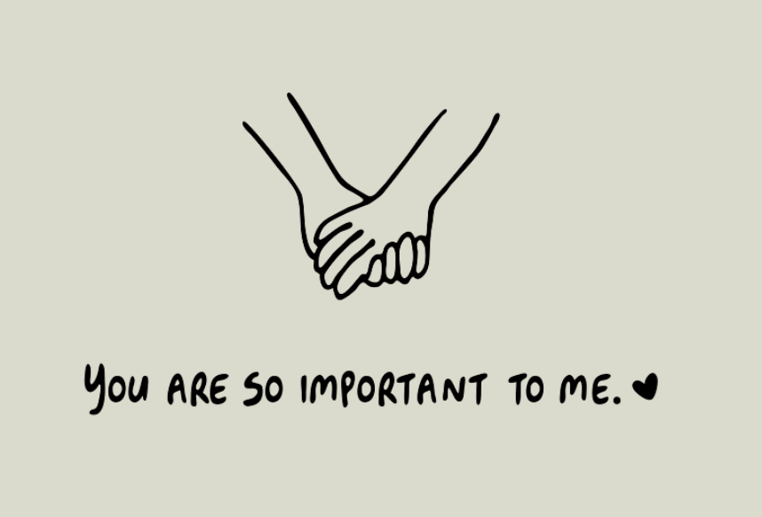
YOURSELF

Slide 31
고맙습니다!
Благодаря ти!
Kang Byoung Yoong

