Slide 1
Applied Artificial Intelligence Lecture 21 Problem Knowledge Acquisition
Arthur Kordon
Kordon Consulting LLC

Slide 2
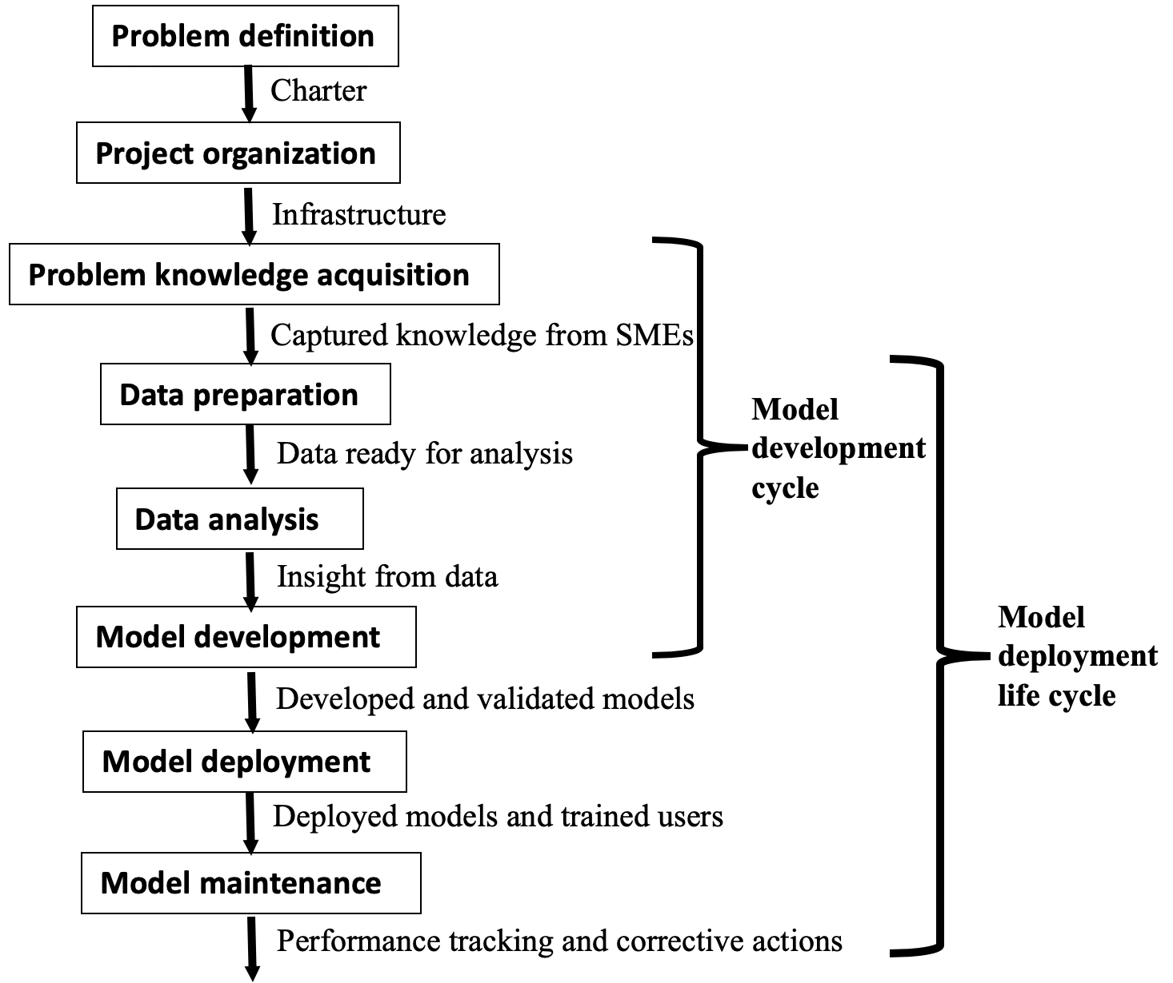
Methodology workflow

Slide 3
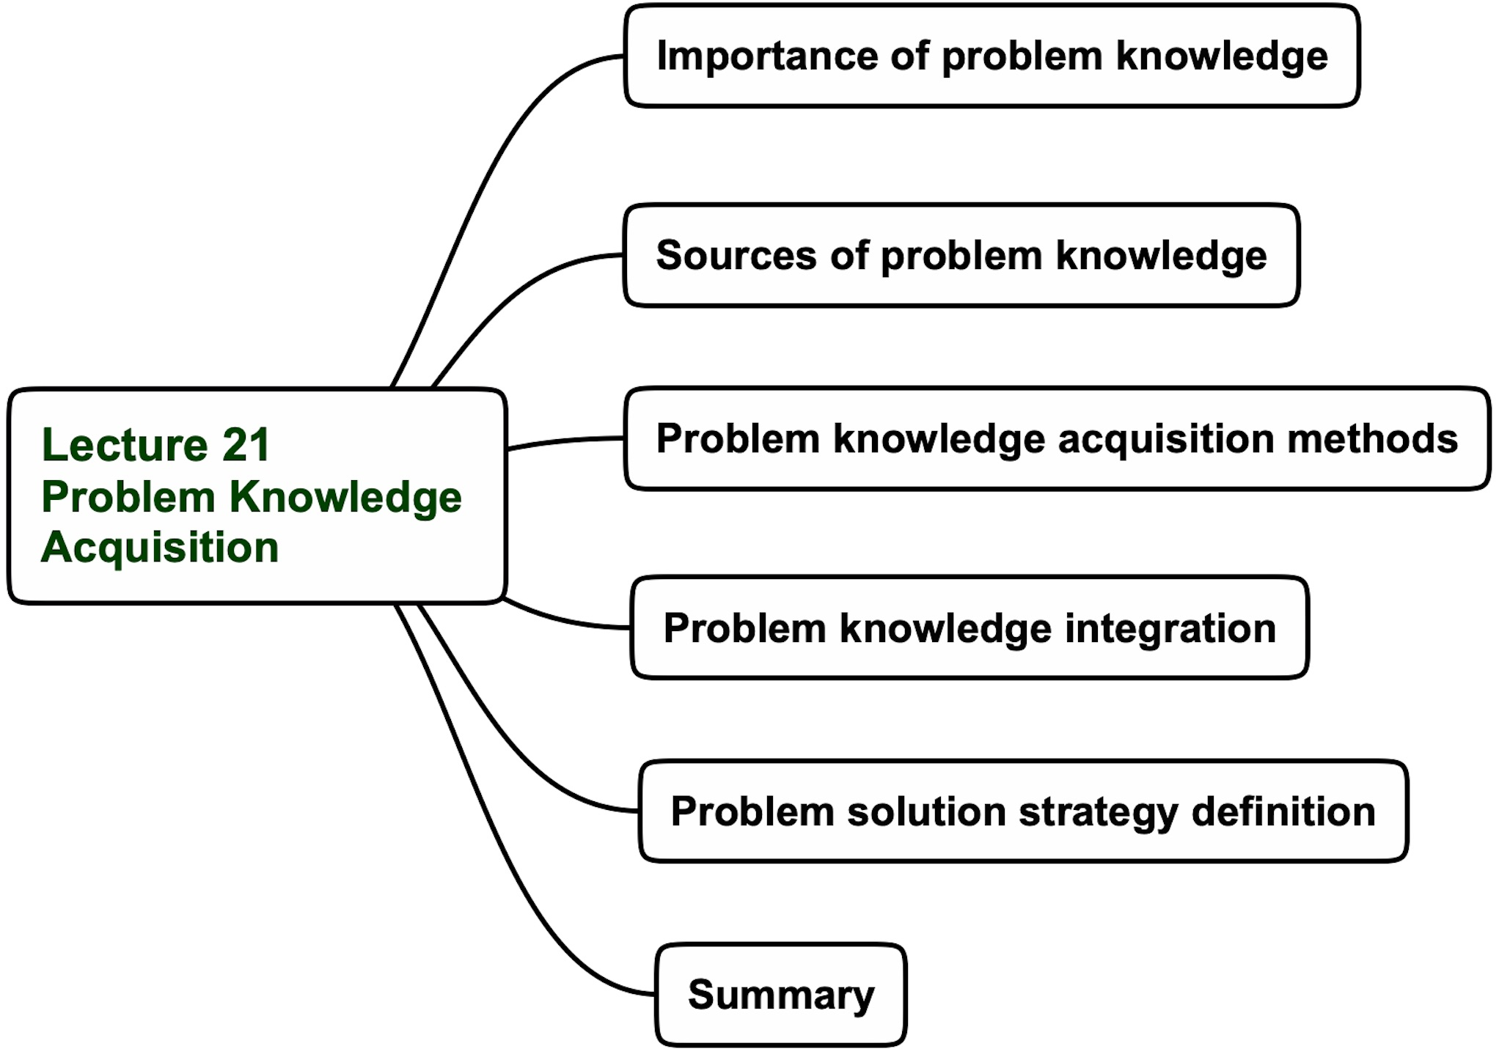
Lecture 21 agenda

Slide 4
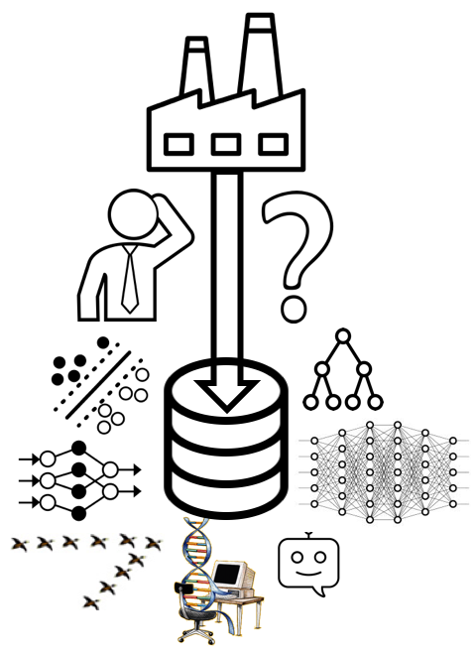
Data-centric real-world problems solution
Desired solution
Project starting position

Slide 5
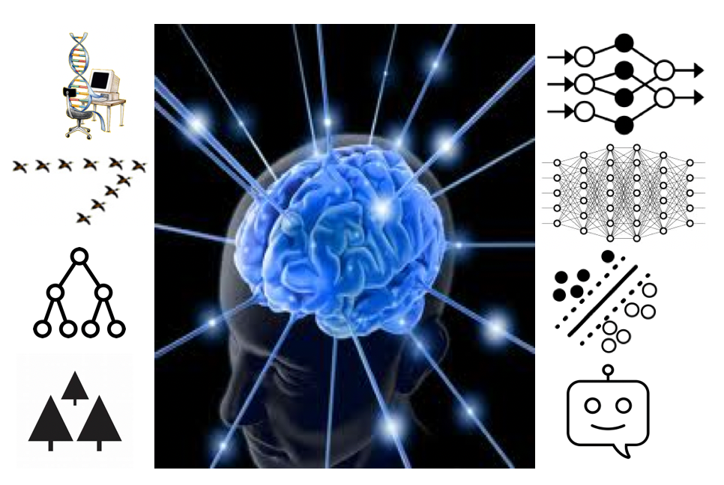
Knowledge acquisition-centric real-world problems solution
Desired solution
Project starting position

Slide 6
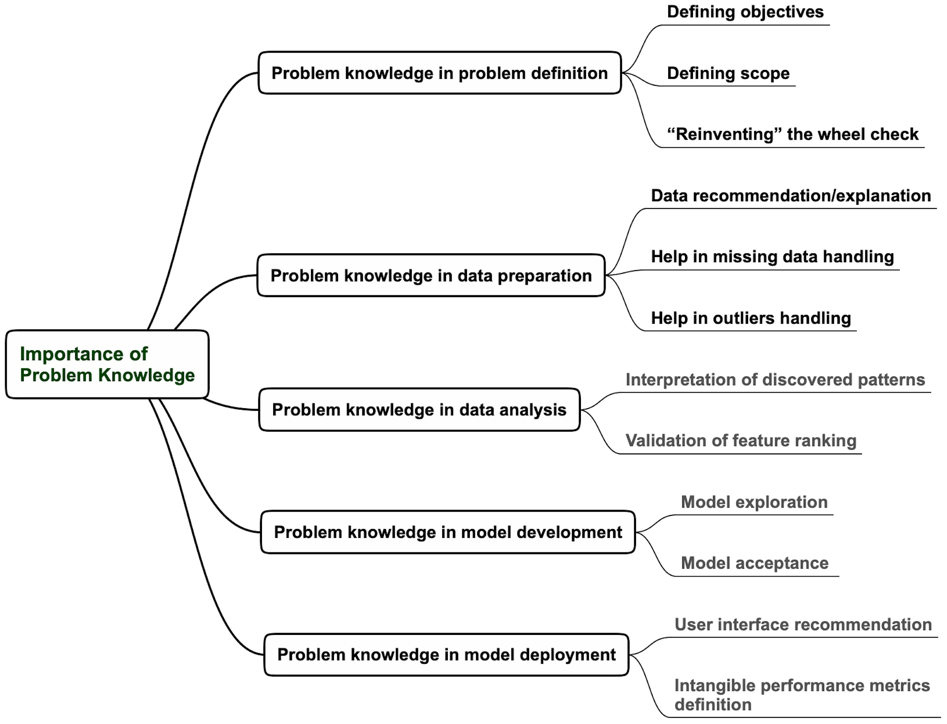
Importance of problem knowledge

Slide 7
Lecture 21 agenda

Slide 8
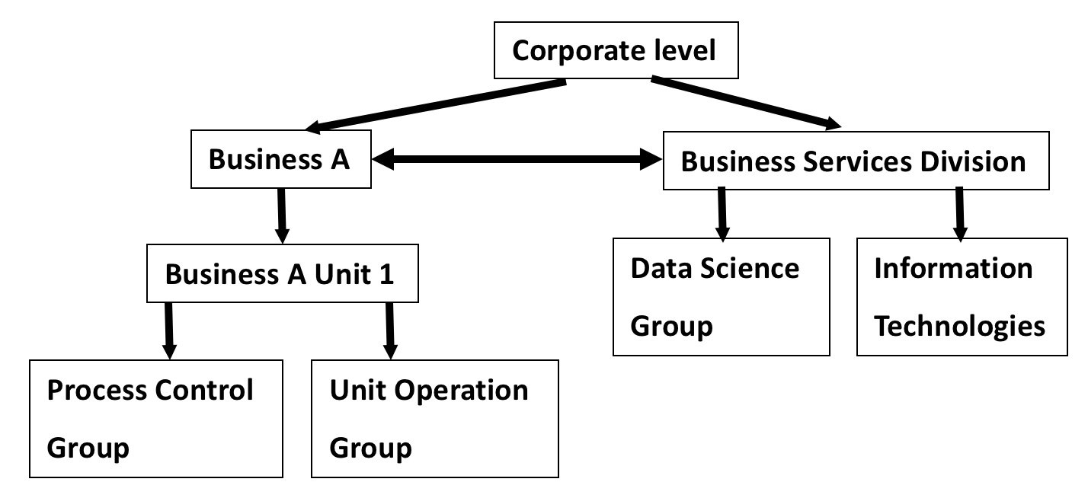
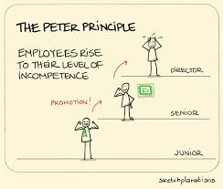
Sources of problem knowledge
Subject Matter Experts (SMEs)
Business structure (decision-making diagram)

Slide 9
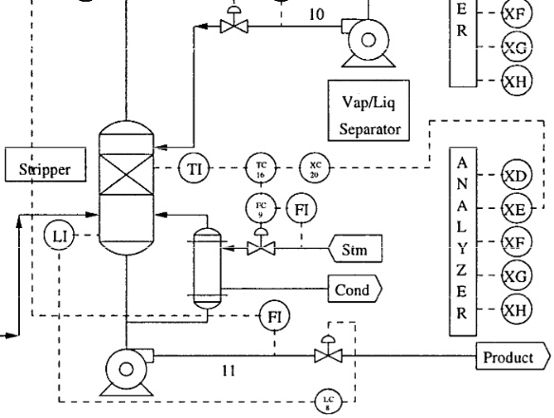
Sources of problem knowledge
Process diagrams
Process documentation

Slide 10
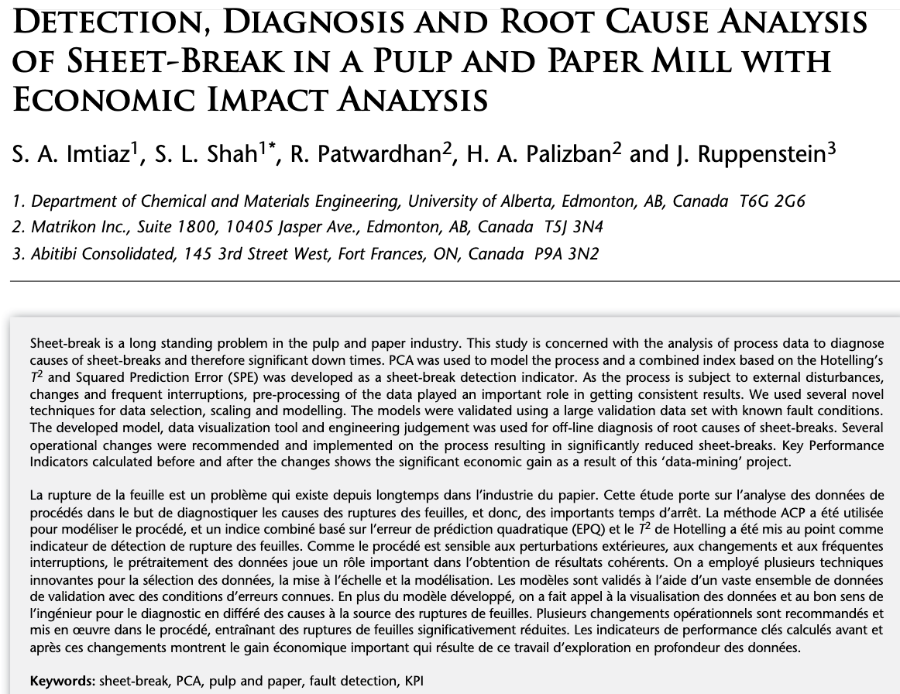
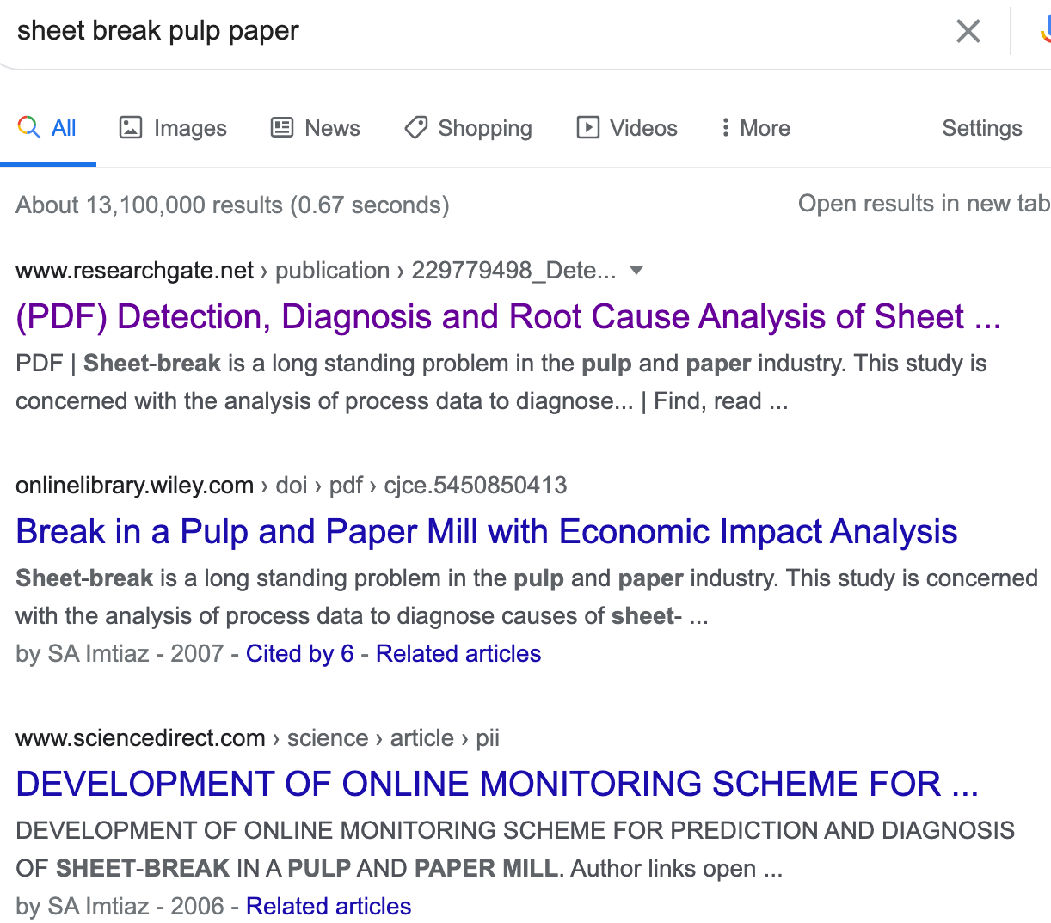
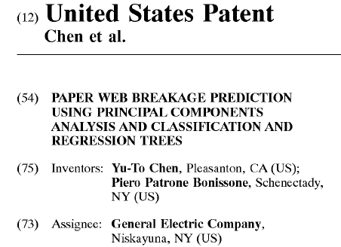
Sources of problem knowledge
Papers
Googling
Patents

Slide 11
Lecture 21 agenda

Slide 12
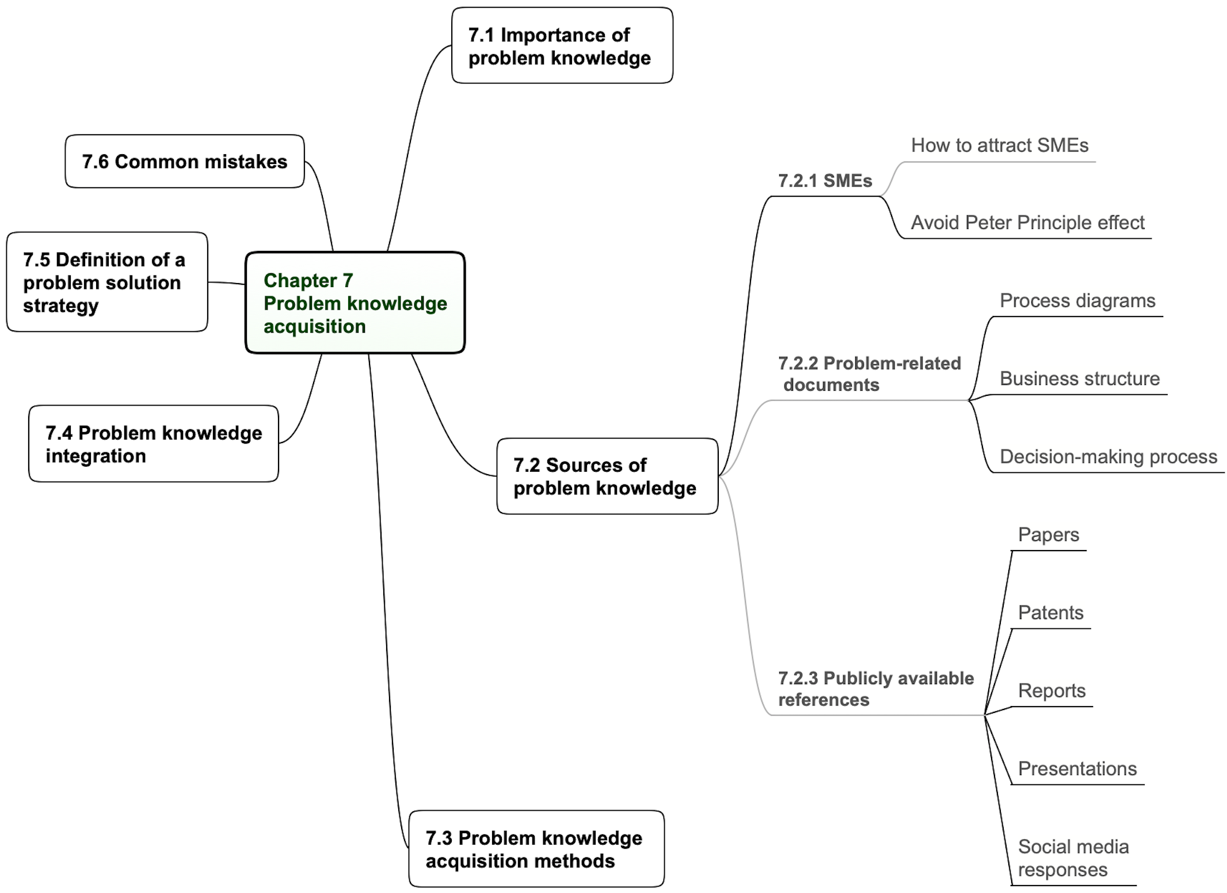
Mind-mapping

Slide 13
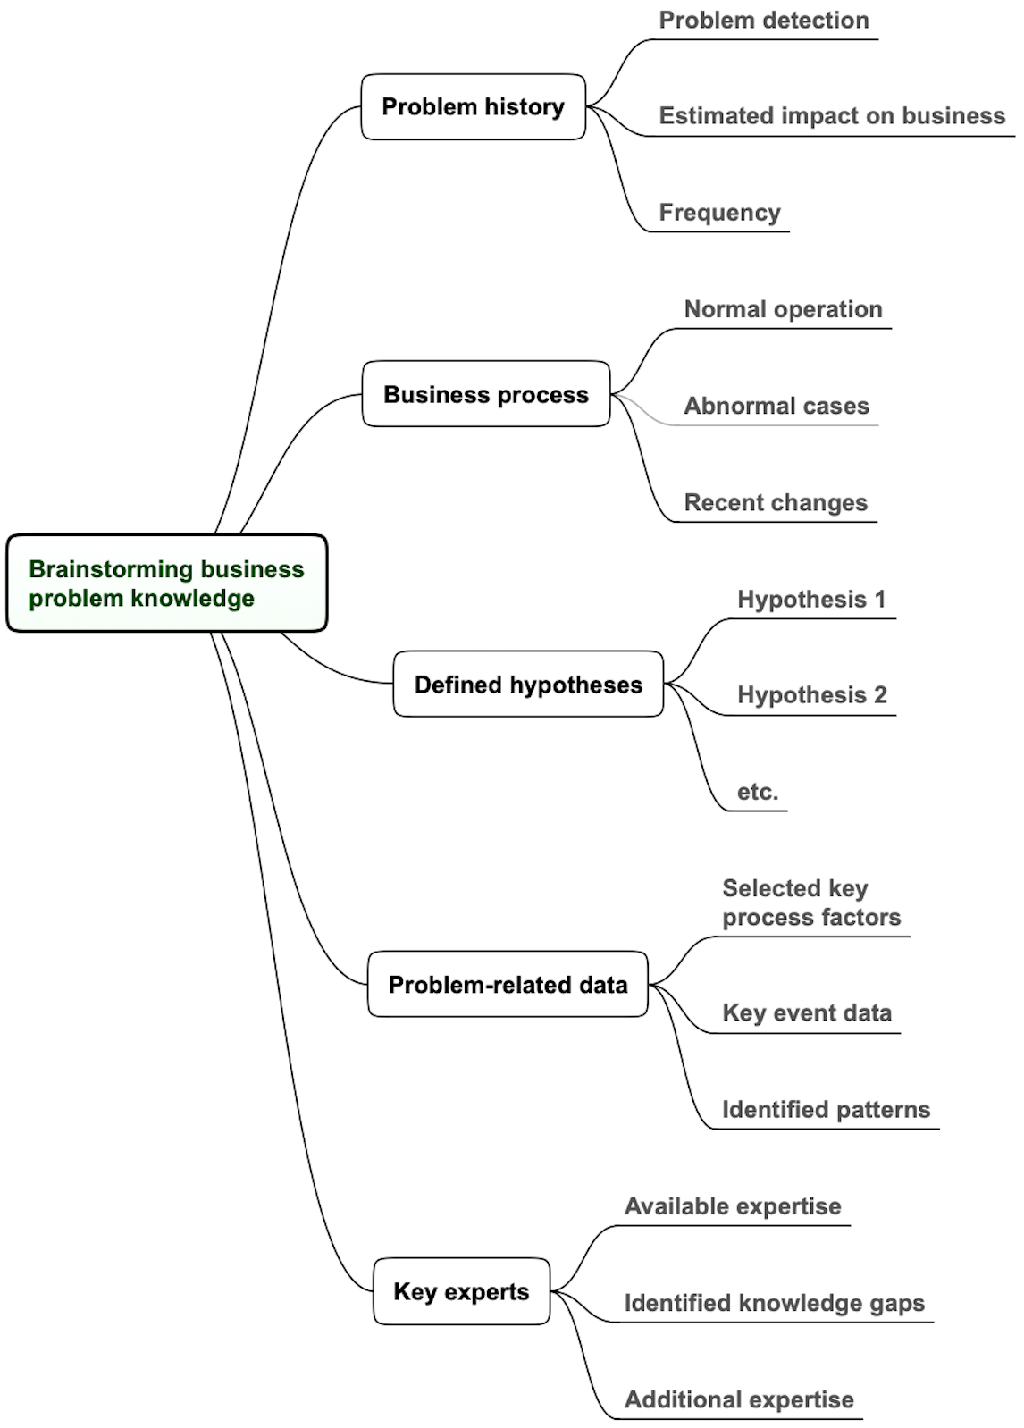
Brainstorming

Slide 14
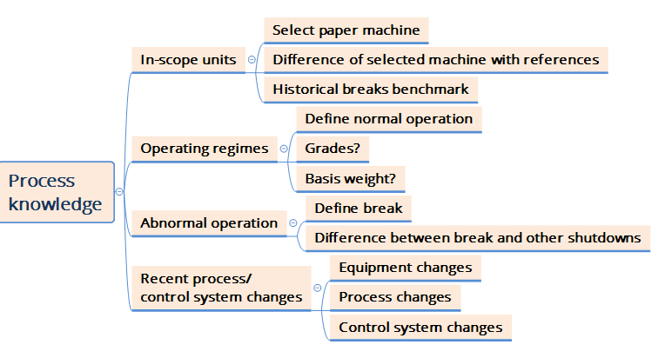
Brainstorming example

Slide 15
Lecture 21 agenda

Slide 16
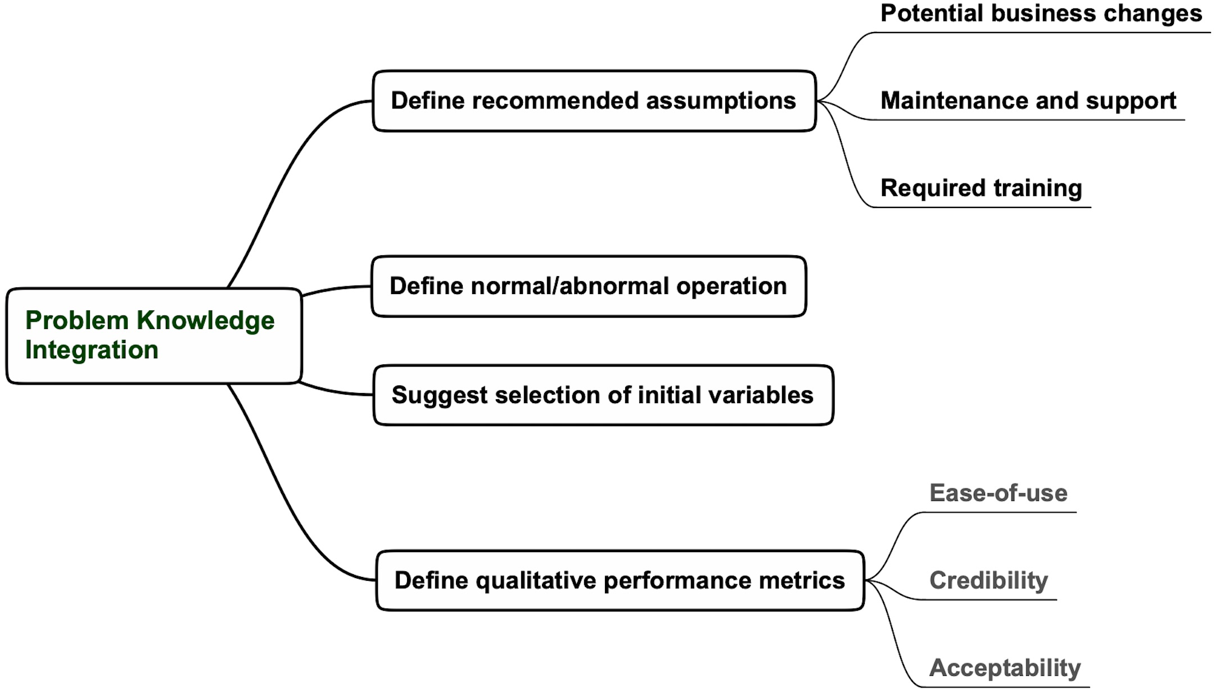
Problem knowledge Integration

Slide 17
Lecture 21 agenda

Slide 18
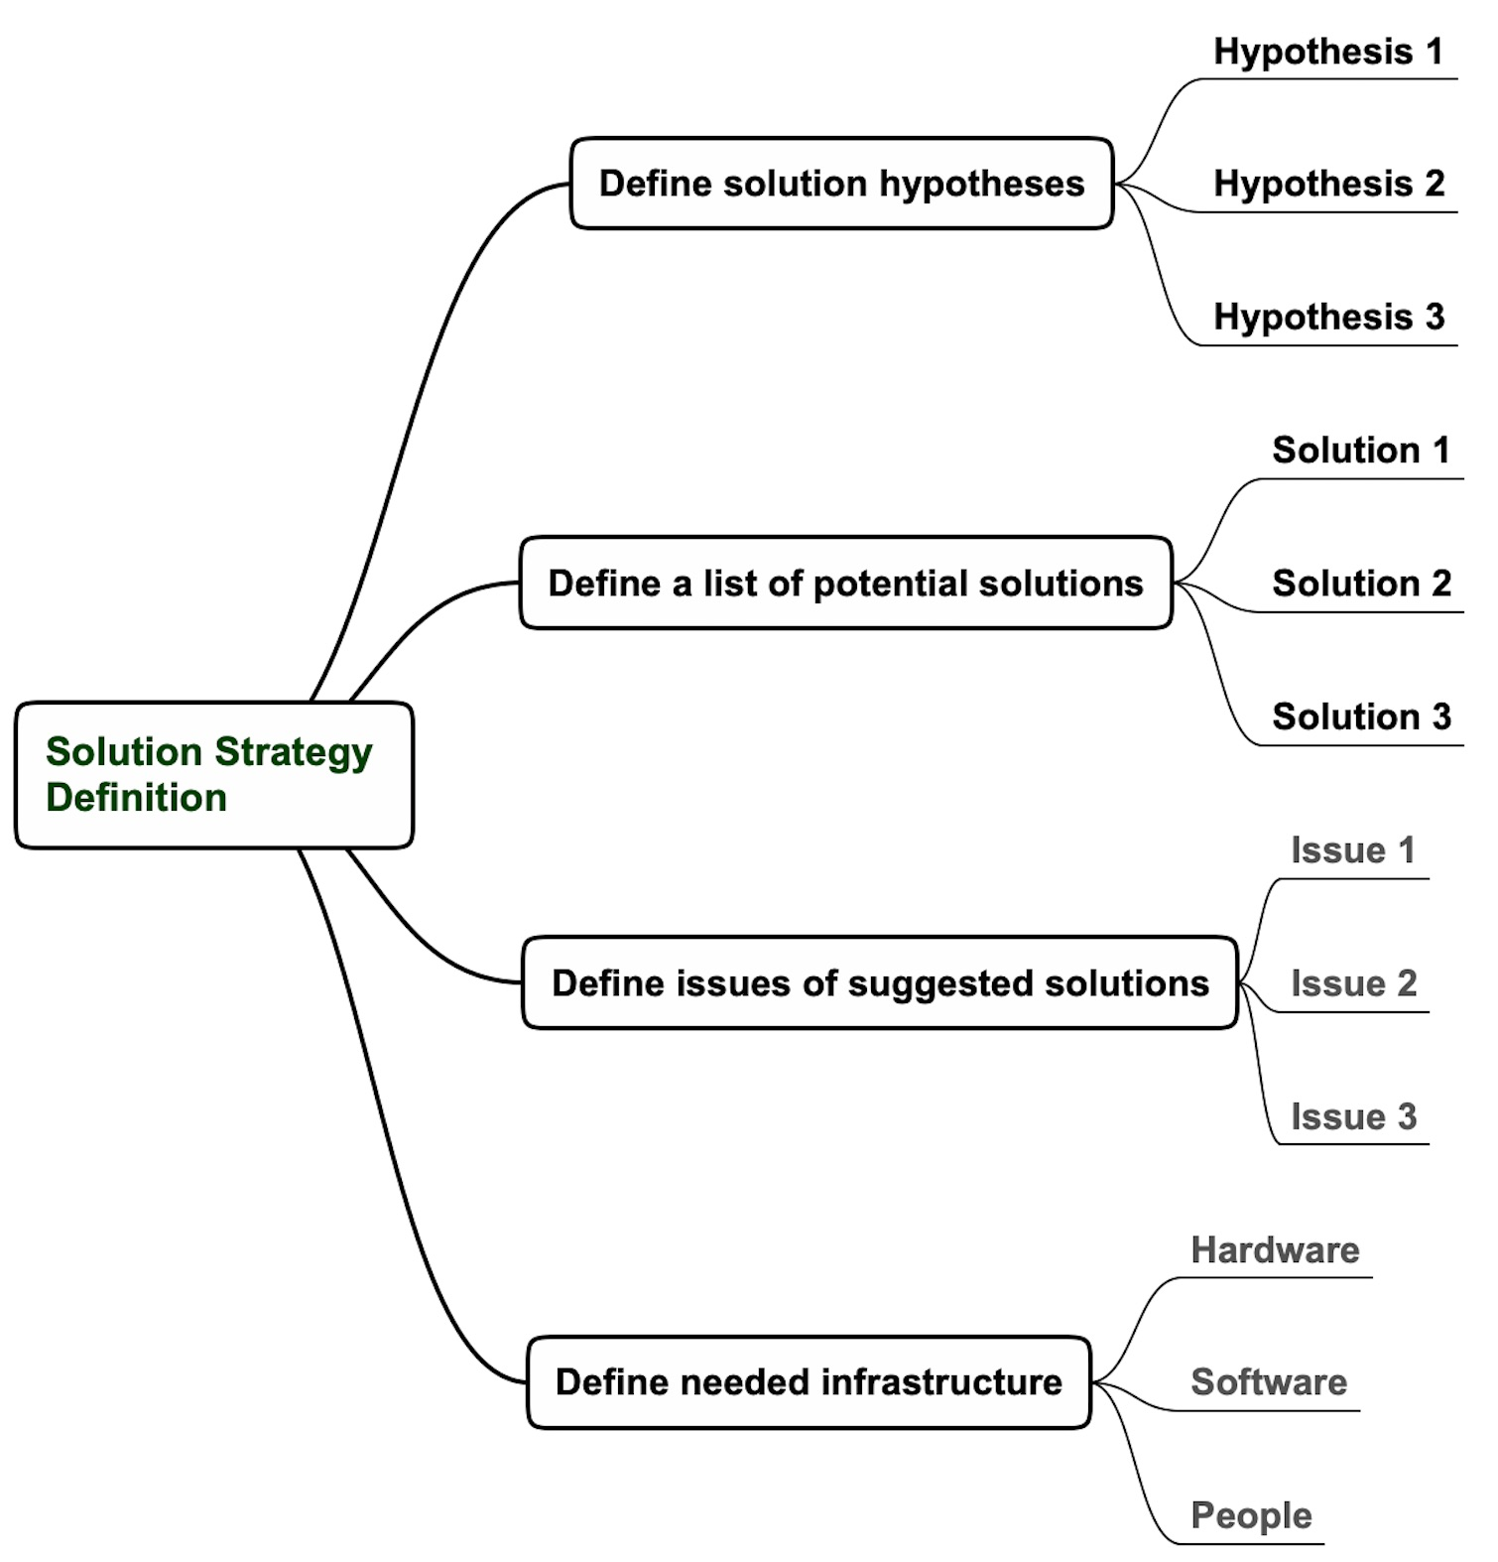
Problem solution strategy definition
Switch from Problem to Solution Space
only after knowledge acquisition
Nonlinear relationship with emissions
Examples from emissions estimator project
Genetic programming
Performance degradation with time
Powerful laptops

Slide 19
Lecture 21 “Problem knowledge acquisition” Summary
Problem knowledge acquisition significantly increases AI development efficiency
Problem knowledge is needed in all steps of the AI development methodology
The critical internal sources of problem knowledge are SMEs and available internal documents
The key external sources of problem knowledge are Google searches, papers, and patents
Mind-mapping and brainstorming are recommended for effective knowledge acquisition
Problem knowledge is integrated by defining assumptions, normal/abnormal operation, qualitative performance metrics, and suggesting a starting list of variables
The problem-solution strategy is defined after knowledge acquisition.
The Bottom Line
Problem knowledge acquisition extracts the relevant human intelligence for developing successful AI-based solutions

Slide 20
Details on this topic are given in the following chapters of “Applying Data Science” book: Chapter 7

