Slide 1
Applied Artificial Intelligence
Lecture 19
Selecting and Defining Real-World Problems Appropriate for AI
Arthur Kordon
Kordon Consulting LLC

Slide 2
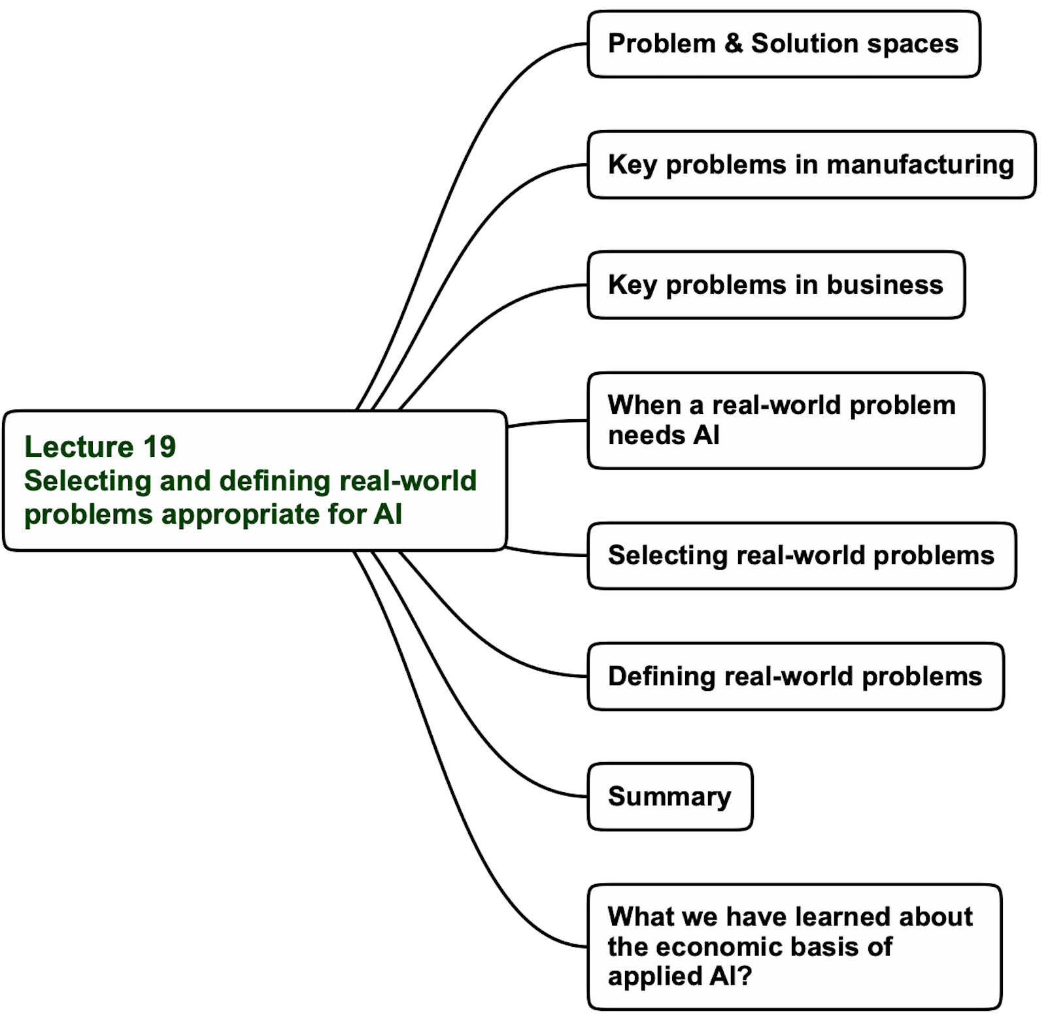

Lecture 19 agenda

Slide 3




Problem & Solution space
Solution space
Translation
Problem space
Prediction
Raw materials forecasting
Forecasting
Classification
Reduce steam consumption
Cost
Clustering
Association
Reduce machine breakdown
Optimization
Simulation
Product quality estimate in real time
Recommendation
Profit
Price elasticity analysis
Root-cause discovery
Solution-specific language
Business-specific language
Translate problems and solutions in Plain English
Notes:
3

Slide 4
Lecture 19 agenda

Slide 5
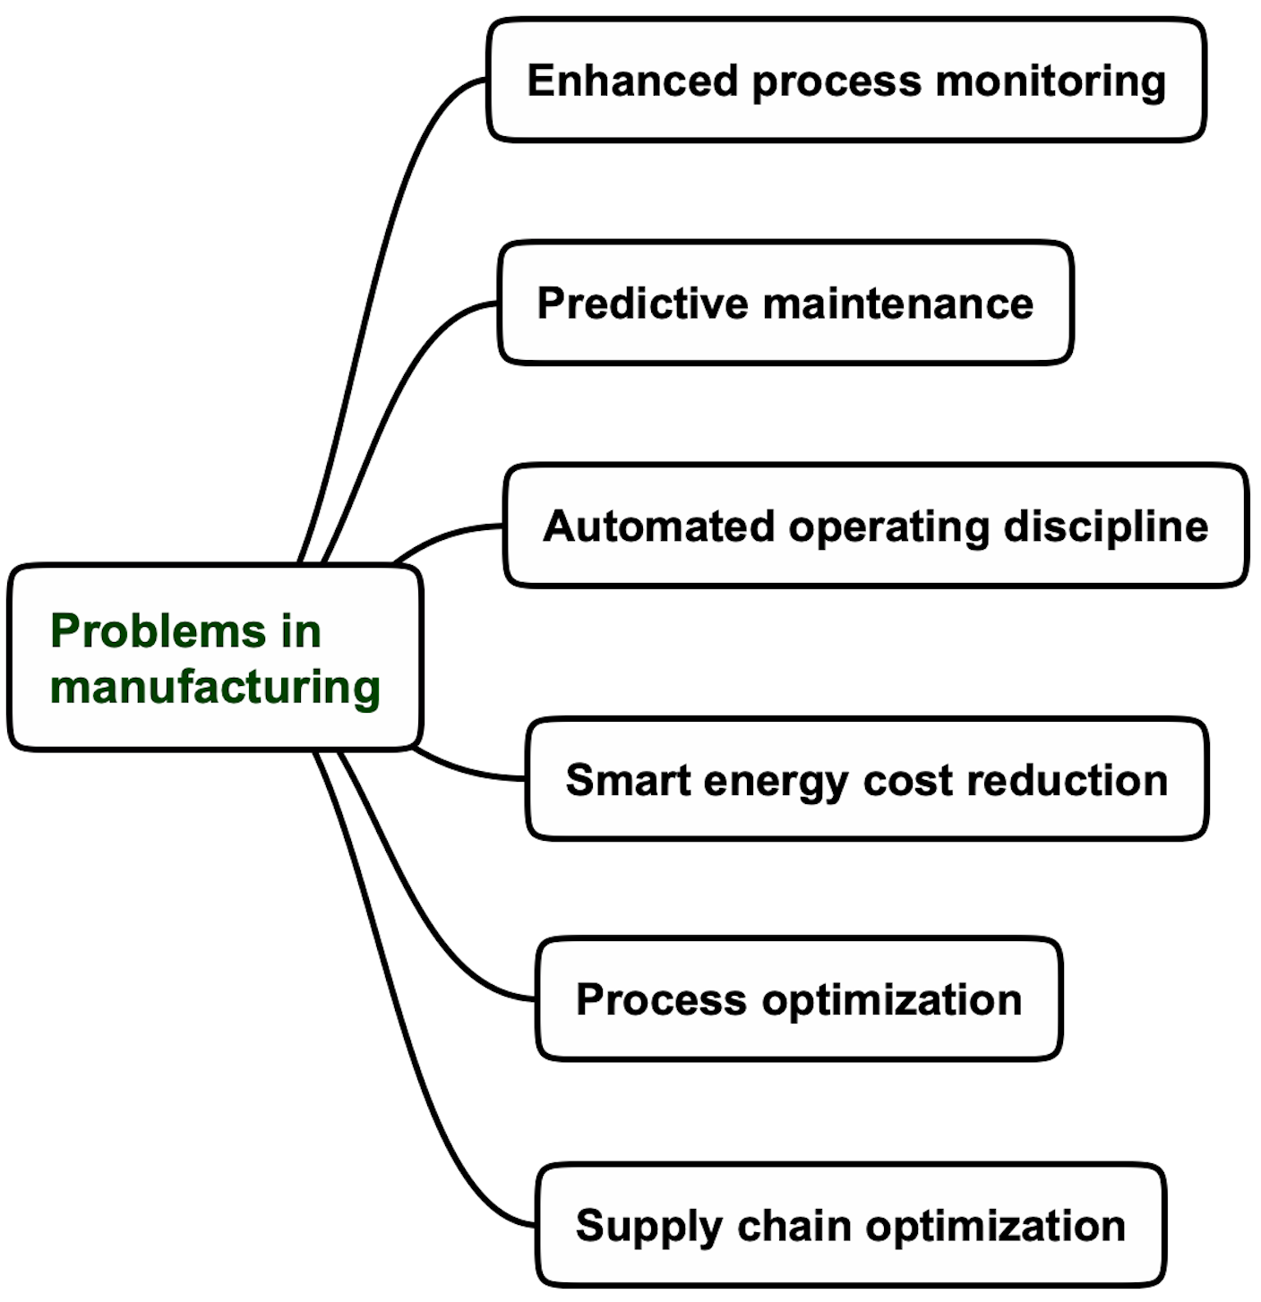
Key problems in manufacturing

Slide 6
Lecture 19 agenda

Slide 7
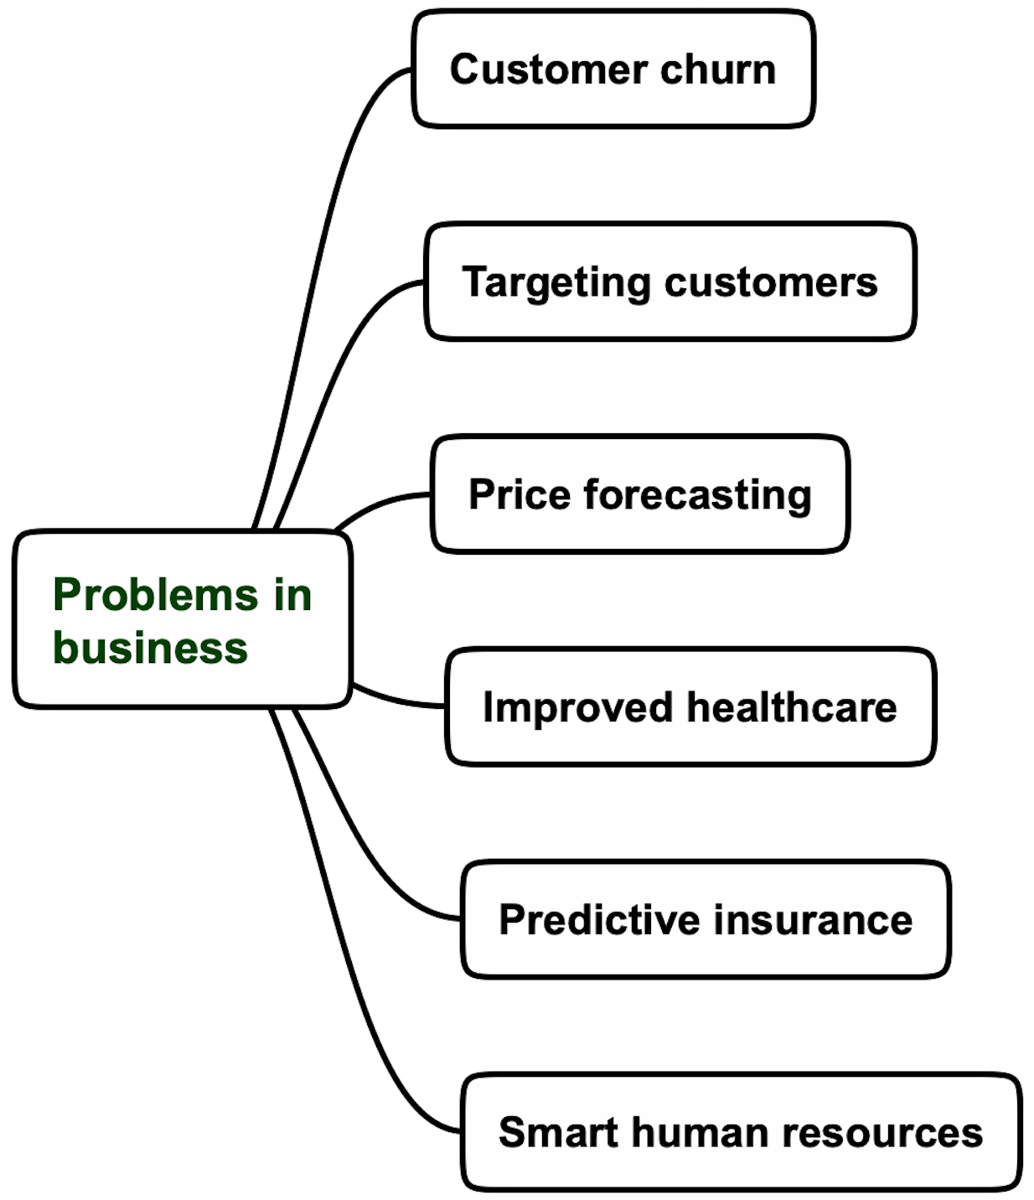
Key problems in business

Slide 8
Lecture 19 agenda

Slide 9
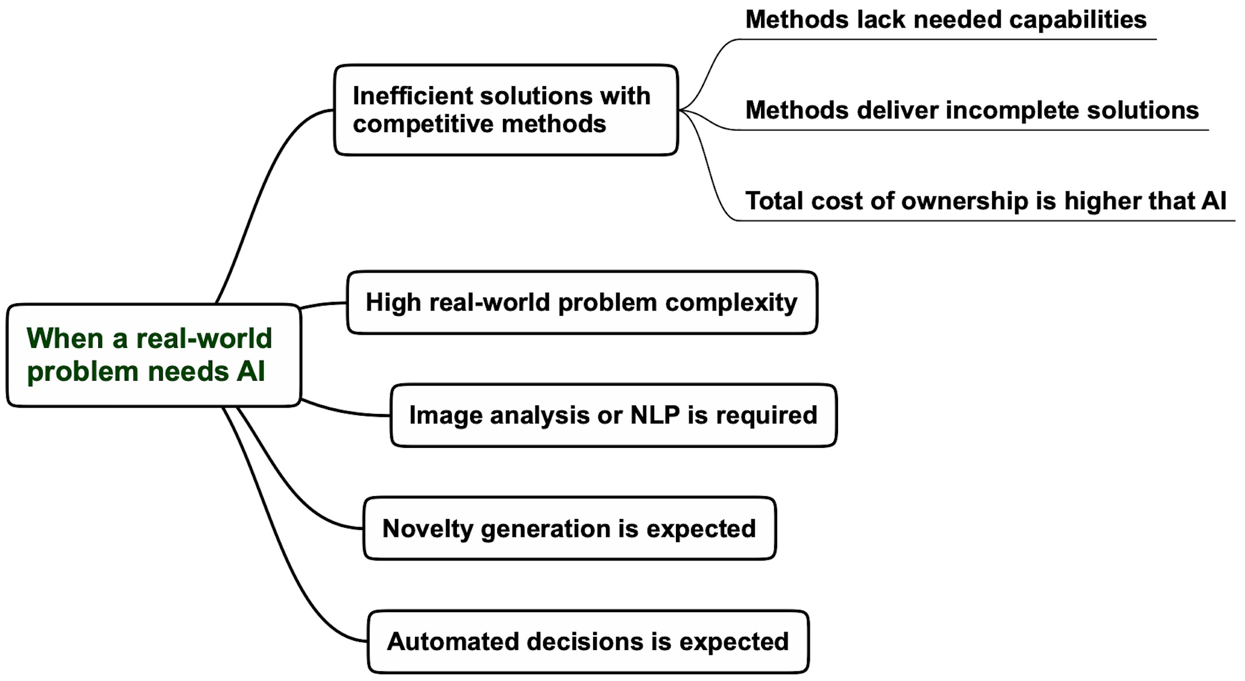
When a real-world problem needs AI?

Slide 10
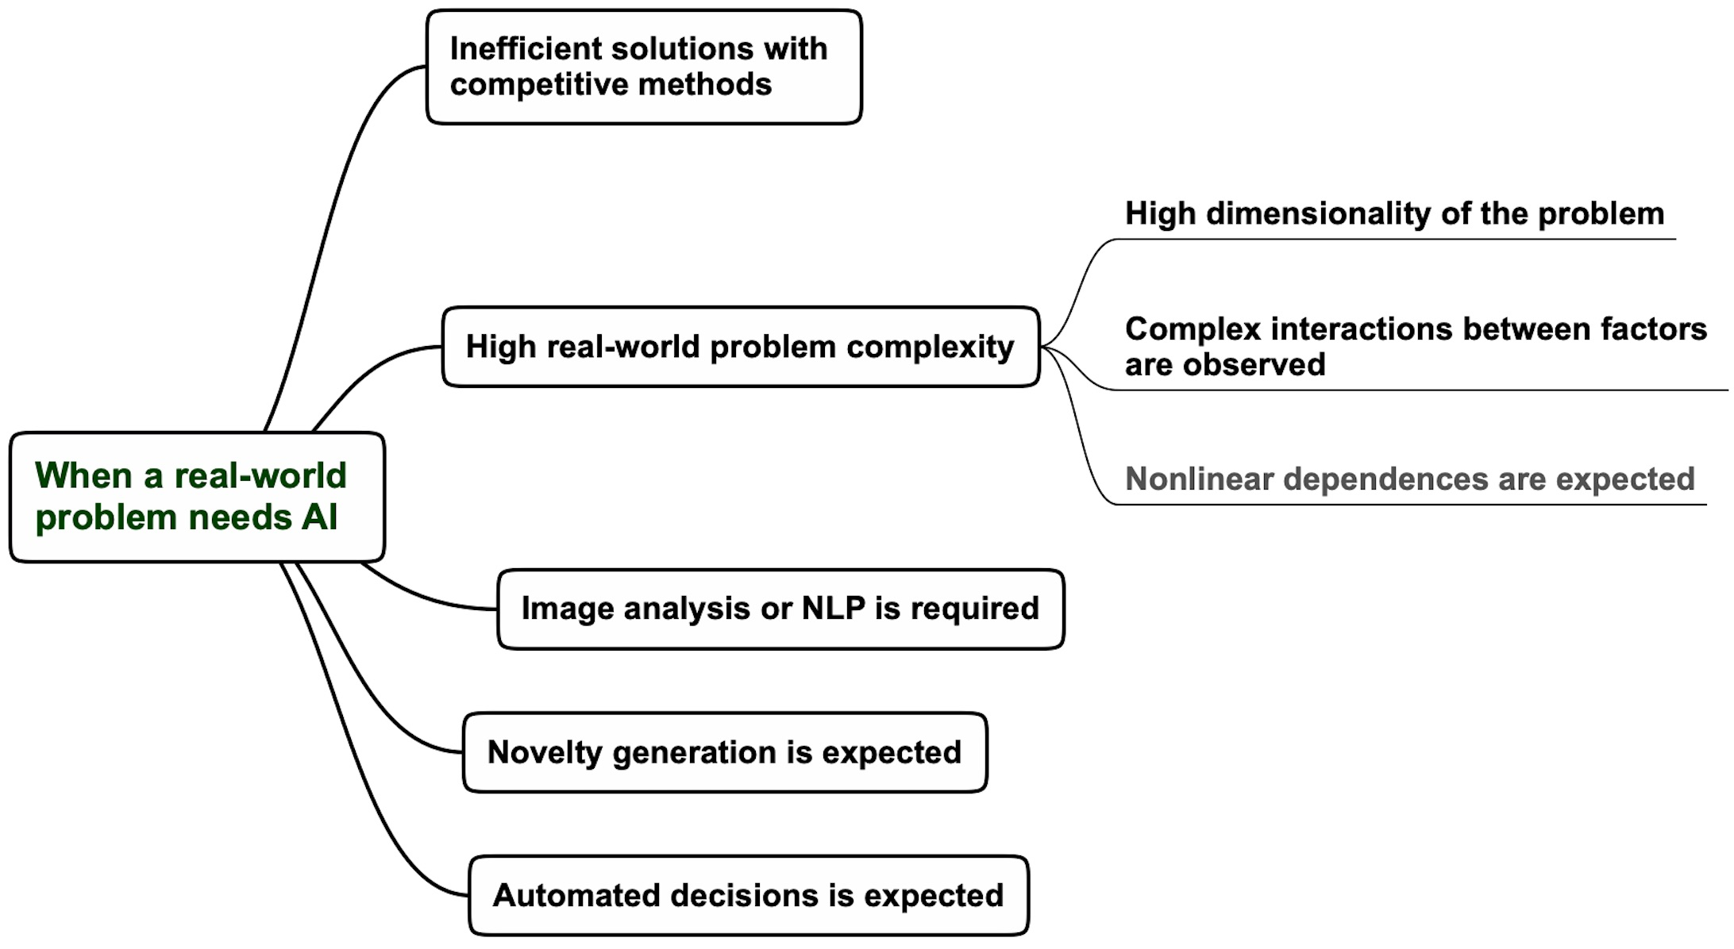
When a real-world problem needs AI?

Slide 11
When a real-world problem needs AI?

Slide 12
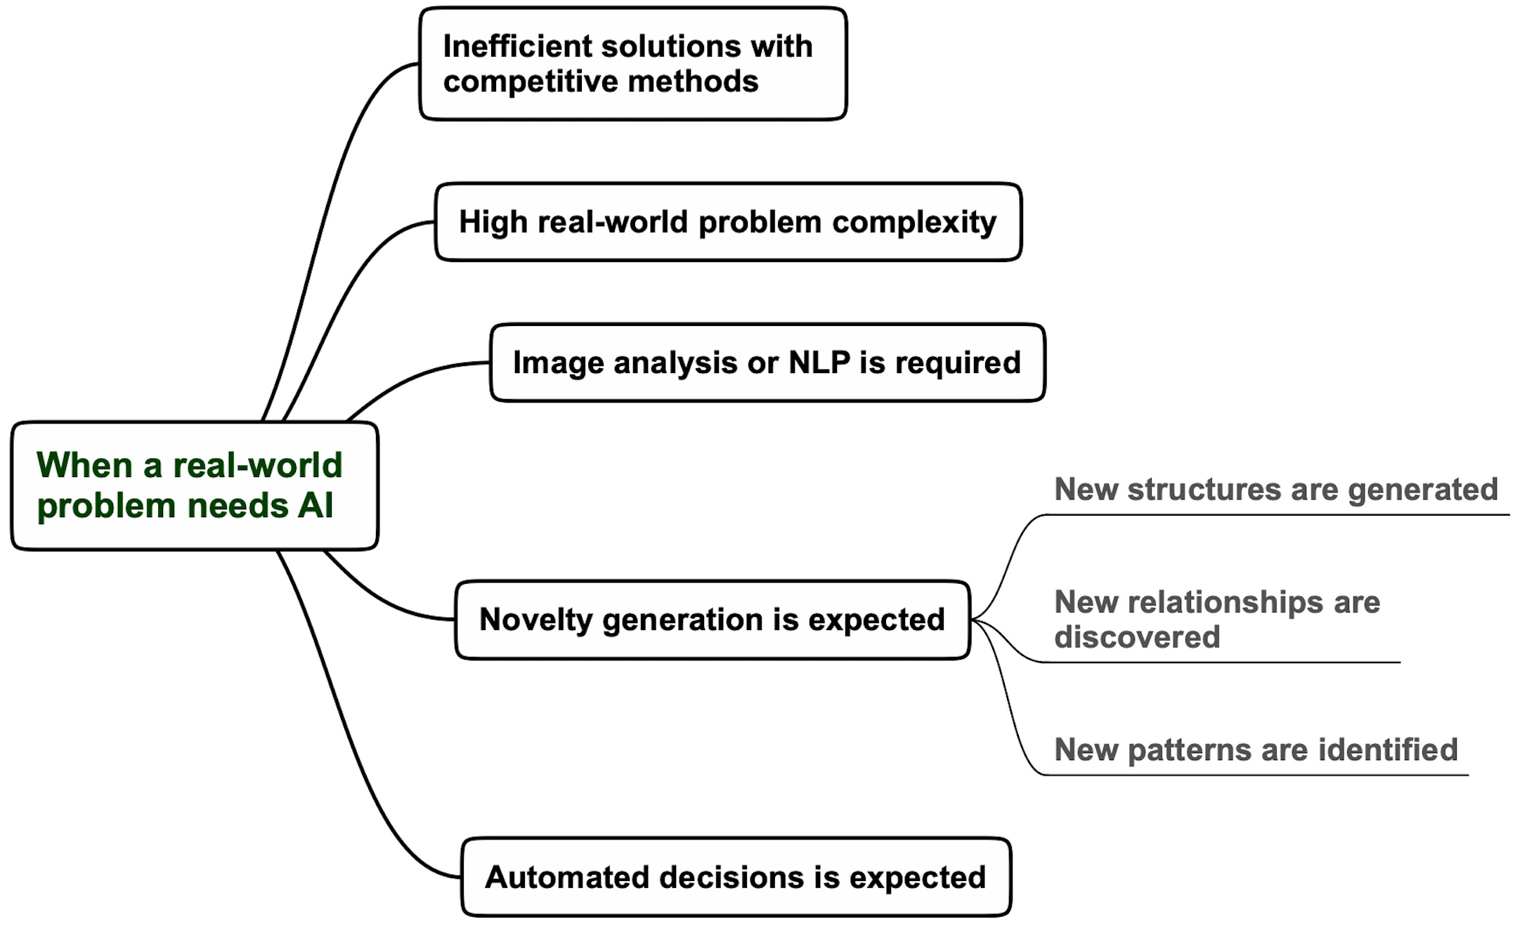
When a real-world problem needs AI?

Slide 13
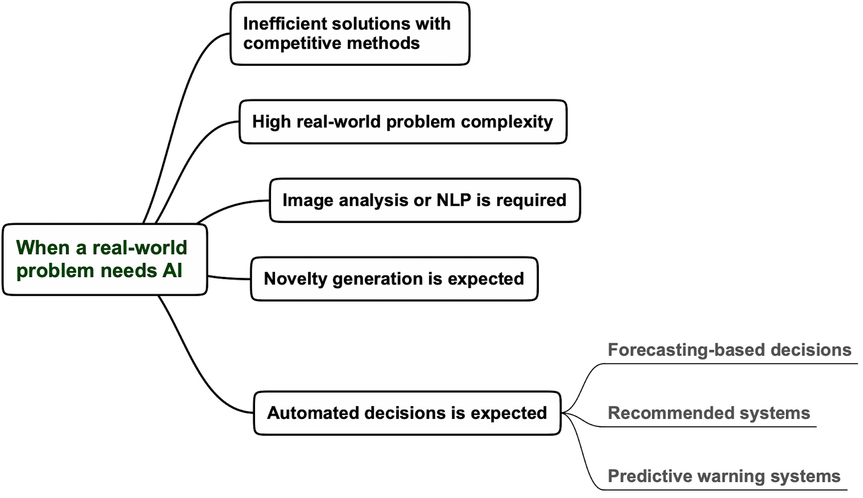
When a real-world problem needs AI?

Slide 14
Lecture 19 agenda

Slide 15

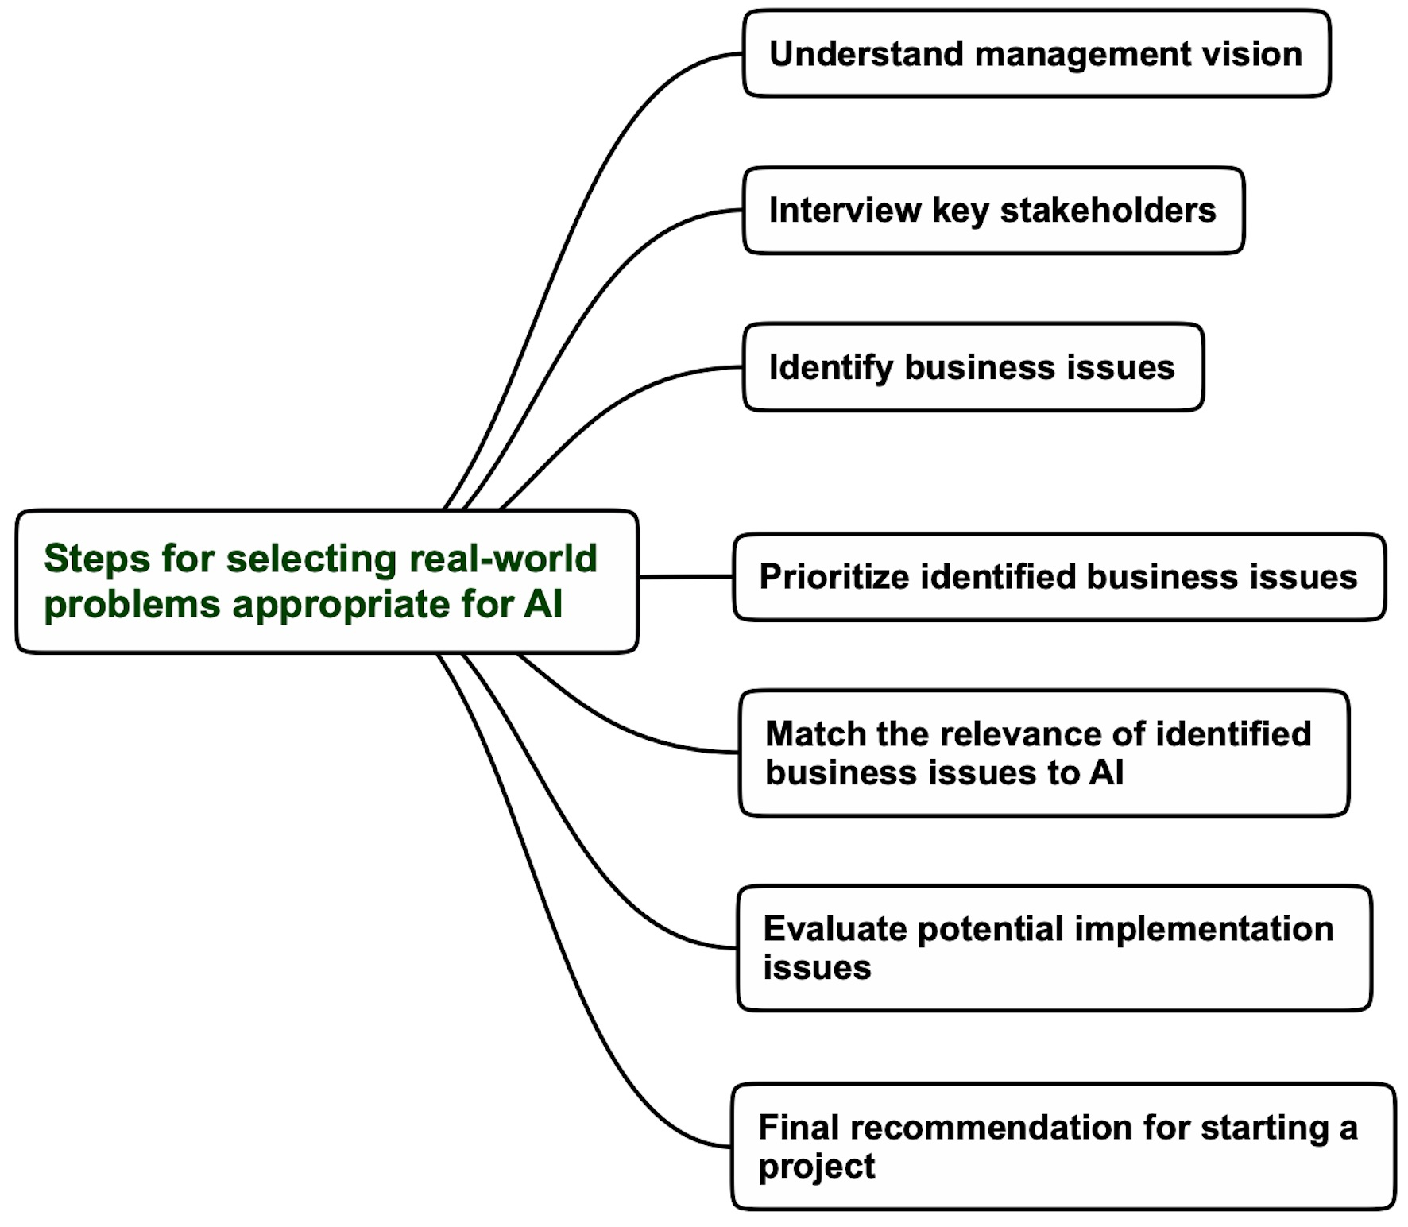
Key steps for selecting real-world problems
AI will increase our productivity in 10%
Where is the
biggest mess?

Slide 16
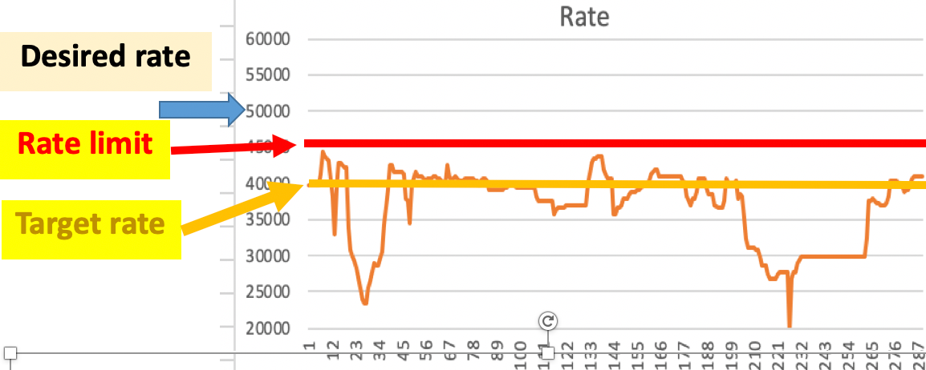

Key steps for selecting real-world problems
Three business issues identified
Predictive maintenance
(reduce paper machines breaks)
Emissions estimation
(increase production rate)
Steam consumption reduction

Slide 17
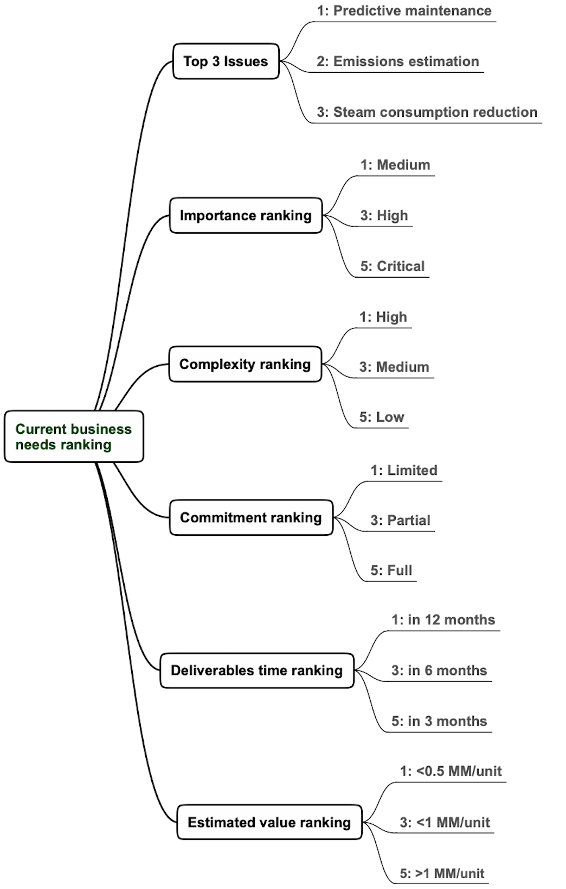
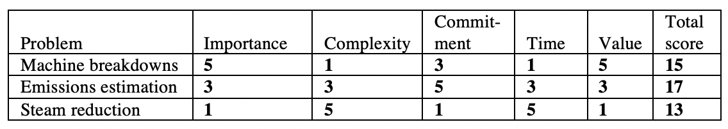
Identified real-world problems ranking process
The final ranking of three identified business problems

Slide 18
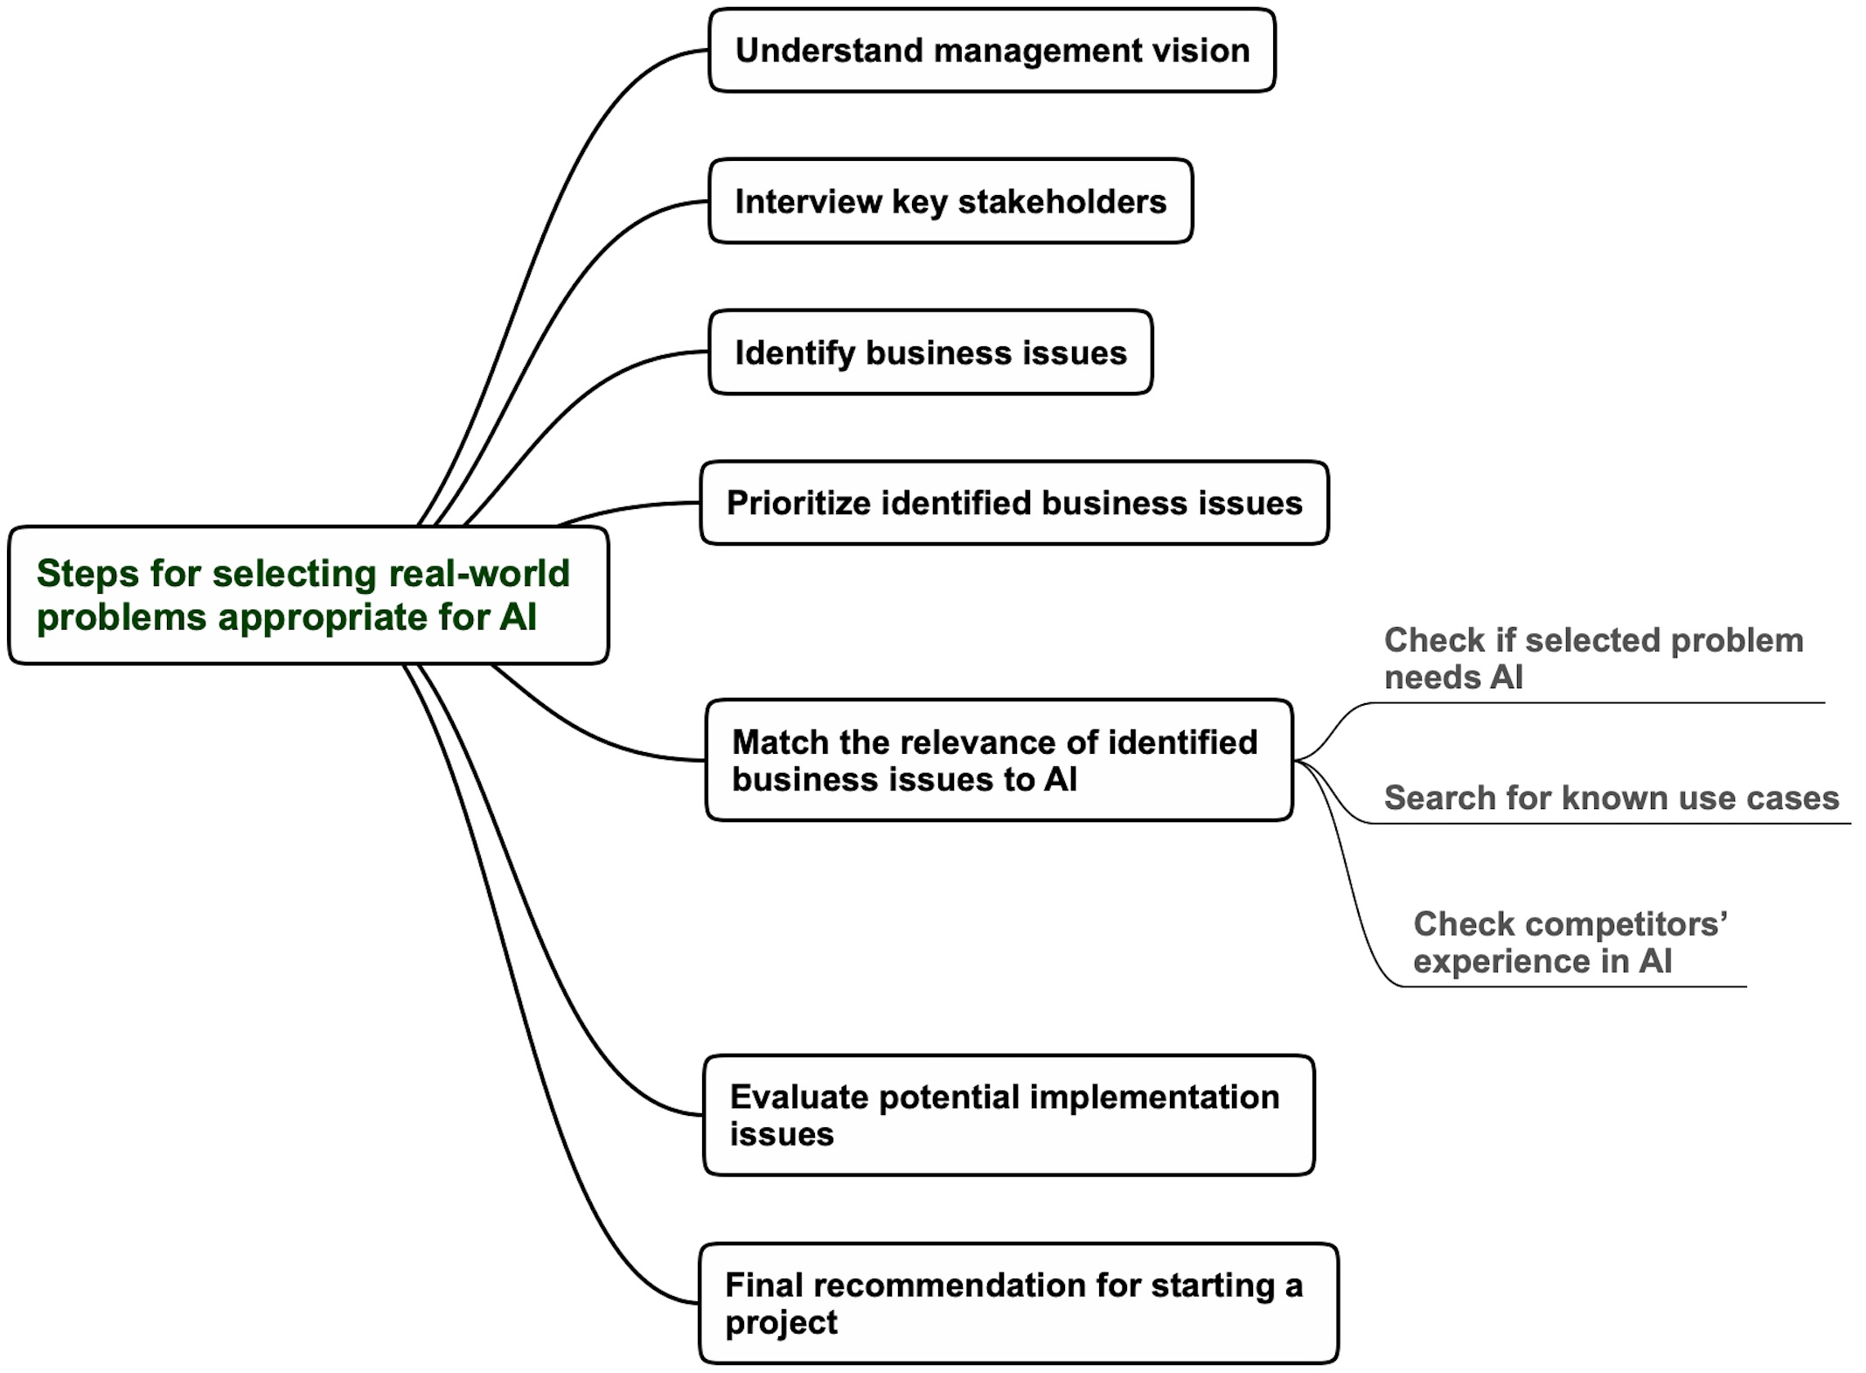
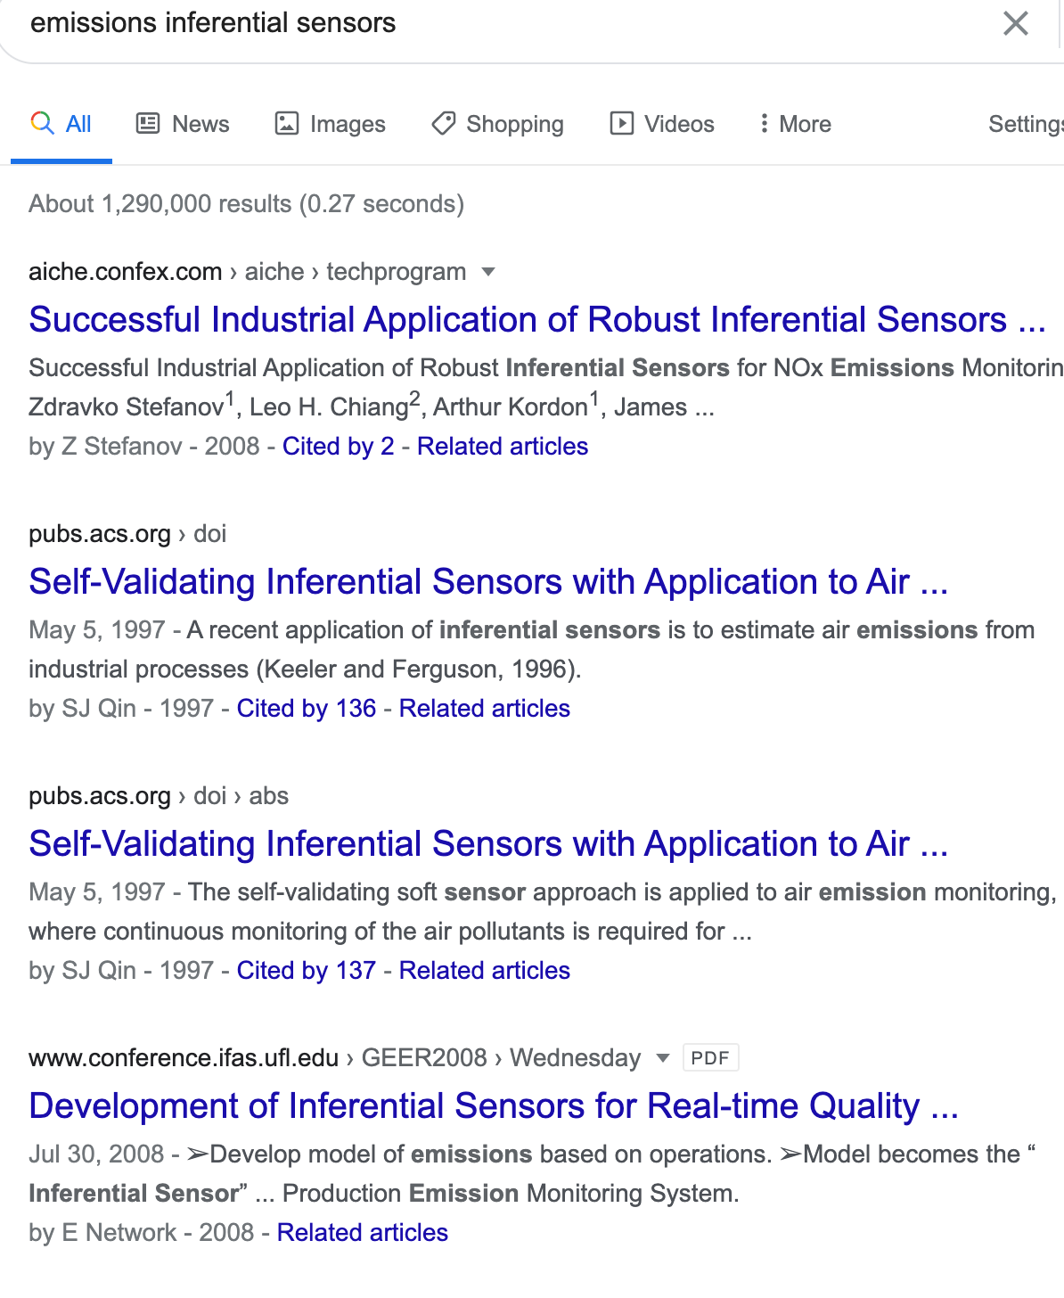
Final steps for selecting real-world problems appropriate for AI
Complex nonlinear relationships between the rate and emissions are expected

Slide 19
Lecture 19 agenda

Slide 20
Project Definition Example
Define project objectives/manage expectations
Define stakeholders/roles
Check for alternative options
Document current performance/issues
Objectives (example):
To develop, deploy, and maintain an inferential
sensor for emissions estimation that passes the
annual regulatory test with an average modeling
error < 15% and contributes to 2% annual increase of
reactor operating rate while reducing the
annual non-compliance cases by 30%
Scope (example):
A specific chemical reactor
Specified ranges of process variation, approved by
management
Deployed model to be compatible with existing
control system

Slide 21
Lecture 19 agenda

Slide 22
Lecture 19 “Selecting and defining real-world problems appropriate for AI” Summary
Differentiating the solution from the problem space is of critical importance
The key problems in manufacturing include enhanced process monitoring, predictive maintenance, automating operating discipline, and smart energy cost reduction
The key problems in business include customer churn, targeting customers, business forecasting, and improved healthcare
Each proposed real-world problem needs to pass an explicit check about the need for AI
The key steps for problem selection include interviewing critical stakeholders, identifying and prioritizing business issues, evaluating potential implementation issues, and final recommendations about starting a project
The key steps for problem definition include defining project objectives and stakeholder roles and clarifying the scope.
The Bottom Line
Selecting and specifying significant real-world problems appropriate for AI is the most essential and DIFFICULT first step towards solving the problem

Slide 23
Lecture 19 agenda

Slide 24
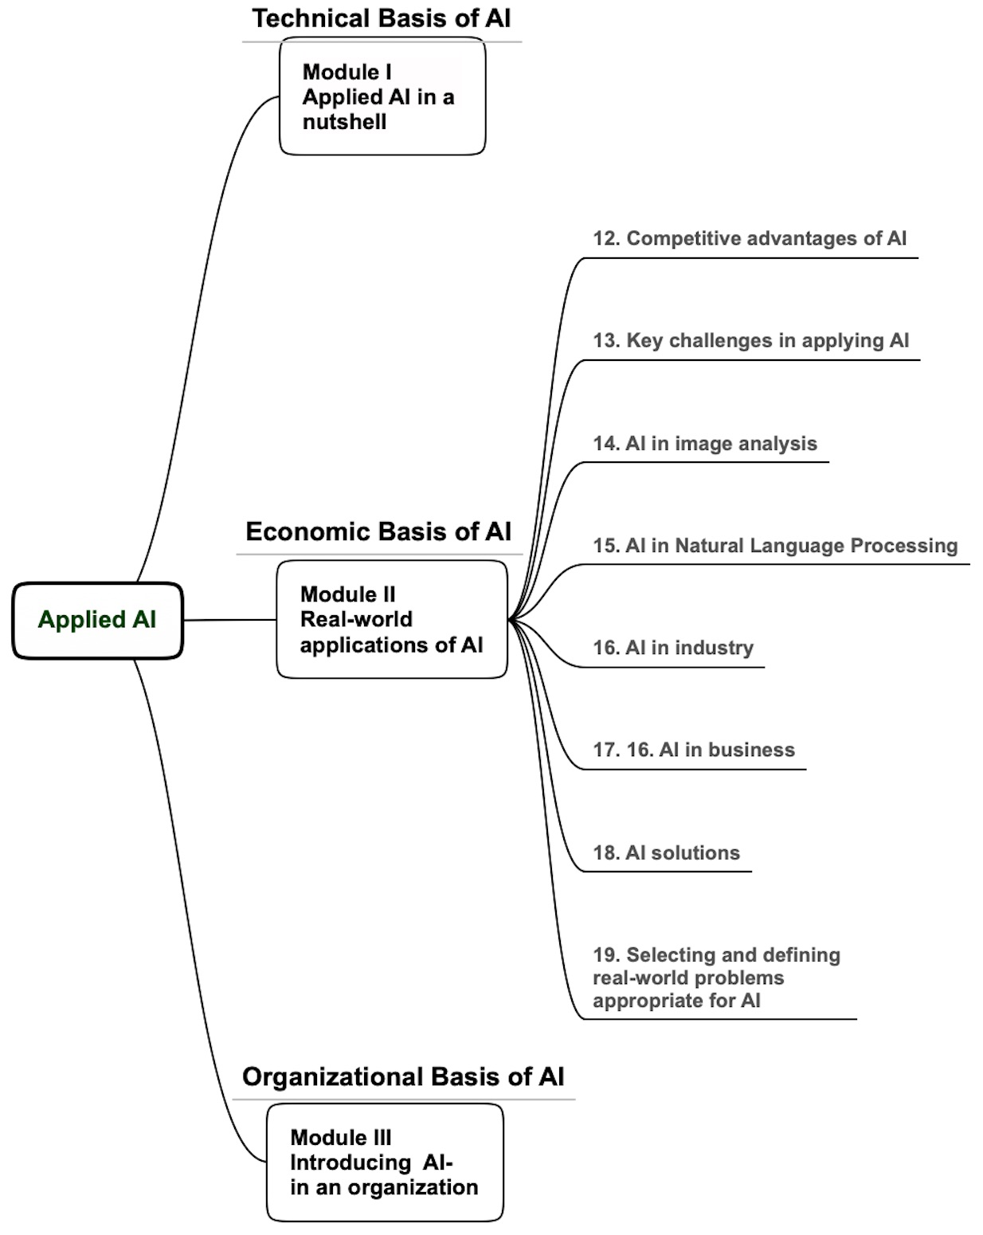
What we have covered
Objective 2
Describe the applicability of AI in different areas

Slide 25
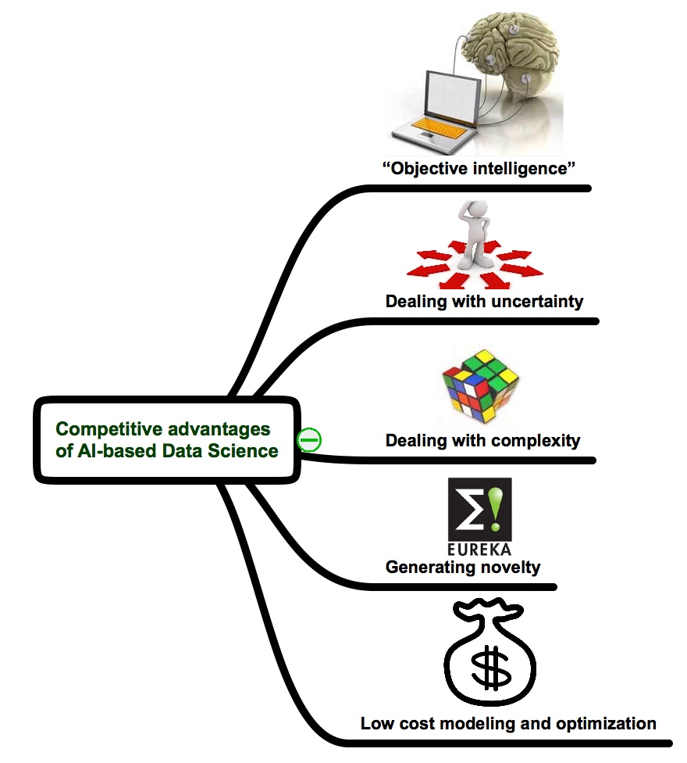
Key technical competitive advantages of AI
Technical competitive advantage
Technological superiority that cannot be reproduced by other technologies and can be translated with minimal efforts into a position of competitive advantage in the market place.

Slide 26
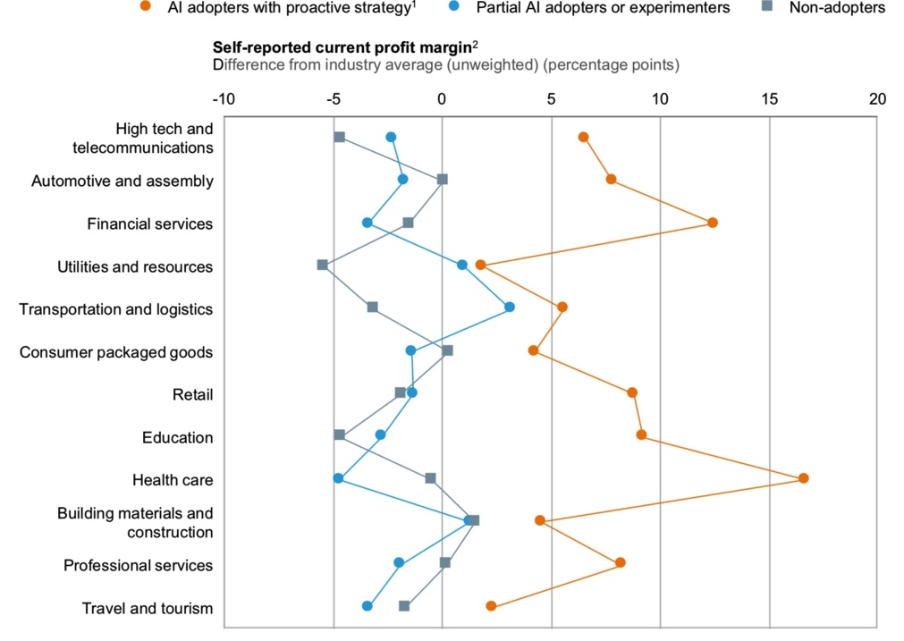
Business advantages of AI
Businesses using AI have a higher profit margin
McKinsey Global Institute, AI: The next Digital Frontier, 2017

Slide 27
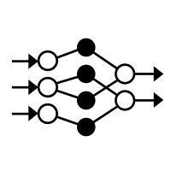
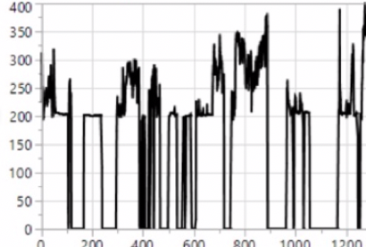


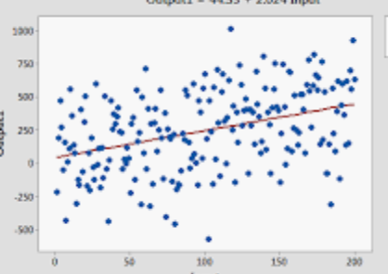

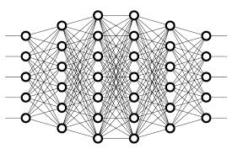




Example of applied AI challenges: wrong expectations issue – GIGO 2.0
  GIGO 1.0 – Garbage-In-Garbage-Out
  GIGO 2.0 – Garbage-In-Gold-Out
Stubborn illusion that low-quality data can be improved by sophisticated algorithms
Bad data
Best algorithms
Bad models

Slide 28

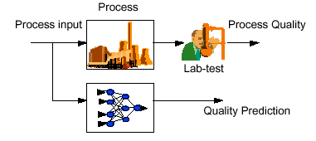

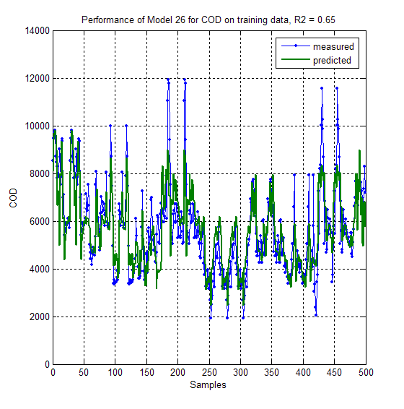

Example of AI industrial application: Emulator for optimization of an industrial chemical process
Four
levels DOE
Reactor
Model
20-25 min/
prediction
Symbolic
Regression
Emulator
5 ms/
prediction
Training
Data set
On-line process
optimization
10 inputs
12 outputs
Test
Data set
Very complex reactor model with slow execution time
Emulator is a simple nonlinear equation
$1.2 million/year
reduced cost
Inferential Sensors
> 9 MM EBIT
COD prediction at Harbor Beach WWTP
2004 - >40 days out of compliance
2005 - ~20 days out of compliance
2006 - 0 days out of compliance
y = f(x)
POPG Freeport - 10
2007
10
Harbor Beach - 2
EOEG Fort -2
Train4/5 BSL – 1
Acrylic Acid - 1
2006
6
2005
5
NOx emissions – 5
Plaquemine 2, LaPorte - 3
2004
4
Dow Biotech - 3
LHC7 -1
Emulators
Applied for PER/TET
Optimization at Plaquemine
Four levels DOE
10 inputs
1.2 MM
EBIT/year
Reactor
Model
20-25 min/
prediction
Symbolic
Regression
Emulator
5 ms/
prediction
Training
Data set
Suitable for online process optimization
Test
Data set
Unsuitable for online process optimization
12 outputs

Slide 29
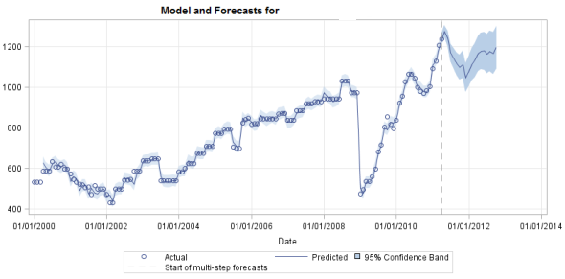
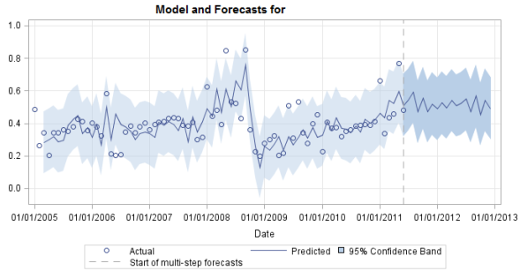
Example of AI industrial application: the best and worst models of a raw materials forecasting project
Best model
MAPE = 0.68
Hold-out MAPE = 1.01
MAPE is Mean Absolute
Percentage Error
Worst model
MAPE = 17.97
Hold-out MAPE = 17.62
Average cost of raw materials is ~ $5 billion/year
Average MAPE of 10% can save ~100 million/year

Slide 30
Problem & Solution space
Solution space
Translation
Problem space
Prediction
Raw materials forecasting
Forecasting
Classification
Reduce steam consumption
Cost
Clustering
Association
Reduce machine breakdown
Optimization
Simulation
Product quality estimate in real time
Recommendation
Profit
Price elasticity analysis
Root-cause discovery
Solution-specific language
Business-specific language
Translate problems and solutions in Plain English
Notes:
30

Slide 31
What next?
Find and solve real-world problems appropriate for AI

